Slide 1
Aerospace Technology Cluster
Company profile
and
innovation methodology
Brindisi, 24/06/2021

Slide 2
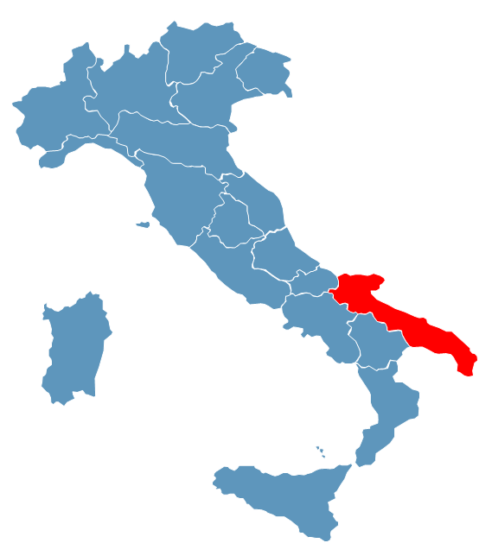
Aerospace and DTA in Puglia
Bari c/o Politecnico di Bari
Apulian aerospace system
90+ public and private organizations
1.5+BL€ turnover
7000+ employees
300+ researchs
450M+€: Export
Headquarter,
Brindisi, Cittadella della ricerca
Brindisi c/o AvioAero
Grottaglie (TA), c/o airport
Dati del Distretto Tecnologico Aerospaziale (2020)
3+M€ Revenues
30+ employees
1 head quarter, 3 local units
27 Members
Public research organization | 5
Private research organization | 2
Sme | 10
Large enterprise | 9
Totale | 26

Slide 3
Distretto Tecnologico Aerospaziale
Research and innovation
projects
Bridging the gap
between industry,
research and education
DTA s.c.a r.l. is a non-profit making consortium company joined by the main enterprises in the aerospace field, 3 universities of Puglia, 2 public and 2 private research centers of Puglia, 20 private companies.
Mission is to increase the competitiveness of its members and of the apulian/Italian/european aerospace value network by improving innovation capacity, developing new competences, developing research infrastructures, pushing internationalization of the regional system
Launching research and innovation projects
Looking for funding
Building partnerships
Leading and managing the projects
Assessing long term knowledge needs of industry
Supporting university in tailor education offer
Course contents
Graduation thesis support
PhD programmes
Consulting with public administrations
Engineering services
On innovation policy and international relationships
Continuous monitor of innovation capacity of Puglia aerospace system
Contribution in innovation strategy setting
Support Region Puglia in NEREUS membership
Support innovative propulsion system and energy management system deveopment

Slide 4
Honors course 2011 -2020
44 | R&D project
210+M€ | R&D project total budget
500+ | Researchers involved
72+ | Private companies involved in R&D projects
17 | High education projects
166 | Educated persons (post diploma or post graduation
52 | Courses for companies’ employees
16.500 | Hours of life long training programmes
436 | Employees involved into life long training programmes
264 | Stages (high percentual of employeement)
10 | Industrial development feasibility studies
3 | Phds
52+ | International mission and projects for cooperation
4 | Industrial development projects
344 | New employees related with DTA projects
340+ | Schools involved in orientation projects
28000+ | Students involved in orientation projects
150+ | Publication related with DTA projects
75+ | Research assistant and PhD started with DTA projects
18 | National and international cooperation agreement
Projects co-funded by:
Ministry of University and Scientific Research
ESA
Ministry for Economic Development
EUSPA
H2020
SESAR
Regione Puglia

Slide 5
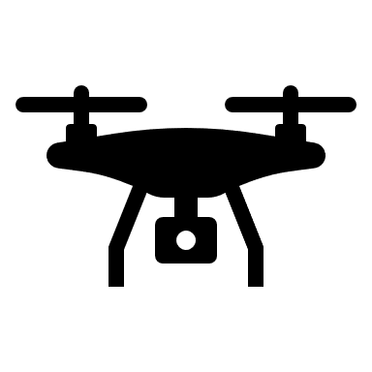
Competence (DTA and shareholders)
Materials
Composite & metal parts / Additive Material characterization, innovative architectural design and manufacturing processes (additive manufacturing, out of autoclave), defect and repair management
Engine / Hybrid Energy Management system, MRO, additive manufacturing also applied to repair and to composite materials
Fleet management / product data management, maintenance process forecast, MRO process optimization
UAS / Advanced ATM, cybersecurity, applications and mission management – Emergency management, precision farming – aerial (platform and PL) data management, innovative service provision
Cybersecurity / RPAS, automotive, TELCOM, SATCOM, SATNAV
Aerial services / flight procedures, air traffic management (UTM), payload and data management, data fusion, data (image) processing, service design, UAM
Space / space propulsion system for LEO, microsatellite frame and electronic components, on board/ground data management, EO data processing, EO services
Space
Consolidated
In development
Available and in further development

Slide 6
Research and Innovation domains
Aeronautic manufaturing technologies
Industry4.0 technologies
Advanced materials
UAS
Aerial platform development
CyberSecurity
ATM/ATC
UTM
UAS services
Space services
Precision farming
Emergency management
Urban aerial observation
Urban Airmobility
EO services for territory monitoring and precision farming services,
Microsatellite and LEO propulsion system
Satellite platform and avionic modules
Propulsion system (Hall effect)
Innnovative EO services
additive manufacturing
simulation, horizontal/vertical integration
Big Data analytics
GNSS and SATCOM for UAS
FLET4.0, SIADD, SMEA
CLOSE
RPASinAir, CRUISE, ECARO, ReDOX, ACROSS, UAS/RPAS, CORUS-XUAM
RPASinAir, ReDOX, SAPERE, TEBAKA, ASSURED-UAM, CORUS-XUAM, SkEye
RPASinAir, CRUISE, ECARO, SAPERE, Space2Waves, SkEye, UAS/RPAS, 4S_User-Study

Slide 7
Grottaglie Airport Test Bed
Mission
Grottaglie Airport Test Bed (GATB) is a Research Infrastructure in the technology domain of UAS. It is intended to support regional, national and european public and private organizations in creating new knowledge, competence and capacity in technologies, systems and applications of UAS.
Sistems and applications
UAS
Urban Air
Mobility
Earth observation
Monitoring services
ATM/U-Space
UAS regulations and impacts
Spaceport
Tecnologies
SatCom & Telecom
Payloads
Vehicle automation
Airframe and propulsion
Cyber Security
Data
Analytics & AI
AR/VR
HMI
GATB will provide experimentation services aimed at boosting UAS innovation development
Initial focus
Long term focus

Slide 8
GATB Architecture
Satellite Segment
Jammers
Sat Nav
Sat EO
Sat Com
Meteo Sat
Ground sensors
Sensori O/I
Mobile Control Room
UAS e piattaforme aeree
Sensori Radar
Sistemi sorveglianza
Sistemi Telcom
EMC M/S
Manned Chase
Altri sensori
Datalink
Telemetria
Partners Facilities
Partners’ facilties
Grottaglie
Database Esterni
Telcom
System
A/D
System
Control Room fisse
GBAS
EMC C/S
Meteo
Data Centers
Telemetry
GW
Data link
University Laboratories
UNISA
External laboratories
UNIBA
Ground Station
Simulation facility
Laboratori
POLIBA
Componenti esterni
Componenti interni
Fuori dal perimetro del GATB

Slide 9
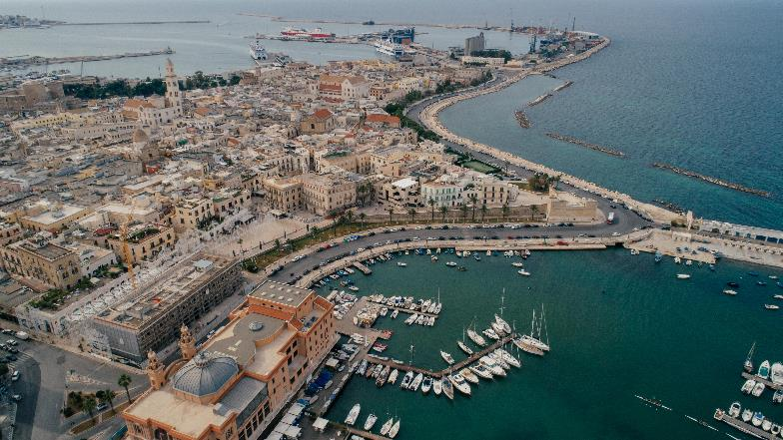
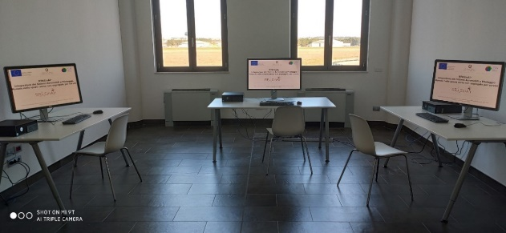
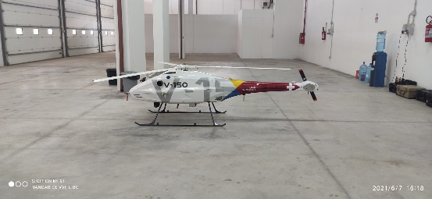
Grottaglie Airport Test Bed
Infrastructure
Public and private organizations
Institutions
UAS, U-Space, ATM, Mobility and Aerial services
People

Slide 10
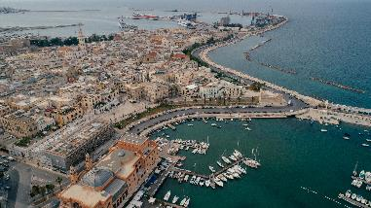
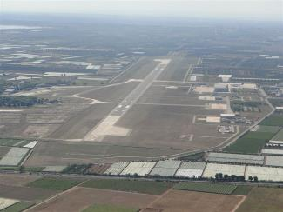
UAS and UAM on going projects
RPASinAir
CRUISE
ECARO
CORUS-XUAM
REDOX
RPAS insertion into ATM, SATCOM, flight tests
Cyber vulnerability assessment service, needs and requirements
RPAS navigation capacity for GNSS-based approach procedure
ATM/U-Space handshake for UAM flight operations
U-Space service for wide range of precision farming operations
We are here
2018
2019
2020
2021
SAPERE
TEBAKA
SMEA
Formazione
ASSURED-UAM
Bari Open Innovation Hub
U-Space services for safe drone operations into urban areas
Plantation monitoring through UAS operation (and other remote sensors)
Plantation monitoring through UAS operation (and other remote sensors)
Supporting cities with UAM knowledge framework, recommendations for acceptability, safety and sustainability
Flight trials supporting UAM innovative services and application

Slide 11
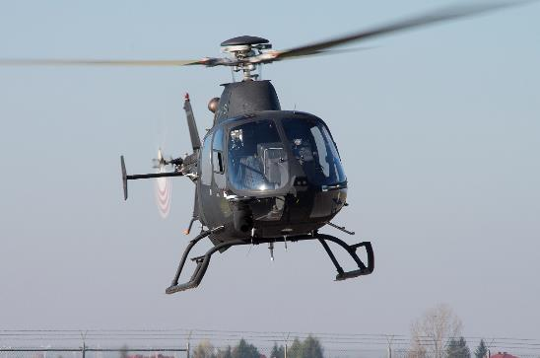
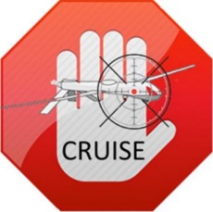
Air vehicle configuration
Projects
RPASinAir - Integration of RPAS in non-segregated airspace for service
ECARO – Egnos Civil Aviation Roadmap
CRUISE - Cyber secuRity in Uas mIssions by SatellitE link
Technology scopes
BVLOS operations, SATCOM and BRLOS operations
BRLOS operation design and impact on ATM
Cybersecurity of SATCOM
Simulation laboratory
Emergency management operation
Payload and data management and analysis process
GNSS
GNSS based navigation (capacity and autonomous navigation)
LBS services

Slide 12
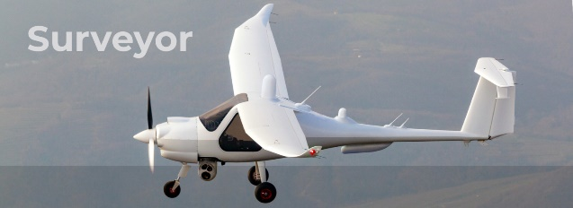
ATM/U-Space
Projects
RPASinAir - Integration of RPAS in non-segregated airspace for service
REDOX - Remote Early Detection of Xylella
CORUS-XUAM - CONCEPT OF OPERATIONS FOR EUROPEAN U-SPACE SERVICES - EXTENSION FOR URBAN AIR MOBILITY
ASSURED-UAM - Acceptance, Safety and Sustainability Recommendations for Efficient Deployment of UAM
Technology scopes
BVLOS operations, SATCOM and BRLOS operations
BRLOS operation design and impact on ATM
Simulation laboratory
GNSS
GNSS based navigation (capacity and autonomous navigation)
LBS services
Integration of ATM and U-Space
U-Space service to speed up drone commercial operations
REDOX

Slide 13
Autonomy of vehicle
Projects
RPASinAir - Integration of RPAS in non-segregated airspace for service
ECARO – Egnos Civil Aviation Roadmap
Technology scopes
BVLOS operations, SATCOM and BRLOS operations
BRLOS operation design and impact on ATM
Simulation laboratory
Payload and data management and analysis process
GNSS
GNSS based navigation (capacity and autonomous navigation)
LBS services
Satellite-based navigation procedures

Slide 14
Security
Projects
CRUISE - Cyber secuRity in Uas mIssions by SatellitE link
Technology scopes
Evaluation of cyber-attacks vulnerability and asses risks on UAS performance in Visual/Radio/Beyond Radio Line of Sight (VLOS/RLOS/BRLOS) mission operation conditions
Test objectives:
Quality, consistency and authenticity of the data detected during the monitoring or surveying mission critical scenarios
Cyber vulnerability assessment of aerial platforms;
Cyber vulnerability assessment of payload sensors;

Slide 15
Flight tests campaigns - Plan
 |  | Jan | Feb | Mar | Apr | May | Jun | Jul | Aug | Sept | Oct | Nov | Dec | Jan | Feb | Mar | Apr | May | Jun | Jul | Aug | Sept | Oct | Nov | Dec | Jan | Feb | Mar | Apr | May | Jun | Jul | Aug | Sept | Oct | Nov | Dec | Jan | Feb | Mar | Apr | May | Jun | Jul | Aug | Sept | Oct | Nov | Dec
 |  | 2021 |  |  |  |  |  |  |  |  |  |  |  | 2022 |  |  |  |  |  |  |  |  |  |  |  | 2023 |  |  |  |  |  |  |  |  |  |  |  | 2024
Grottaglie airport | RPASinAir
 | ASI/RPAS
 | CRUISE
 | ECARO
 | CORUS-XUAM
Rural areas | TEBAKA
 | REDOX
Bari | SAPERE
 | Casa Delle Tecnologie
G.Airport & Bari | AURORA
 |  | gen-21 | feb-21 | mar-21 | apr-21 | mag-21 | giu-21 | lug-21 | ago-21 | set-21 | ott-21 | nov-21 | dic-21 | gen-22 | feb-22 | mar-22 | apr-22 | mag-22 | giu-22 | lug-22 | ago-22 | set-22 | ott-22 | nov-22 | dic-22 | gen-23 | feb-23 | mar-23 | apr-23 | mag-23 | giu-23 | lug-23 | ago-23 | set-23 | ott-23 | nov-23 | dic-23 | gen-24 | feb-24 | mar-24 | apr-24 | mag-24 | giu-24 | lug-24 | ago-24 | set-24 | ott-24 | nov-24 | dic-24

Slide 16
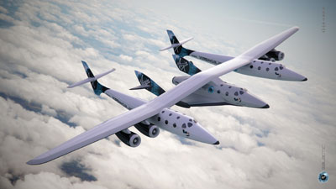
Grottaglie SPACEPORT
The Italian Government has intended to promote asustainable development of suborbital commercial flight and autonomous access to space, given that “space and airspace are two sectors considered to be fundamental and strategic in the interest of the Country”
On 21 October 2020 ENAC published the regulation on the construction and operation of spaceports (Regulation) which is the first piece of legislation on this type of infrastructure and is aimed at setting forth the features and requirements for the establishment of the first Italian spaceport.
PROJECTS
On Going: SAMMBA (H2020): develop an EU technological framework and building the value chain to develop space traffic management

Slide 17
Grottaglie SPACEPORT
The Italian Space Agency, in order to investigate the scenario of possible economic operators in possession of technical skills appropriate to the specificity of the activities related to the "feasibility study for a suborbital flight initiative in Italy through Virgin Galactic's CONOPS", has launched in October 2020 a survey aimed at acquiring the knowledge and availability of subjects making up the market for services and activities in question.

Slide 18
Nereus Association
Political Dialogue
Interregional Co-operation & Partnership and
Technological Trends and Developments relevant for future Space Solutions and User Needs.

Slide 19
Our network
Sono proseguite le collaborazioni con Enti, Istituzioni e Aziende e con cluster nazionali e reti internazionali e ne sono state attivate nuove a livello, regionale, nazionale e internazionale.

Slide 20
For more information
Giuseppe.acierno@dtascarl.it
Antonio.zilli@dtascarl.it
Silvano.capuzzo@dtascarl.it
Manuela.matarrese@dtascarl.it

