Slide 1
UNIVERSEH
The UNIVERSEH Alliance in a nutshell

Slide 2
UNIVERSEH: An ambitious project
Main concept
Creation of a European University focusing on the space sector, tackling
social, societal and environmental challenges.
A key pillar of innovation, entrepreneurship and collaboration in the EU.
European Space University for Earth and Humanity
UNIVERSEH & Beyond UNIVERSEH
Notes:
UNIVERSEH is an alliance of five young and mature universities from five European countries. It was established in November 2020 to develop a new way of collaboration in the field of Space, within the new “European Universities” initiative promoted by the European Commission.
Beyond UNIVERSEH is a SWAFS (Science With and For Society, Horizon 2020 programme) project involving the five partners of the UNIVERSEH Alliance and aims to create a common research strategy for this European university.

Slide 3
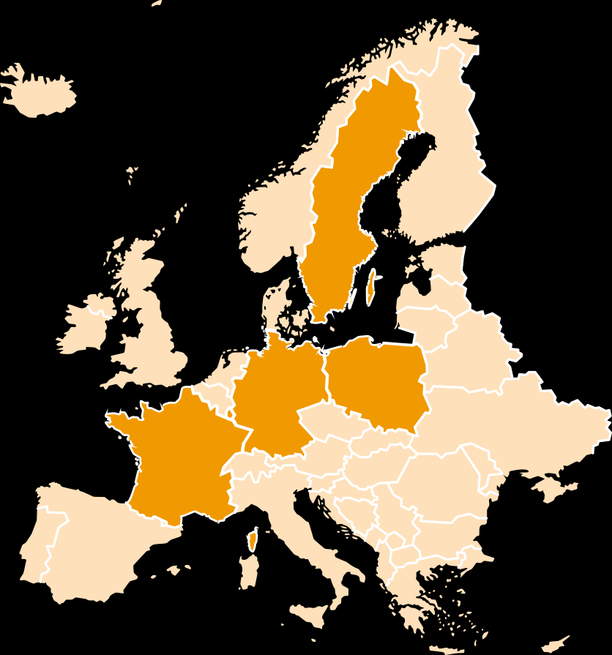
A pan-European alliance…
Five partners
Notes:
Special strengths that each partner brings to the Alliance:
Toulouse: strong grounding in aeronautics and space-related fields (Supaero) - Toulouse is the home base of Europe’s leading space companies, Airbus
Uni.lu: research and teaching programmes related to space (Space Master programme, Space Law, SnT has a multitude of applied research projects related to space) - Luxbg is the home base of one of the world’s largest satellite operators
HHU: a comprehensive university involved in Development of integrative multilingualism concepts
Luleå University of Technology with strong grounding in space research and education, close links to Esrange space centre in Kiruna.
AGH Krakow: historically grounded in metallurgy, mining, and has strong pillars of activity that are space-related.

Slide 4
Vision & Objectives
An open and comprehensive university
First and unique comprehensive ‘European University’ on the space sector worldwide
Comprehensive approach of today’s and tomorrow’s challenges
Multi & interdisciplinary courses & programmes
Future jobs and market needs for students and professionals
European Values, inclusive education, multilingualism and mobility for students and staff
Innovative approaches for Teaching & Research
Innovation and entrepreneurship among students and staff
Break the barriers between academics and other societal actors
Contribute to awareness of the Space and New Space
European Union as a global leader in the Space sector
Notes:
What ever is your social background

Slide 5
A comprehensive University
Six disciplines
Science & Engineering
Economy, Business & Finance
Medicine & Health
Human & Social Sciences
Art & Cultural Studies
Innovation & Entrepreneurship
Notes:
What ever is your social background

Slide 6
Focus areas
Four sections
Space Exploration & Deep Space
Space Settlement & Resources
Space Sustainability
Climate Change
Geo Data & AI
Observation
Geopolitics
Space for Earth and Society
Cultural Studies
Space Law
Navigation & Mobility
Telemedicine
Robotics @ AI
Satellite constellations
Agriculture

Slide 7
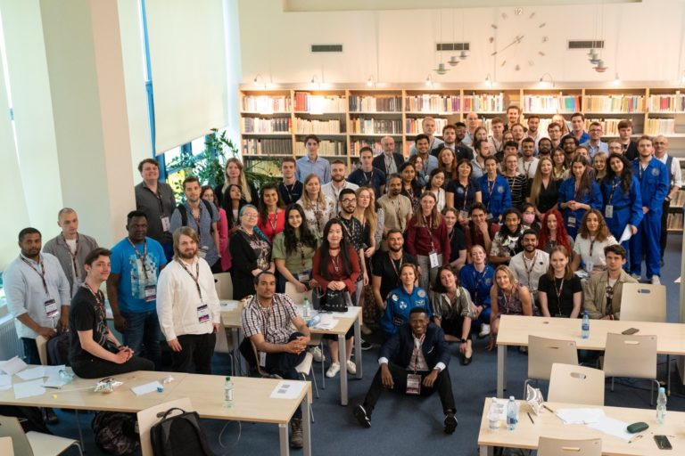
The University for Earth, Space and Humanity
Main academic achievements
Innovative pedagogical models:
16 new courses: validated by academic council
Common & open Learning Management System (Moodle)
Stakeholders’ survey: skills & competences
Mobility
Multilateral Inter-Institutional Agreement (MIIA)
Mobility platform (MOPLAT) for student and staff
Summer School on Space resources, 50 students in Krakow
Equity, Diversity & Inclusion
Student conferences on Space, Toulouse (France) and Krakow (Poland)

Slide 8
Strengthening the UNIVERSEH community
Main community achievements
The UNIVERSEH Alliance
A multidisciplinary, engaged Student Community
Over 10 conferences and events organised by and for students
50+ students are part of Governance bodies and implementation of both projects
Building bridges with the European Space ecosystem
Network: 70+ stakeholders
Entrepreneurship and innovation
New courses design launched
Startech programme 2021 (F) & 2022 (S): Earth observation data-driven apps
SpaceHack2021 & 2023 (L): “Design the Future Lunar Settlement Foundations”
Creation of the Advisory Board
Notes:
What we do to approach the other space sectors:
Network of 70+ stakeholders in working groups
Surveys, events, workshops, etc.

Slide 9
External partners
Space agencies
Space industries
Service providers
Research institutions
Representative bodies

Slide 10
Future challenges
Building together the next phase of UNIVERSEH
UNIVERSEH 2.0
2050 vision and a 2035 roadmap for UNIVERSEH community
Close work with our stakeholders and the society, and with public authorities
a Systemic, structured and sustainable project
‘One classroom’ & ‘One lab’ concepts
New programmes that meet the European needs of today's and tomorrow's market and society
Entrepreneurship & innovation among students and academic staff
Emphasis on social and human sciences and arts in the space sector
New pedagogical models
Community Enlargement: new partners and stakeholders
“Space for all”
….
Notes:
What is expected to Nereus members:
Contact us if they want to be a part of UNIVERSEH as stakeholders
Engage with the community of European Universities
Create reciprocal channels of communication with society

