Slide 1

Sea Innovation Cluster
‘World class track’
Rear Admiral (R) Frédéric Renaudeau
Defence, Deep Sea, Skills&Training Adviser at Pôle Mer Bretagne Atlantique
President at CELADON
Senior Defense adviser at ALCATEL LUCENT ENTERPRISE

Slide 2
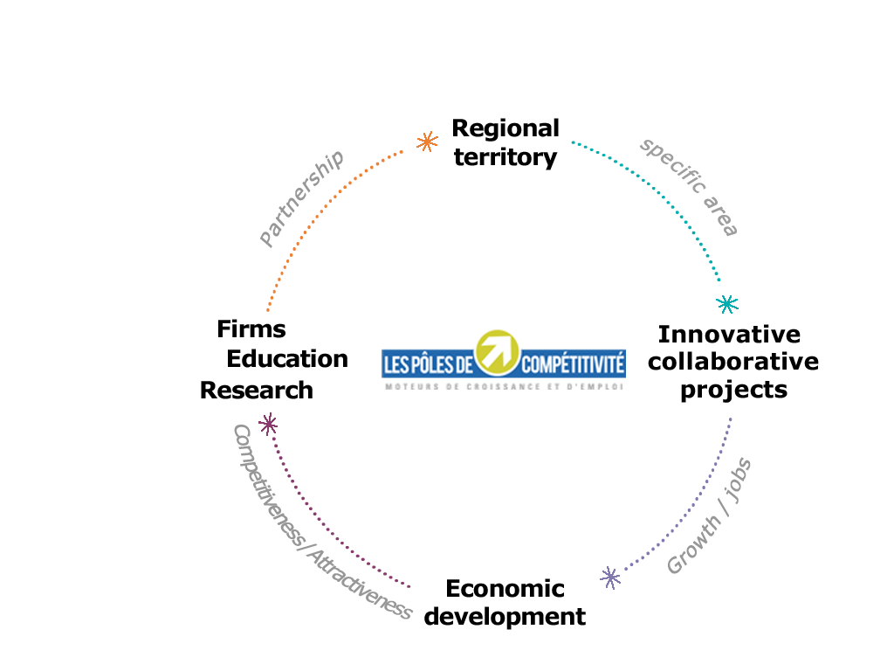
What is a competitiveness cluster?

Slide 3
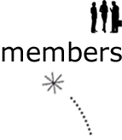

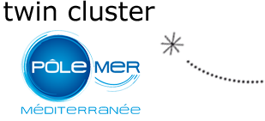


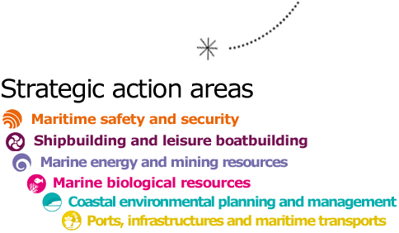
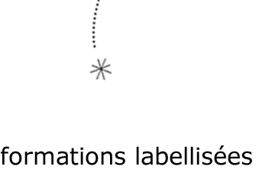
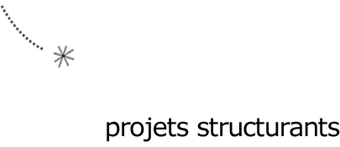
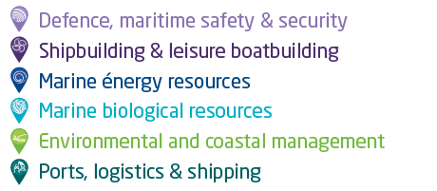
PMBA in figures
436
2
Bretagne
Pays de la Loire
1
480
6
1,148 Mds€ RTD investment
344 M€ public funds
11
42
Structuring programs
Certified training
programs
Update : May 2022

Slide 4

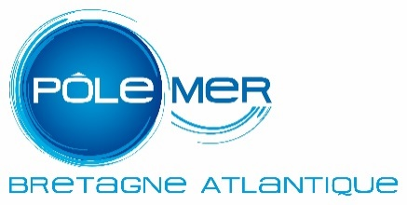

Pôles Mer Bretagne Atlantique and
Mer Méditerranée → Governance scheme
STAKEHOLDERS
Parity – Subsidiarity - Synergy
Board of directors
Engineering and Coordinating Team
Steering committee
Engineering and Coordinating Team
Interregional coordination and steering Committee

Slide 5

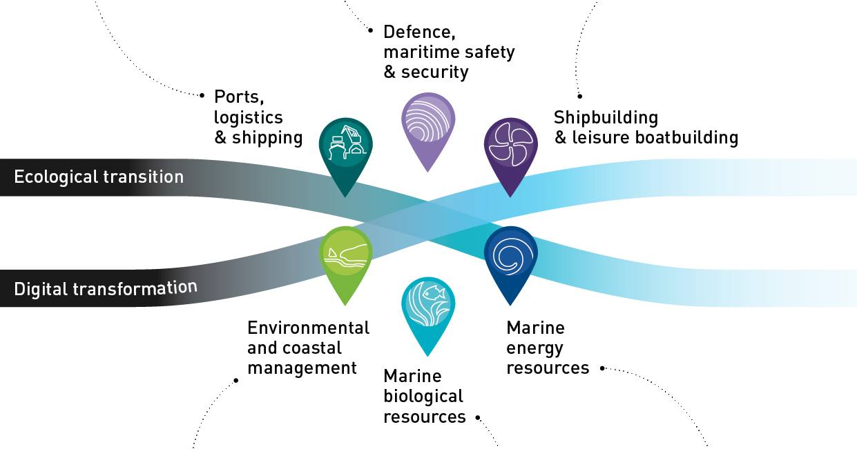
Share with
Pôle Mer Méditerranée
Scope

Slide 6

MARITIME AND SPACE APPLICATIONS
Secure accurate positionning related to risk of spoofing and jamming, within a context of e-navigation and autonomus navigation
Secure and reliable communications
Observation and monitoring
Cybersecurity of autonomous data and fleet centers.

Slide 7
EUROPEAN DEFENCE FUND
Very interesting opportunities for SME despite heavy burden of work : rate of subventions, high visibility, partnerships…
2 ways :
  Thematic call (partnership with large enterprise) related to SPACE
  Open Call dedicated to SME
High support by Ministry of French Armed Forces (DGA)
  Matching meeting with large enterprises ;
  Support of SME (selection of pre-projects, subvention of adviser…)
  Process starting at the beginning of the year

Slide 8
CHALLENGES AND EXPECTATIONS
Organization of european consortium, by
  developping mutual knowledges of potential partnerships between
  Organizing matching meeting
Avoiding competition and promoting synergy on common technological challenges
By Networking and Coworking between regional clusters

Slide 9
IDEAS FOR RELEVANT DEFENCE INITIATIVES
Way of improvement in maritime monitoring and survey due to
  Growing illegal activities (smuggling, drug, migrants, …)
  Growing need for european sovereignty
High intensity naval warfare will need better sharing of information at sea.

