Slide 1
EDUCATION AND TRAINING IN THE SPACE SECTOR: NEW TRENDS, PARTNERSHIPS, AND OPPORTUNITIES
– NEREUS – Presentation:
Network of European Regions
Using Space Technologies
Margarita Chrysaki, Communication/Project officer

Slide 2
Practical Instructions for the teleconference:
Please note the meeting is recorded for follow-up purposes
In order to ensure a good acoustic, please mute yourself, otherwise the moderator will mute you
You may at any time comment or ask questions at any time, please write a message addressed to everyone in the chat which we monitor continuously

Slide 3
OUR
MISSION
SPREAD THE USE AND UNDERSTANDING OF SPACE TECHNOLOGIES
USING SPACE ON EARTH
for the benefits of citizens and territories
Advocate matters of regional space uses
STIMULATE THE DEVELOPMENT OF SPACE APPLICATIONS

Slide 4
NEREUS pillars of action
ADVOCACY/POLITICAL
DIALOGUE
INTERREGIONAL
COLLABORATIONS and PARTNERSHIPS
TECHNOLOGICAL TRENDS/
PUBLIC
OUTREACH

Slide 5
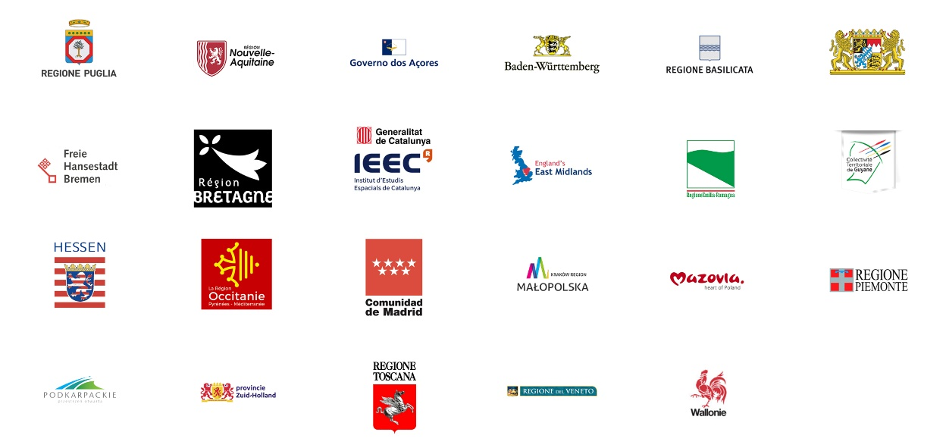
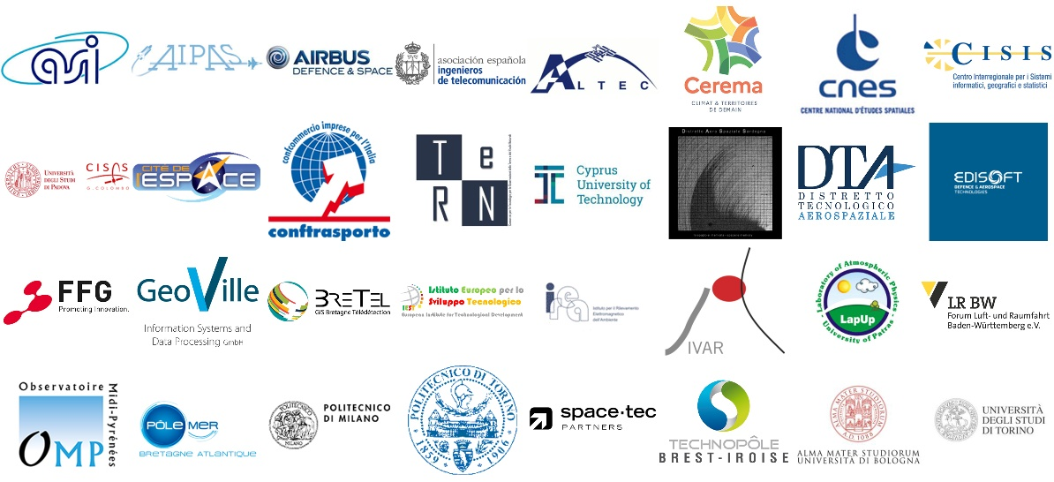
MEMBER REGIONS (Full members)
NEREUS members
Associate Members

Slide 6
Within our Network (non-members)
Within our Network (members)
Centro Interdipartimentale Studi e Attività Spaziali, CISAS, Cyprus University of Technology, University of Patras, Politecnico di Milano, Politecnico di Torino, University of Bologna, University di Torino, Instituto de Investigacao em Vulcanologia e Avaliaçao de Riscos, Institute for Electromagnetic Sensing of the Environment, IREA CNR UOS, Milan, IEST (Istituto Europeo per lo Sviluppo Tecnologico- European Institute for Technological Development), Centre d’Etudes et d’Expertise sur les Risques, l’Environnement, la Mobilité et l’Aménagement
Fondazione politecnico di Milano, Lab#ID (dept. of LIUC University),UCSC, Ulg - University of Liège, UniFI - Università degli Studi di Firenze, Unimi, Università Cattolica del Sacro Cuore, Università degli Studi di Milano, Università degli Studi di Milano-Dipartimento di Bioscienze, University of Brescia, University of Milan,University of Milan, Department of Biosciences, University of Pisa, University of Basilicata (UNIBAS), University of Chieti "Gabriele D'Annunzio",University of Bari, University of Stuttgard, UNIVERSITY OF AZORES, University of Leicester, University of Toulouse, University of Padua, CRAST- Centro Ricerca Analisi geoSpaziale e TelerilevamentoUniversità Cattolica del Sacro Cuore
Our vivid research/academia community!
Outside our Network
Aix Marseille University, Aristotle University of Thessaloniki, Budapest University of Technology and Economics , HUNAGI - Hungarian Association for Geoinformation, ESPI - European Space Policy Institute, National Center for Scientific Research "Demokritos"/ Institute of Informatics and Telecommunications, Szent István University, Université catholique de Louvain – CTMA, Goethe-Institut Brüssel, ULB – University, University of Bonn, University of Parma, KU Leuven (Belgium)...
MoUs and partnerships with university stakeholders: EUROAVIA (European Association of Aerospace Students), etc

Slide 7
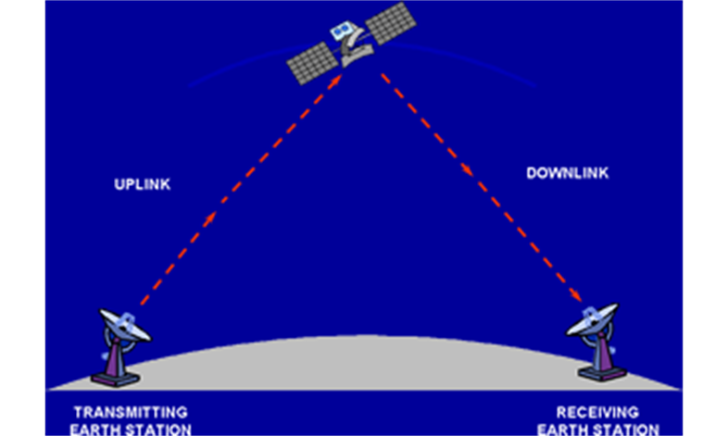
The use of Space

Slide 8
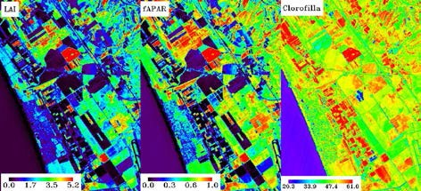
NEREUS is about Using Space
NEREUS is about
Using Space
Useful Information for people, companies and organisations
Data from satellite imagery

Slide 9
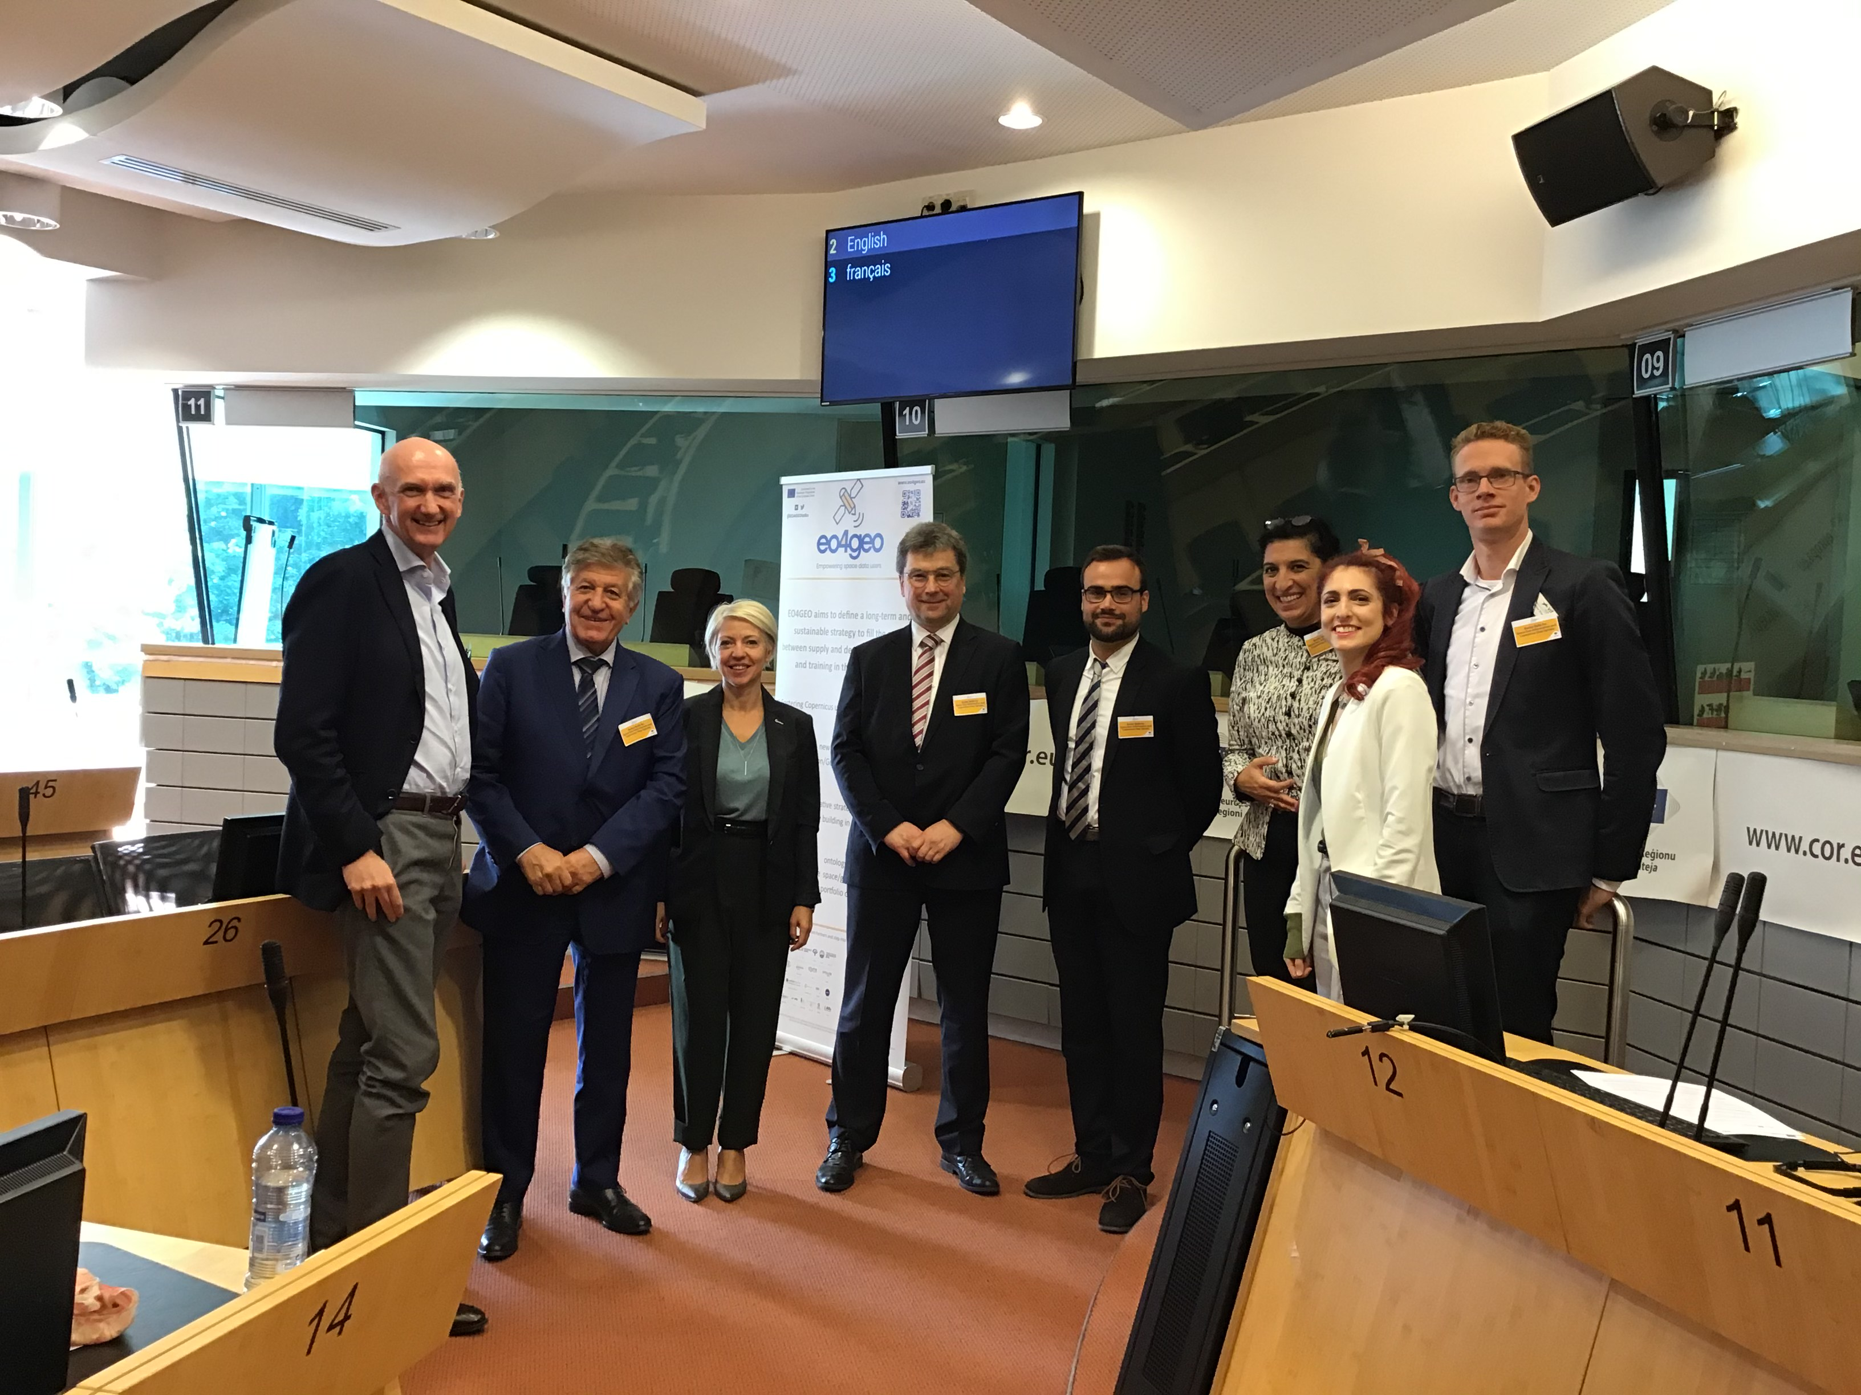
Bridging the skills gap in the Earth Observation sector
Reinforcing the existing training and education ecosystem in the Earth Observation sector
Fostering the uptake of space/geospatial data and services in end-user applications
Education/training
project
www.eo4geo.eu

Slide 10
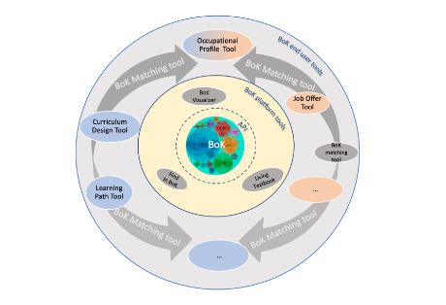
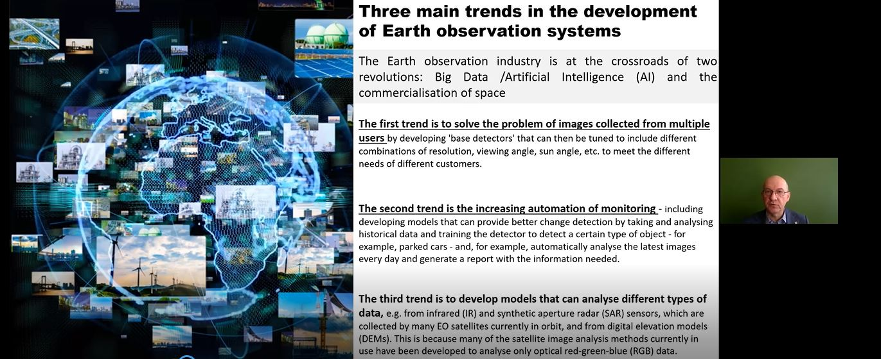
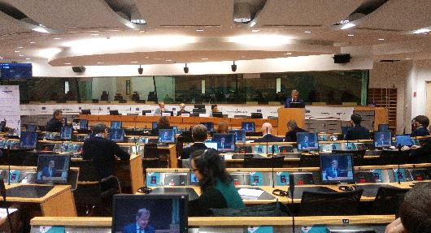
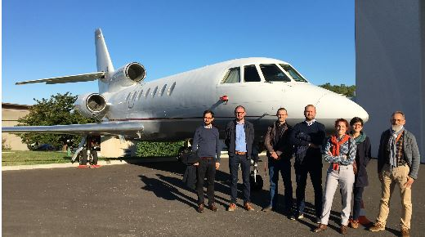
Regional roll-out
NEREUS regional workshops and online sessions with over 500 hundred participants!
Biggest EU Erasmus+ education/training
project
Brussels, Nouvelle Aquitaine, The Azores, Podkarpackie and Mazovia
www.eo4geo.eu

Slide 11
UNIVERSEH is an alliance of five young and mature universities from five European countries to develop a new way of collaboration in the field of Space, within the new “European Universities” initiative promoted by the European Commission
NEREUS is a member of the Advisory Board

Slide 12
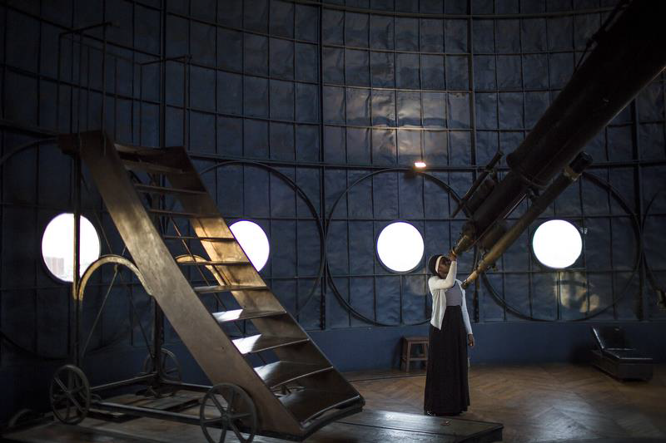
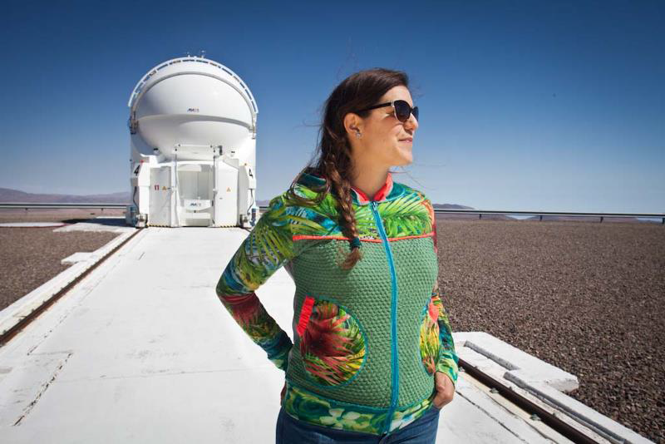
SPACE GIRLS/
SPACE WOMEN
Mobile Photo-exposition
(1)
40 photo portrays of girls and women of three different generations and different continents with their heads in the stars who choose space as a career, work or study option
Supported by Sipa-Press and ESA (NEREUS is together with CNES, Cité de l'Espace, Universpace and GSA sponsoring partner);
Following events in Brussels and Paris exhibition tours through NEREUS-regions

Slide 13
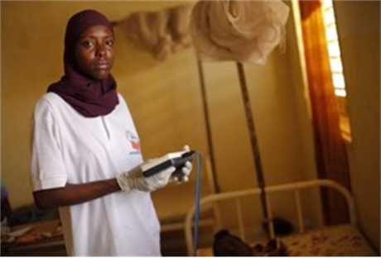
Bring SPACE4OUR Planet to your region
New exhibition:
Space4OurPlanet
(1)
« SPACE4OurPlanet» - features portrays of
17 Women, men, boys and girls from
17 Countries explaining how space technologies contribute to the accomplishment of
17 Sustainable Development Goals (SDGs)
https://www.space4ourplanet.org/
Space sustainability
Launched on 28th September 2021 in Brussels/Belgium in front of the European Parliament

Slide 14
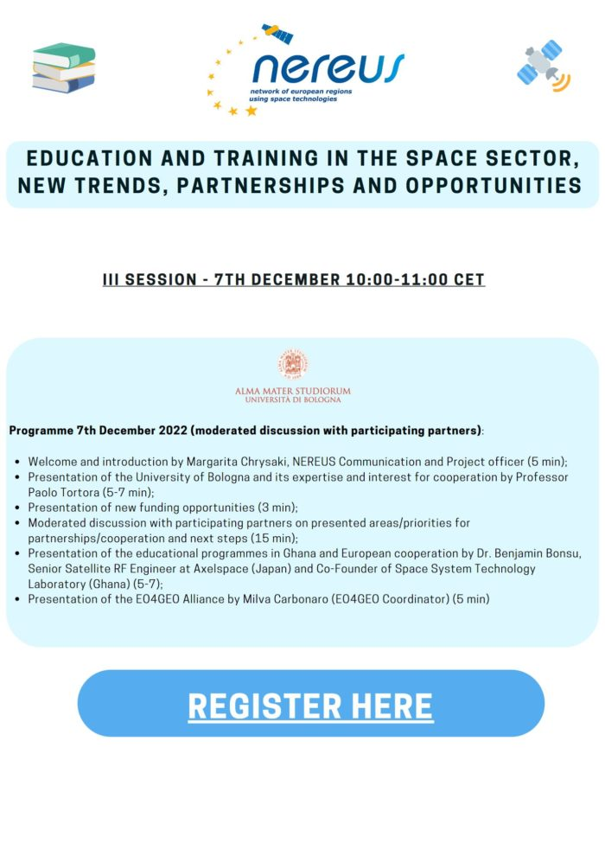
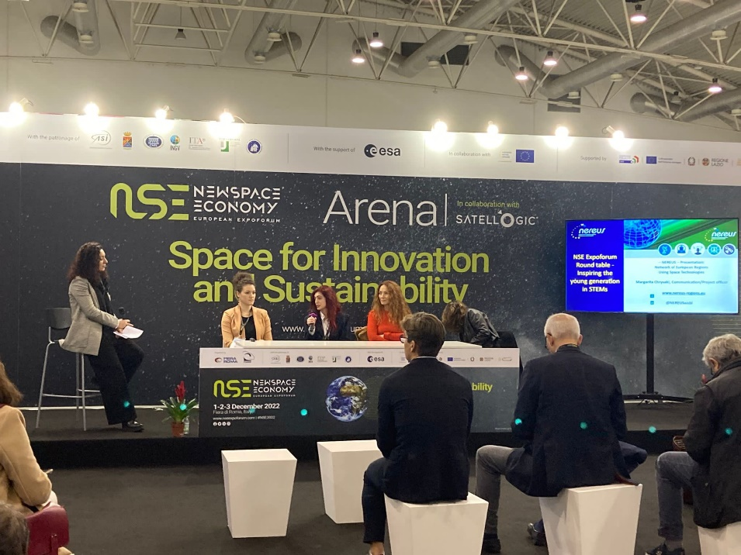
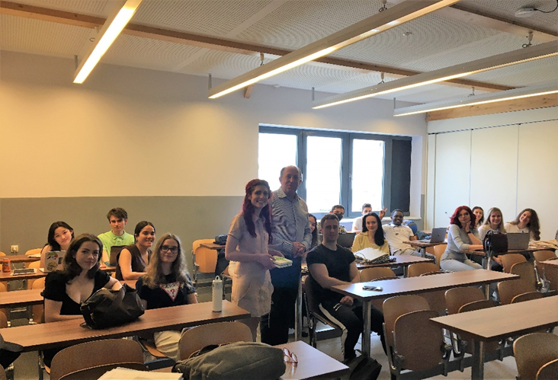
Newspace economy forum: Round table on Education and STEM, Rome, December 2022
Webinars on education in 2022
NEREUS activities on education/training in the space sector
Annual visits to universities

Slide 15
Marie Skłodowska-Curie Actions
MSCA COFUND 2022
Objective: The COFUND action provides funding for regional, national and international programmes for training and career development, through co-funding mechanisms. It spreads the MSCA’s best practices by promoting high standards and excellent working conditions.
2 types of COFUND:
Doctoral Programmes.
Postdoctoral Programmes.
Who can apply? A single legal entity in an EU Member State or a Horizon Europe Associated Country applies. Additional partners can be included in the project.
What does the funding cover? COFUND projects should last for up to five years and should recruit at least 3 researchers.
Call budget: A beneficiary can receive a maximum of €10 million per call.
Deadline: 9 February 2023
Link to the call

Slide 16
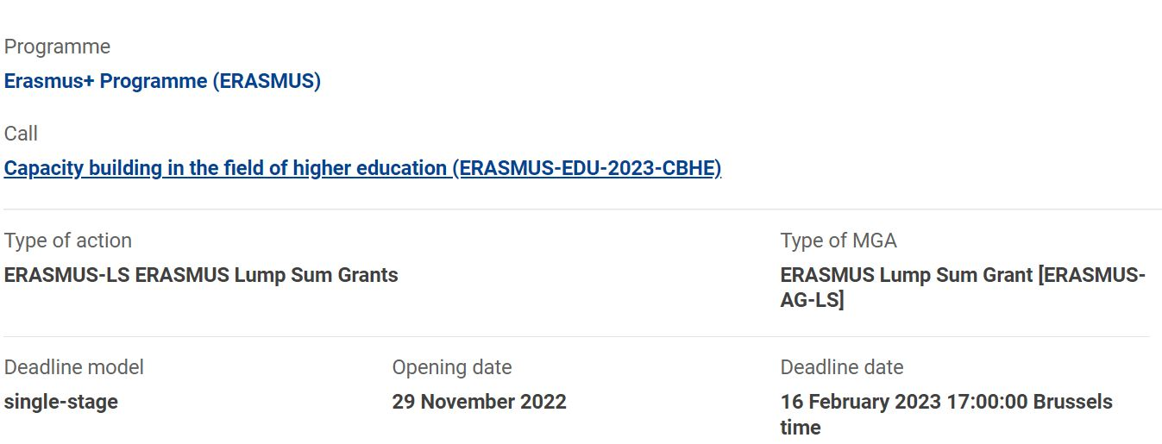
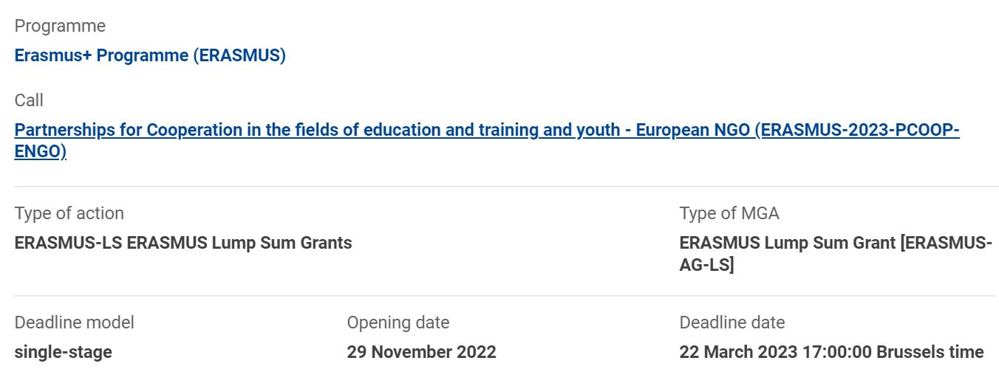
ERASMUS+

Slide 17
ESA Business Applications
Space-based Innovation and Digitalisation for the School of Tomorrow: Digital Learning for STEM Education
Scope: Use Satellite and digital technologies in education to engage students and communities, enable inclusiveness, increase efficiencies, and provide tools to support excellent teaching and raise student attainment.
Who can apply? Funded participation is open to any company and/or organization residing in ESA Member States.
How to apply? Two steps: 1) outline proposal 2) full proposal
Eligibility criteria:
Engage with at least two schools
Deploy and provide a solution which will support the digital transformation of the school for the benefits of the students and the teachers
Prove the benefit of including at least one space asset in the proposed solution
Funds: ESA will bear up to 50% of the acceptable cost (up to an estimated amount of max. 1,000,000 Euro).
Deadline: 15 January 2023
Link to the call

Slide 18
THANK YOU!
www.nereus-regions.eu
@NEREUSaisbl
NEREUSaisbl
Network of European Regions Using Space

