Slide 1
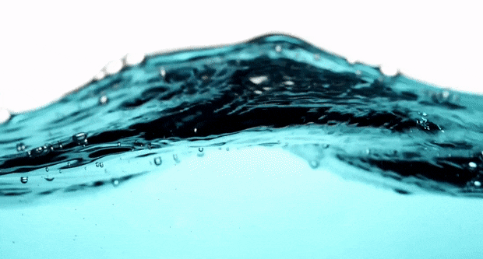
in collaboration with
Cosmic Rays Technology for Water Leaks Detection
www.CosmicWaterLeaks.Space

Slide 2
Neptune & Cosmic share distribution
Marchetto
Riccardo
Michelini
Giuseppe
50%
Cosmic Srl
50%
25%
37,5%
37,5%
Neptune Srl
Italy
Patent
Method and system to find leaks of pipes for the transport substances containing Hydrocarbons based on secondary cosmic radiation measurements
Patent
Method and system to search for water leaks through the analysis of images generated by remote sensing systems
Italy
Spain
France
EU extension (future)
Portugal
Patent
Method and system to search for water leaks on the basis of secondary cosmic radiation measurements
Italy
EU extension

Slide 3
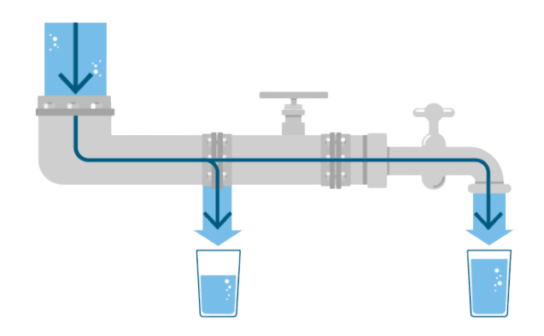
Water leaks – a global problem
The situation in Italy is certainly not good, but also in Europe and the World water leaks are over 30%.
8.3 billion cubic meters of drinking water injected into Italian distribution networks
Total leaks
41,4%
3,45
Billion of cubic meters
delivered to users
58,6%
The dispersed water would meet the annual needs of 40 million people.

Slide 4
Water leaks – standard solution
Current solution =
2 specialized operators, step by step, acoustically check the network.

Slide 5
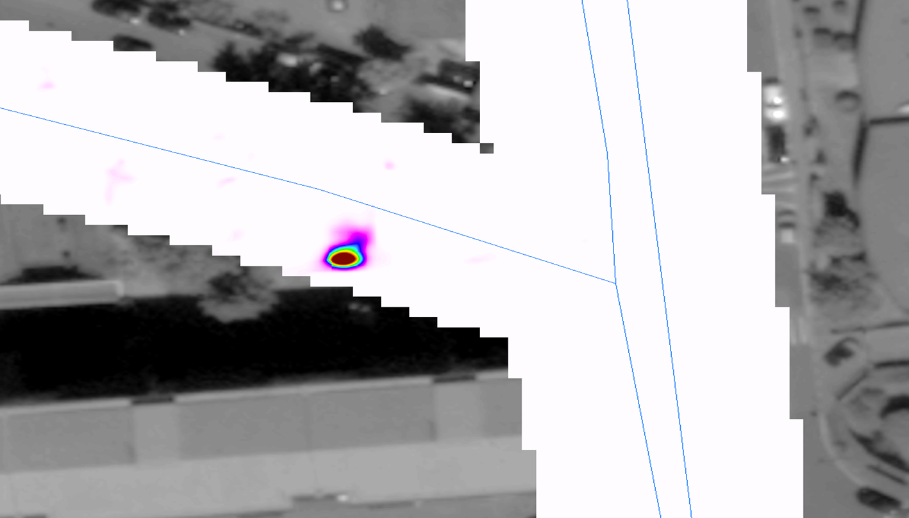
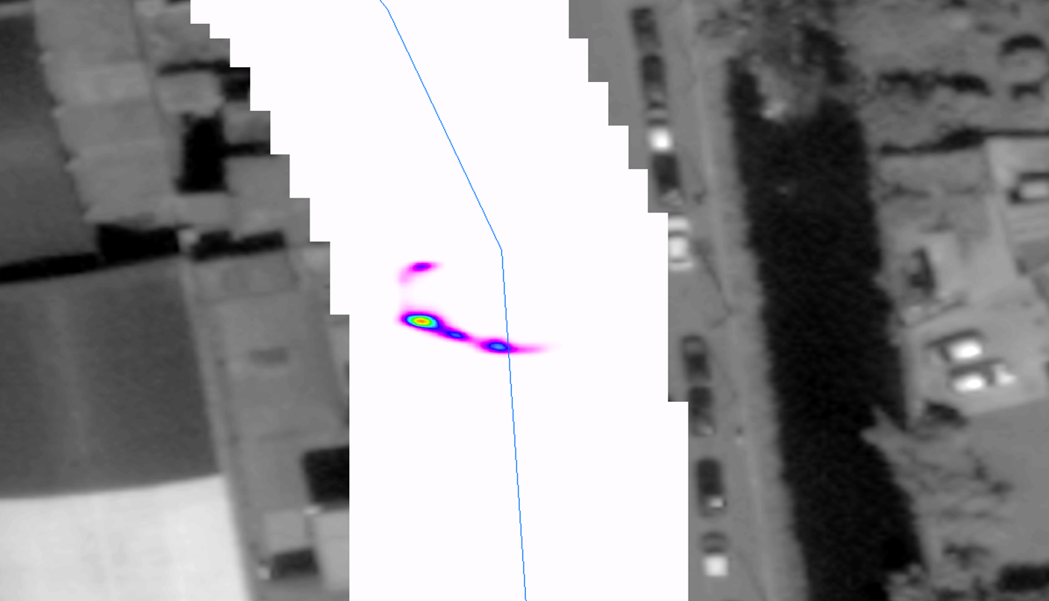
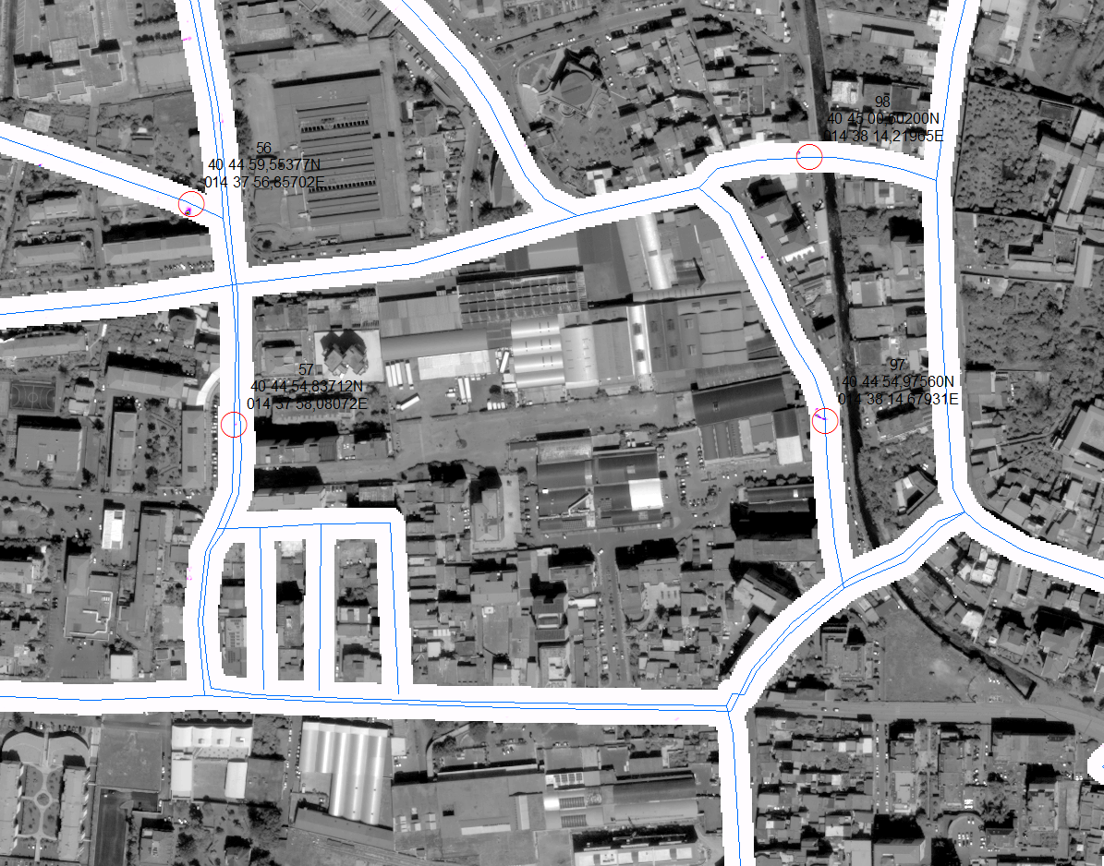
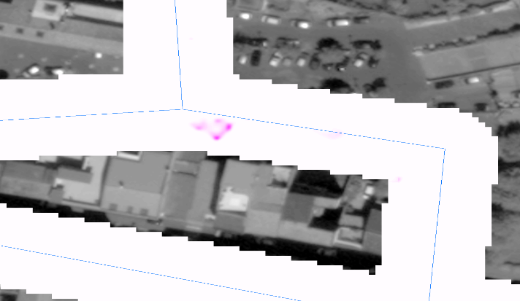
Water leaks – satellite solution
New
satellite system that overcomes limitations in high-density urbanization (canyoning, shadowing)
provides dynamic data analysis with accurate 4D visualization and predictive maintenance.
Water leak
Water leak
Water leak

Slide 6
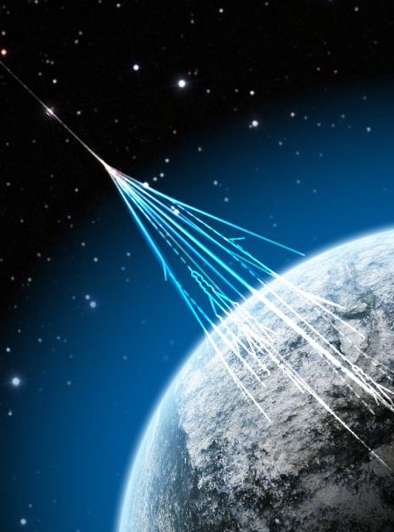
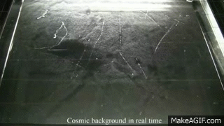
What are cosmic rays and neutrons

Slide 7
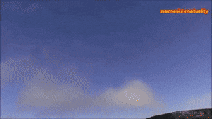
What are cosmic rays?
Particles of various origins (extragalactic, galactic, solar) that continuously affect the Earth.
They're divided into:
- primaries (incidents)
- secondary (cascaded derivation from the former by interaction with particles in the atmosphere)
Composed of atomic and subatomic particles they reach the ground and go beyond the Earth.

Slide 8
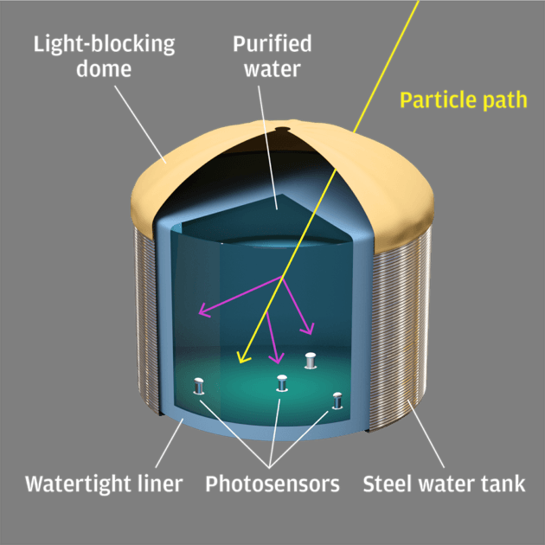
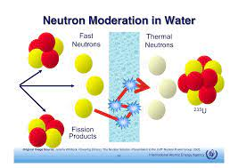
Cosmic neutrons interaction with H₂O
Hydrogen/water
- high moderating effect on neutrons and absorbent effect.
For water in the soil –
reduces measurable neutrons.
Fact - Water is used as a moderating element in nuclear reactors.

Slide 9
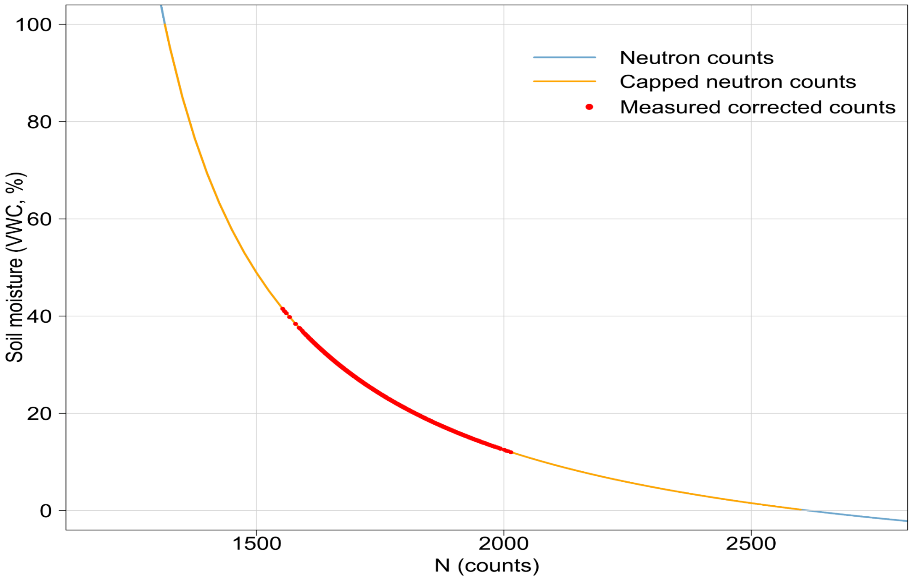
Soil Moisture and Neutrons
Inverse proportionality correlation between soil moisture and number of neutrons.

Slide 10
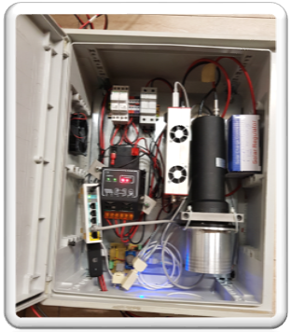
Neutrons detector – 1° Prototype
High Voltage Source
Power supply module
Photo multiplier
Data logger & transmission module
Lithium 6 probe

Slide 11
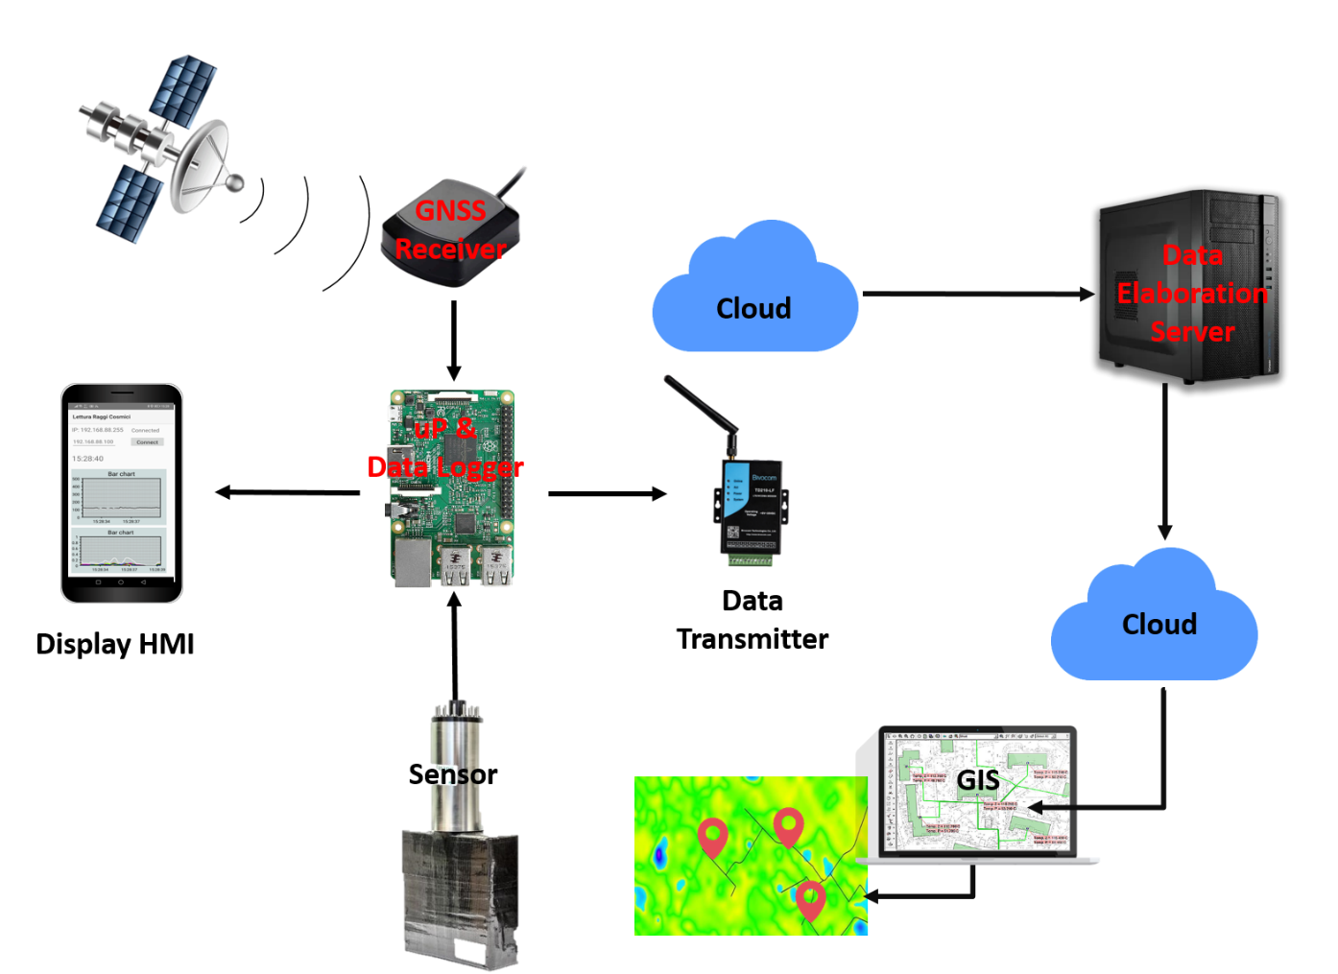
System architecture
Nuclear physics applied to soil moisture
Interfaced with ML & big data analysis
Geo-referenced system for the localization of water leaks
Absorption of neutrons derived from cosmic rays
In the presence of hydrogen contained in water (H2O).

Slide 12
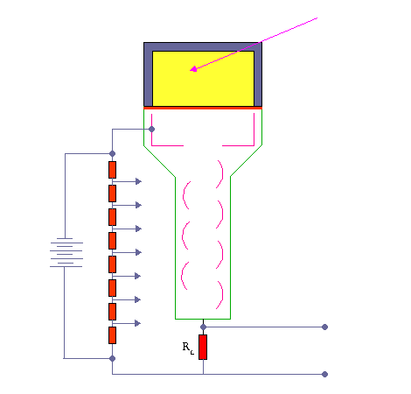
How a scintillator works
Neutron particle
Lithium 6 probe
Photocathode
Photo multiplier
High Voltage Source
Pulse discriminator,
Digital counter,
Multichannel analyser

Slide 13
The idea
Install a cosmic rays detector on a moving vehicle to dynamically map the water leaks

Slide 14
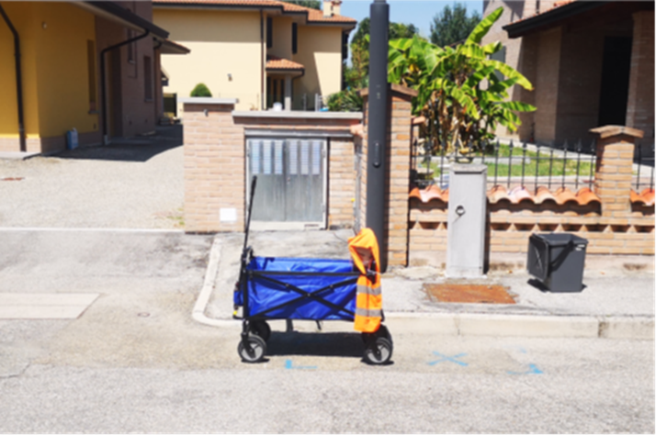
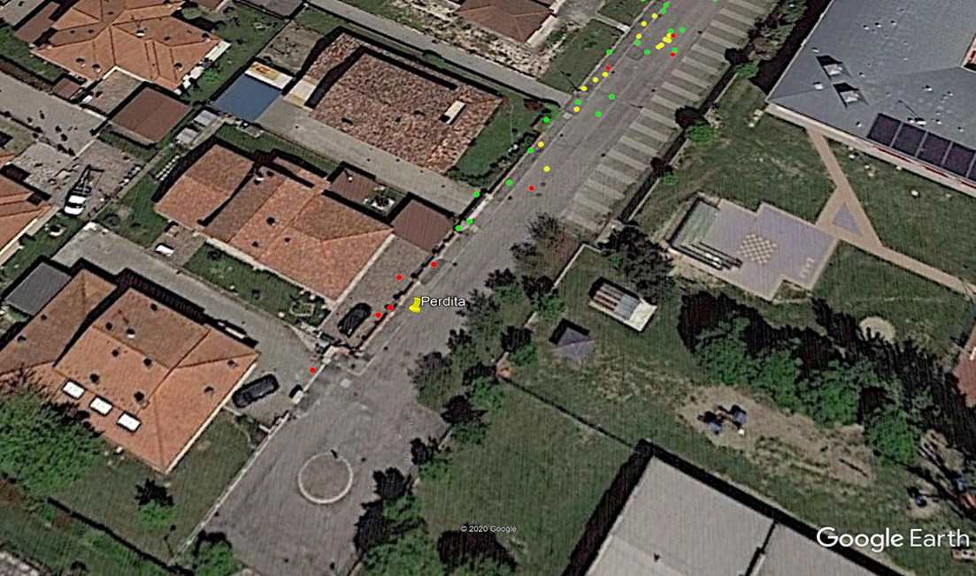
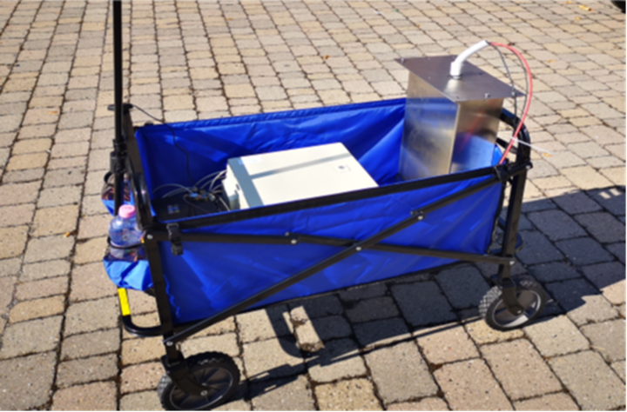
First steps outside the lab
Calibration phase done with an autonomous hand-pulled trolley over the pipelines.
low speed
low distance

Slide 15
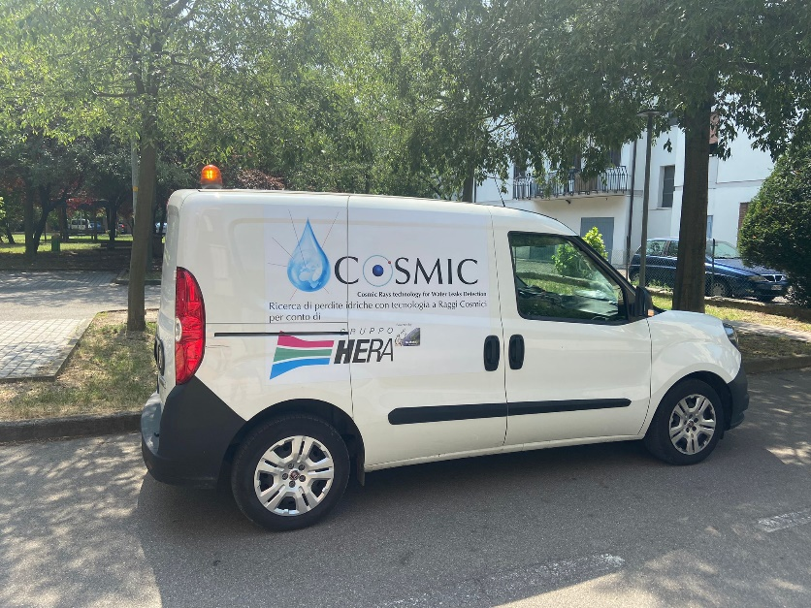
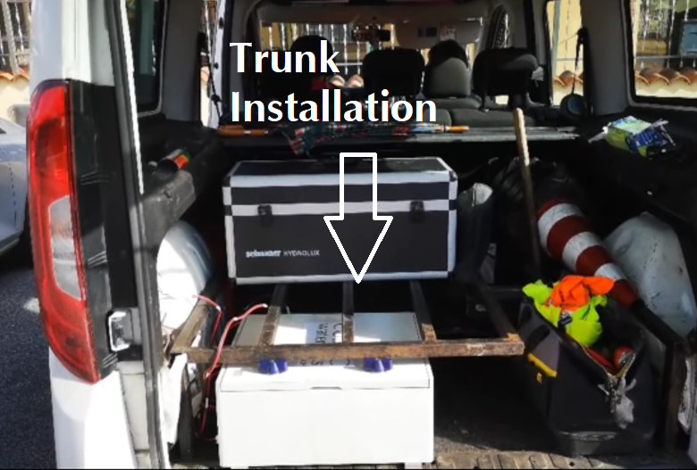
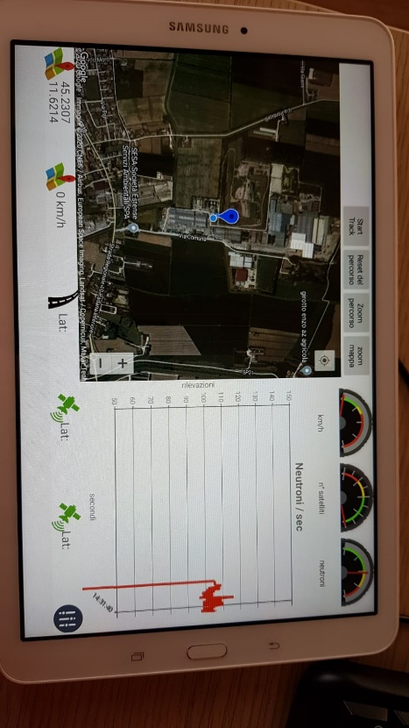
Vehicle installation
...water leaks are found by driving a car
Installed device on a vehicle
increase speed
increasedistance

Slide 16
Vehicle prototype
Device’s behaviour over a water leak.
Leak in hole!

Slide 17
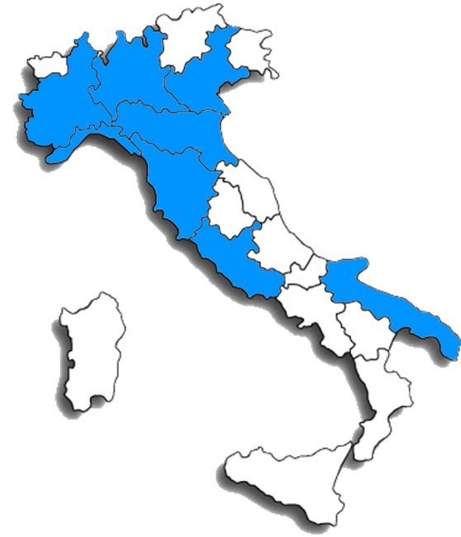
Customers in a year of activities
Over 5,400 kilometers of pipelines monitored

Slide 18
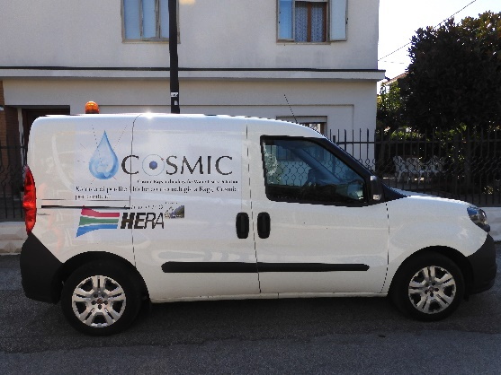
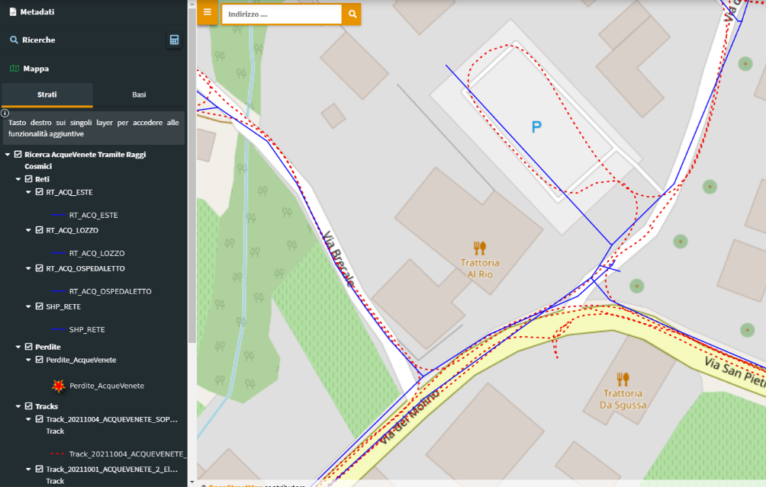
Business model
Complete process (Data acquisition, analysis, validation -> Final report)
Very fast solution
Performed to collect information at a speed of 40 km per hour
Automatic analysis with ML algorithm that generates the points to investigate.

Slide 19
Business model
This is a most effective solution
Slower
But, in addition to the leaks that can be found with the electroacoustic search, it is also possible to find leaks that are not audible from the operating organs (hydrants, gate valves, sockets)

Slide 20
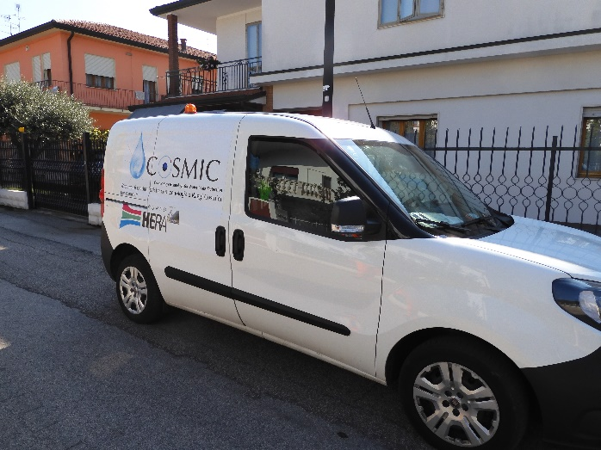
Comparison of two methodologies
Systematic
Area 1: 0.14 losses per km
Area 2: 0.08 losses per km
Cosmic
Area 1: 0.16 losses per km
Area 2: 0.083 losses per km

Slide 21
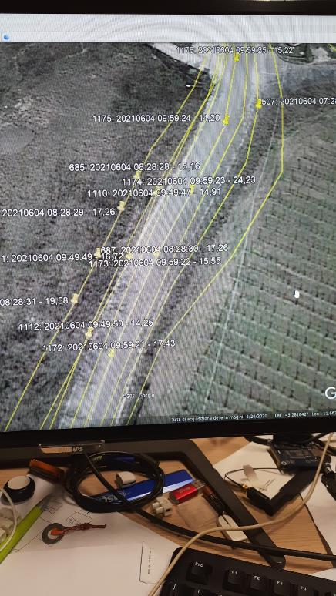
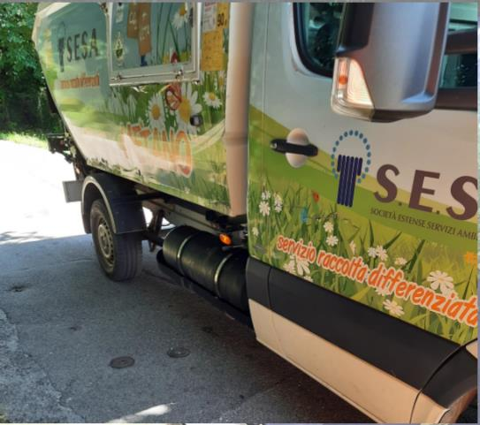
Developments and new applications - 1
Installation on urban waste trucks for a daily and capillary mapping.

Slide 22
About us
Cosmic has won the first place at the ESA Startup Competition.

