Slide 1


Water scenarios For Copernicus Exploitation
Tiit Kutser
Water-ForCE is a Coordination and Support Action (CSA) that has received funding from European Union's Horizon 2020-research and innovation programme under grant agreement number: 101004186.

Slide 2
Coordination and Support action
We did not develop any new products or services NEREUS partners could use
We analysed the present situation with water related products scattered among the six Services
Analysed user and stakeholders needs
Identified bottlenecks that hamper the wider use of Copernicus Services
Analysed how four possible future scenarios will allow to reach better Copernicus water portfolio

Slide 3
Assessment of Water Quantity portfolio
Existing products
Comments
Many other providers (ESA, JAXA, NOAA);
Missing products (evapotranspiration, soil moisture, soil maps, groundwater, and discharge, inland water bathymetry);
Higher spatial resolution needed
Validation and maturity of products varies
Uncertainties of products are usually missing
Lack of awareness in user community
Quasi similar products
Lack of harmonisation
NASA Earthdata, CMEMS, C3S much better than the Land Service portal

Slide 4
Assessment of Water Quality portfolio
Existing products
Missing products
carbon related products e.g. coloured dissolved organic matter, (CDOM), dissolved organic carbon (DOC), total organic carbon (TOC), dissolved inorganic carbon (DIC), total inorganic carbon (TIC), CO2);
shallow water products e.g. bathymetry, benthic habitat cover (%) and types, benthic primary production, benthic carbon, etc.;
floating matter products e.g. plastic and other litter (wood, glass, metal, textile, etc.), cyanobacterial scum on the water surface, macroalgae (Sargassum, Ulva) or plants (water Hyacinth, duckweed) floating on the water surface, tree pollen).
For about 4700 lakes out of 117 million
All exist at local scale

Slide 5
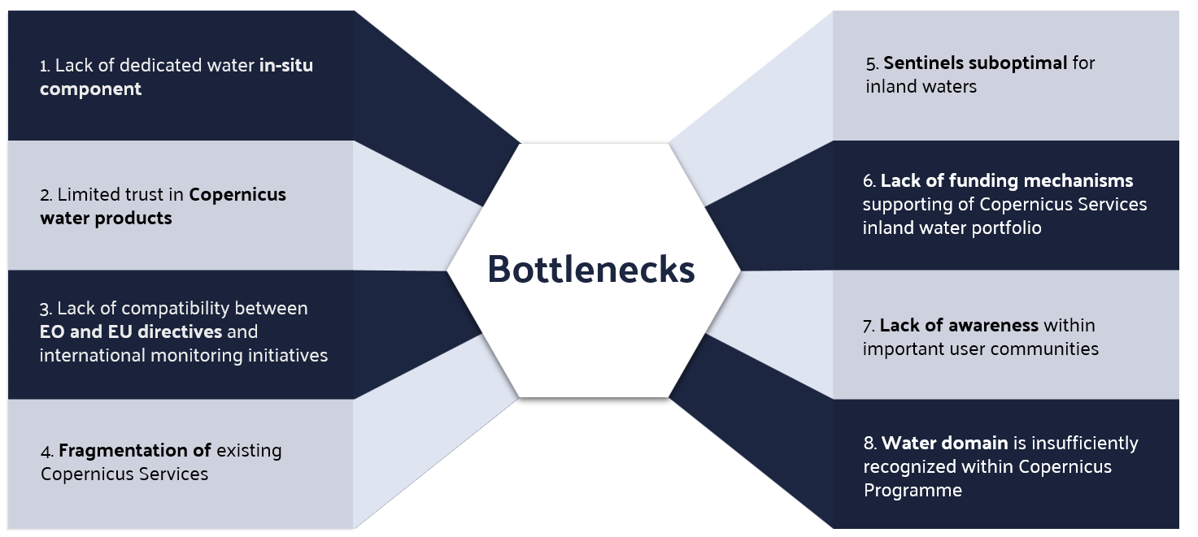

Slide 6
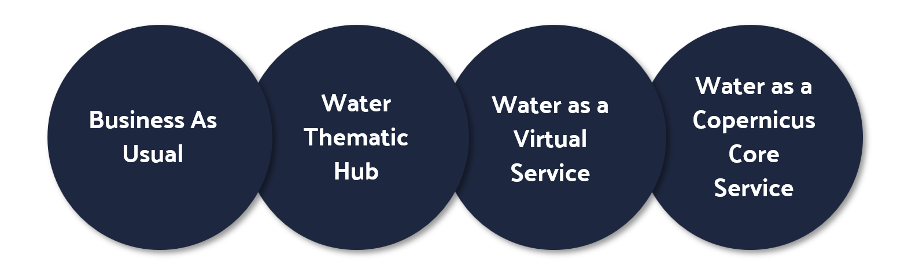
Scenarios
From 2027 onwards

Slide 7
Roadmap
https://zenodo.org/records/10847654
DOI 10.5281/zenodo.10847653
https://waterforce.eu/roadmap

Slide 8
Thank you!
Tiit.Kutser@ut.ee
Water-ForCE is a Coordination and Support Action (CSA) that has received funding from European Union's Horizon 2020-research and innovation programme under grant agreement number: 101004186.

