Slide 1

An Introduction to the Copernicus Energy Hub
The Gateway to Copernicus for Energy Actors
Space Data for Energy Webinar by NEREUS Regions,
Online, 20 January 2025
Presented by Ms. Catherine Mandler of Evenflow on behalf of ECMWF
CEH team and contributors
Tim Heijmann and Catherine Mandler of Evenflow, Copernicus Energy Hub consultants
Nube Gonzalez Reviriego and Chiara Cagnazzo, Thematic Applications on C3S Energy, ECMWF
Delphine Deryng, Cristina Ananasso, Stijn Vermoote, User Outreach and Engagement Section, ECMWF

Slide 2
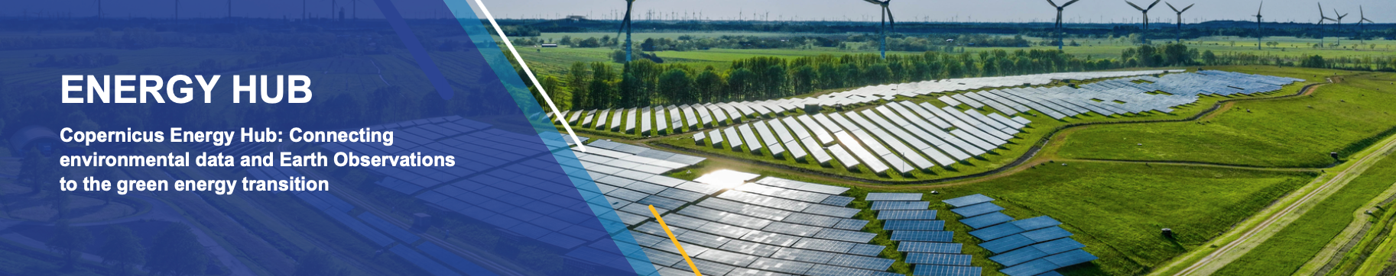
Energy Hub in a nutshell
energy.hub.copernicus.eu
FIRST POINT OF ENTRY
Bring together all of Copernicus' energy-related activities in a simple and user-friendly way
GATEWAY TO COPERNICUS FOR ENERGY
Easy access to free energy-related Copernicus information and datasets
SHOWCASE & INSPIRE
Showcase stories of how the data can be used and inspire with use cases
COMMUNITY OF PRACTICE
Catchment point for user feedback and requests, and to encourage collaboration

Slide 3
Energy Hub: A New Beginning
The Energy Hub offers a robust platform for energy sector collaborations, advances and alignment between resources, techniques, strategy and actors to ultimately support progress forward in the energy sector for the energy transition.
The Energy Hub community and innovation leadership aspects
  Community engagement with real partners and stakeholders
  Sharing of best practices, general and sub-sector specific
  Showcasing innovations in applying energy data for specific findings and uses
  Maximise operationalisation of Copernicus services and data
The Energy Hub is a part of the wider Copernicus user outreach ecosystem with links to:
JRC/DEFIS KCEO, incl. EU policy “deep dives”
EUSPA downstream market developments, incl. Cassini activities
CAMS and C3S National Collaboration Programmes
Horizon Europe research and innovation actions
GEO and EuroGEO
Notes:
Platform for promoting new collaborations and staying in touch with advances
Opportunity to showcase your work on a prominent platform in the energy sector
Make more network connections through the energy hub

Slide 4
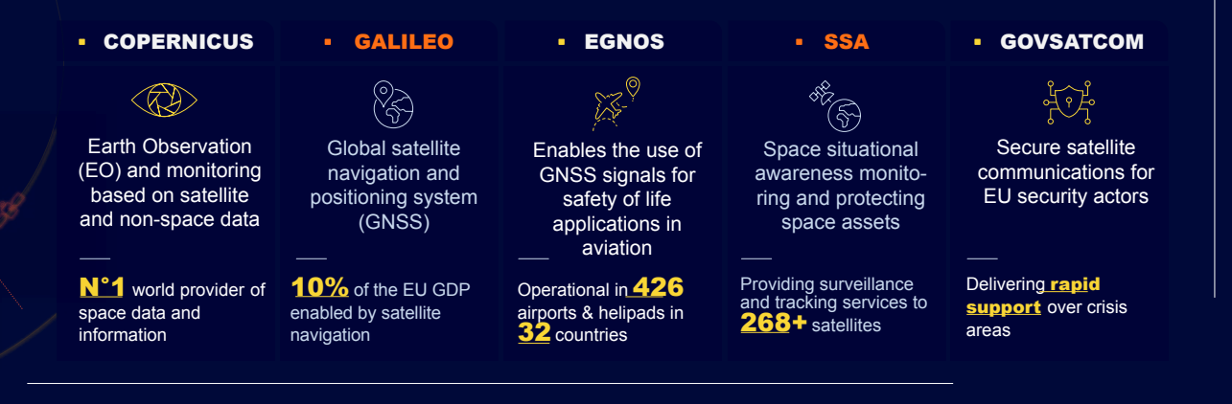
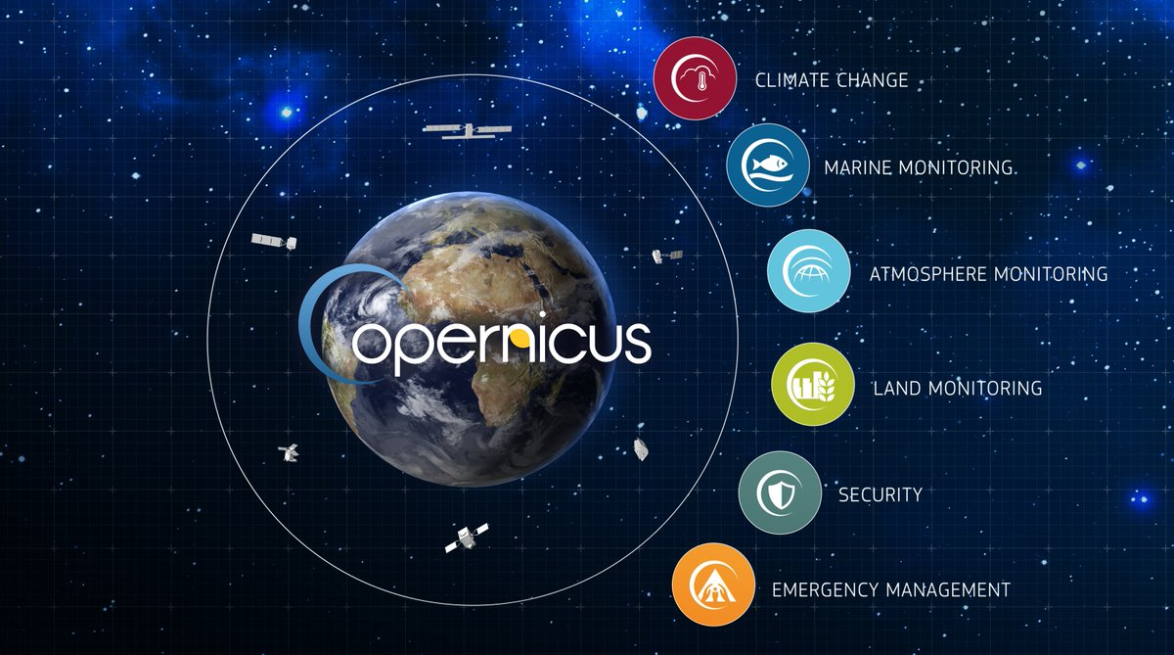
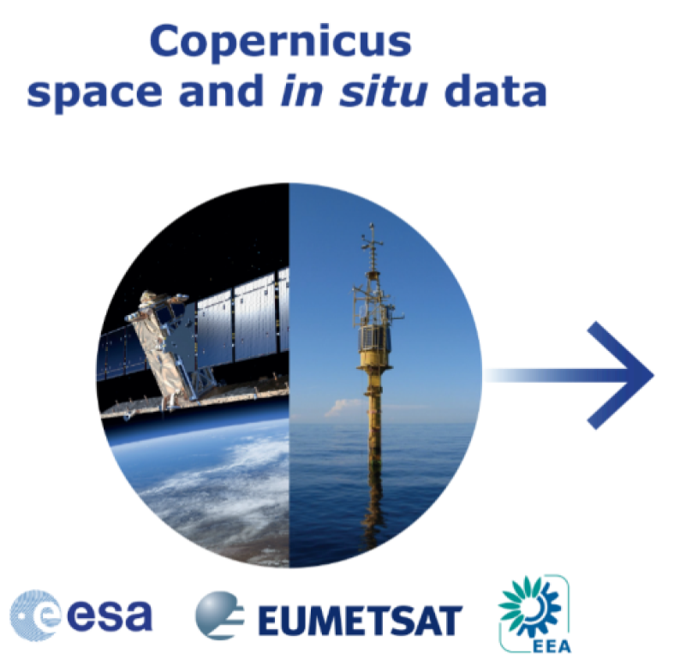

Copernicus Programme
Copernicus is the Earth Observation component of the European Union’s Space Programme
ENERGY AT THE FOREFRONT
Aim of Copernicus
Develop European information services based on satellite Earth Observation and in situ (non-space) data

Slide 5

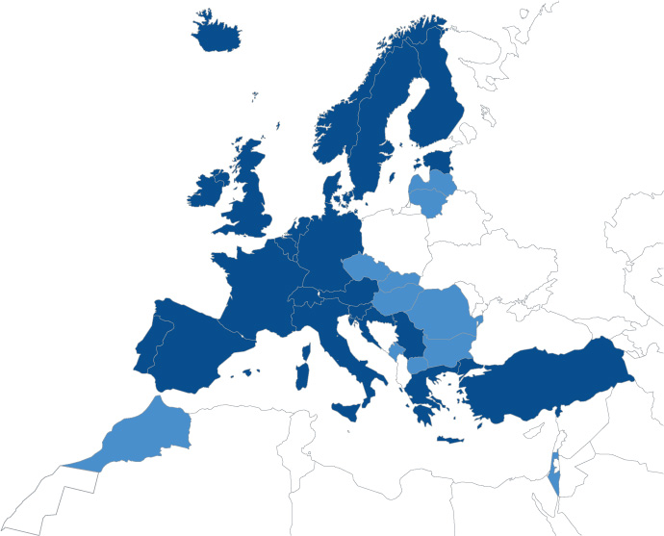
European Centre for Medium-Range Weather Forecasts
About ECMWF
Created in 1975 to address the critical and most difficult research problems in medium-range Numerical Weather Prediction
World leading in global weather forecasting
35 Member and Co-operating States, ~400 staff from 30 countries
Member of the Co-ordinated Organisations, which also includes NATO, ESA, EUMETSAT, etc.
Both a research institute and a 24/7 operational service, producing and disseminating numerical weather predictions to its Member States and licenced users.
The supercomputer facility and associated data archive at ECMWF is one of the largest of its type in Europe and the World.
As an Entrusted Entity for indirect management of EU funds: Copernicus Atmosphere & Climate Change services, and DestinationEarth
Reading (UK)
Headquarters
Bonn (DE)
EU activities
Bologna (IT)
Data Centre

Slide 6
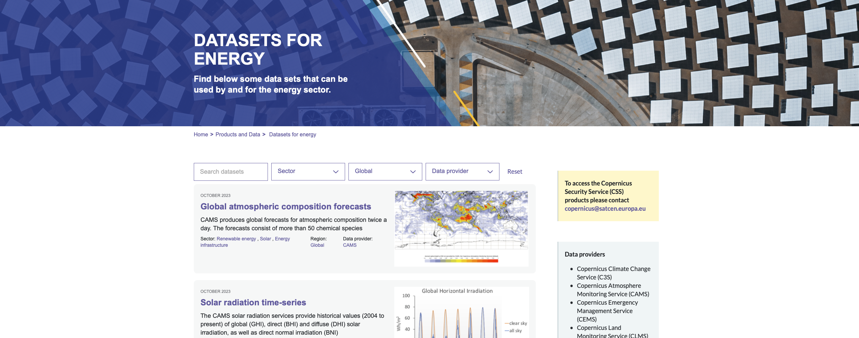
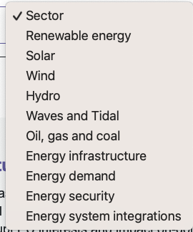
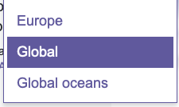
Energy Hub: easy access to data and use cases
Understand how Copernicus is used in the Energy Sector
GATEWAY TO COPERNICUS FOR ENERGY
Easy access to free energy-related Copernicus information and datasets
Notes:
When entering to the Energy Hub website you can find a direct link to the data sets. In order to facilitate the search of the data sets, we have included some filters

Slide 7


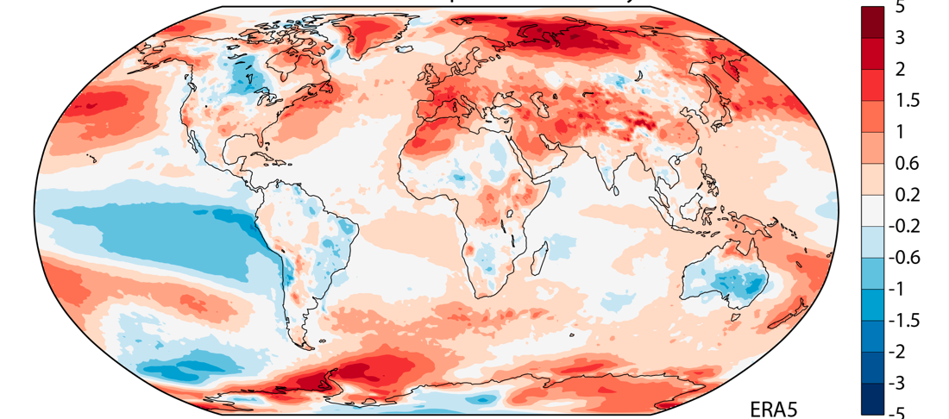
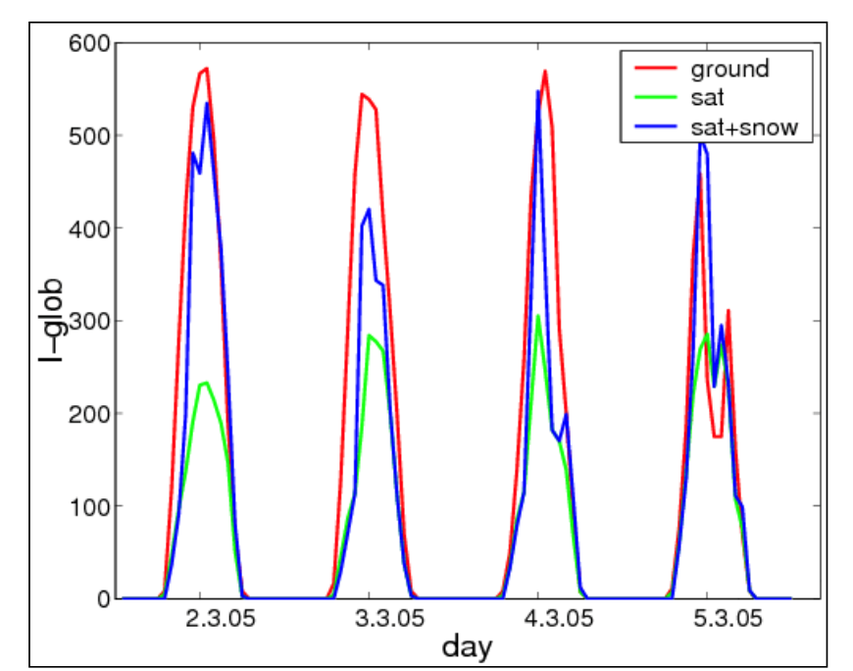
Energy Hub: examples of datasets
ERA5 hourly data on single levels from 1940 to present
CAMS: solar radiation time series
ERA5 provides hourly data about atmospheric, sea surface and land surface conditions for any hour since 1 January 1940 and up until five days before the present.
The CAMS solar radiation services provide historical values (2004 to present) of global solar irradiation, used for planning, monitoring, efficiency improvements and the integration of solar energy systems into energy supply grids.

Slide 8

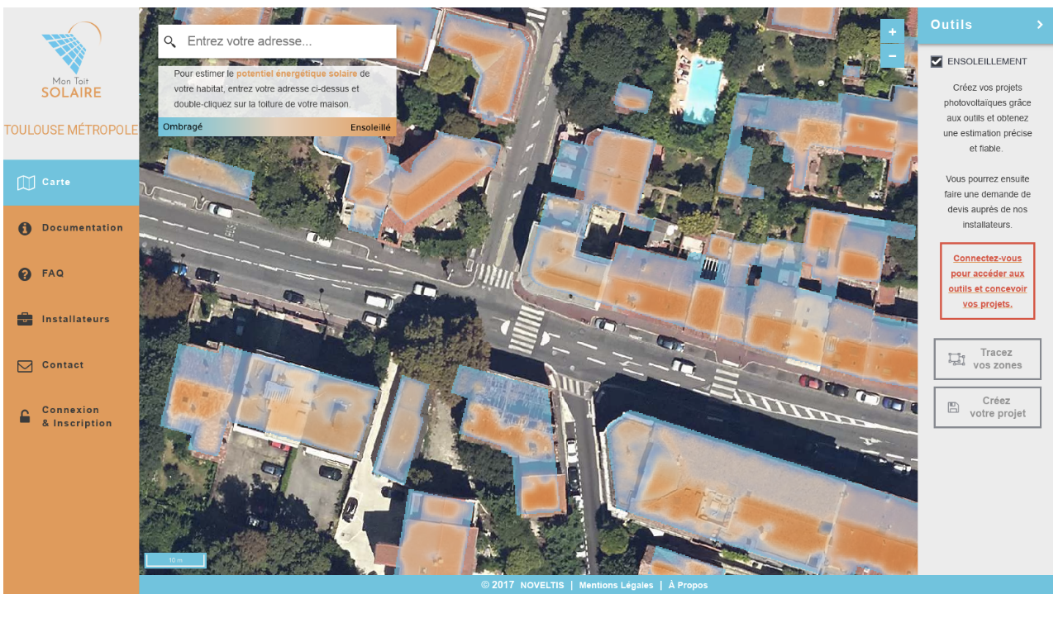
Energy Hub: showcase & inspire
SHOWCASE & INSPIRE
Showcase stories of how the data can be used and inspire with use cases
Use Case: Mon Toit Solaire for photovoltaic rooftops
"Mon Toit Solaire" is a web-based integrated decision support system for the development of rooftop photovoltaic power generation.
Sources of info:
CAMS Solar radiation data
3-dimensional urban topographical data
Simulation toolboxes including tax incentives, CAPEX/OPEX costs and energy pricing allowing return on investment calculations
An interactive listing of local solar energy professionals and an interactive forum between all solar energy stakeholders.

Slide 9






Energy Hub: more datasets to come…
Total/clear-sky solar radiation
CH4 anomalies detection
Aerosol optical depth (e.g. dust)
Global ocean waves Reanalysis
Global ocean waves Analysis and Forecast
Global ocean physics Reanalysis
Mediterranean Sea Biogeochemistry Analysis and Forecast
Global Ocean Along Track L 3 Sea Surface Heights
Reanalysis & climate projections
Meteorological variables (wind speed, precipitation, solar radiation, air temperature, sea level pressure)
Energy derived variables (electricity demand, hydro, solar and wind power generation)
Next: Information at seasonal forecast timescale
Reanalysis and forecasts of river discharge to assess hydropower potential
Drought impacts on energy production
Information on population, buildings and settlements
Urban atlas
High resolution Vegetation Phenology and Productivity
Corine Land Cover (CLC) and CLC+,
European Ground Motion Service (EGMS), HR VPP (for biofuels)
Surface Albedo, Land Surface Temperature
Leaf Area Index & Soil Water Index (biomass estimation)
Land Cover Map
Geospatial Analysis
Mapping for Situational Awareness
Support to Planning

Slide 10
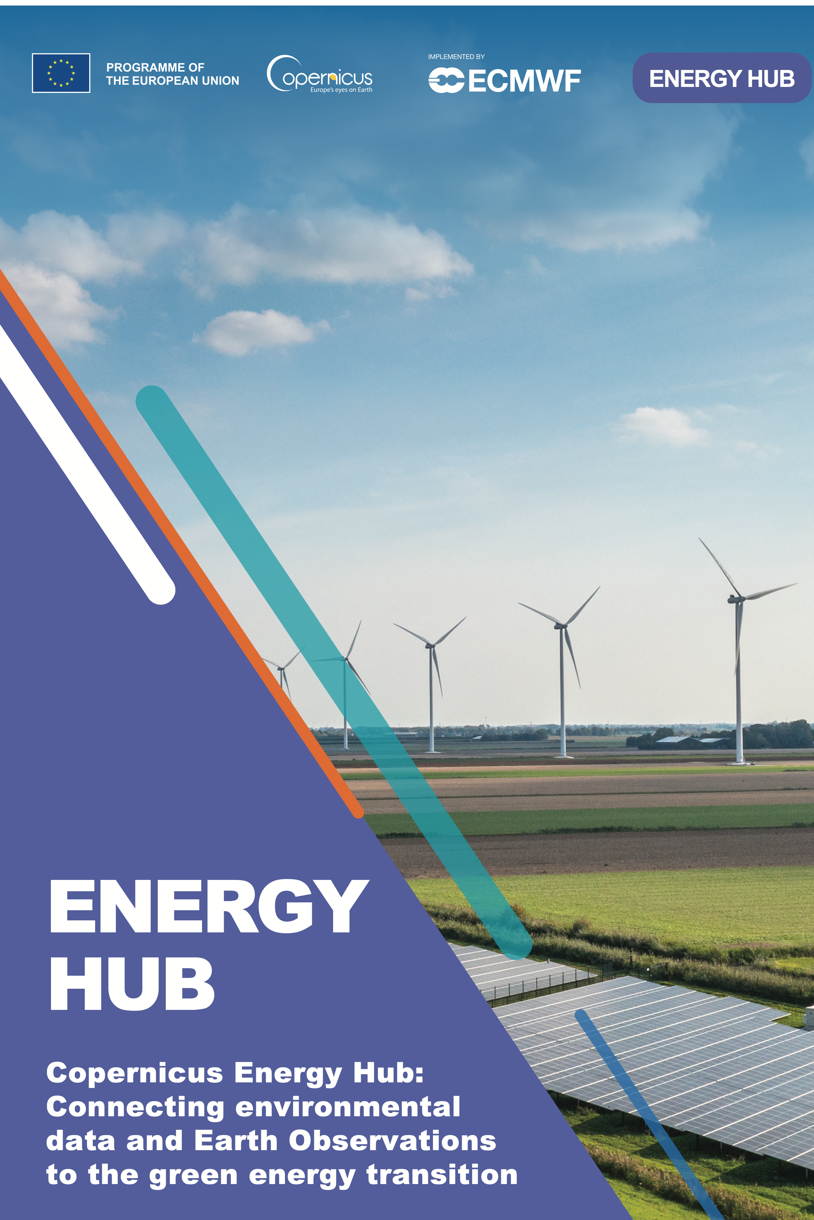

Thank you and we are eager to hear your voice!
Share your story on how you use Copernicus in your day-to-day operations and get featured on the Energy Hub!
Scan the QR or contact the Energy Hub team:
copernicus-energy-hub@ecmwf.int

