Slide 1
1st Benelux Space Startup Competition
Rotterdam, The Netherlands | 01-02 MAY 2025
16th NEREUS Info Session, 27/02/2025
Alice Pellegrino, Co-deputy Event Manager

Slide 2
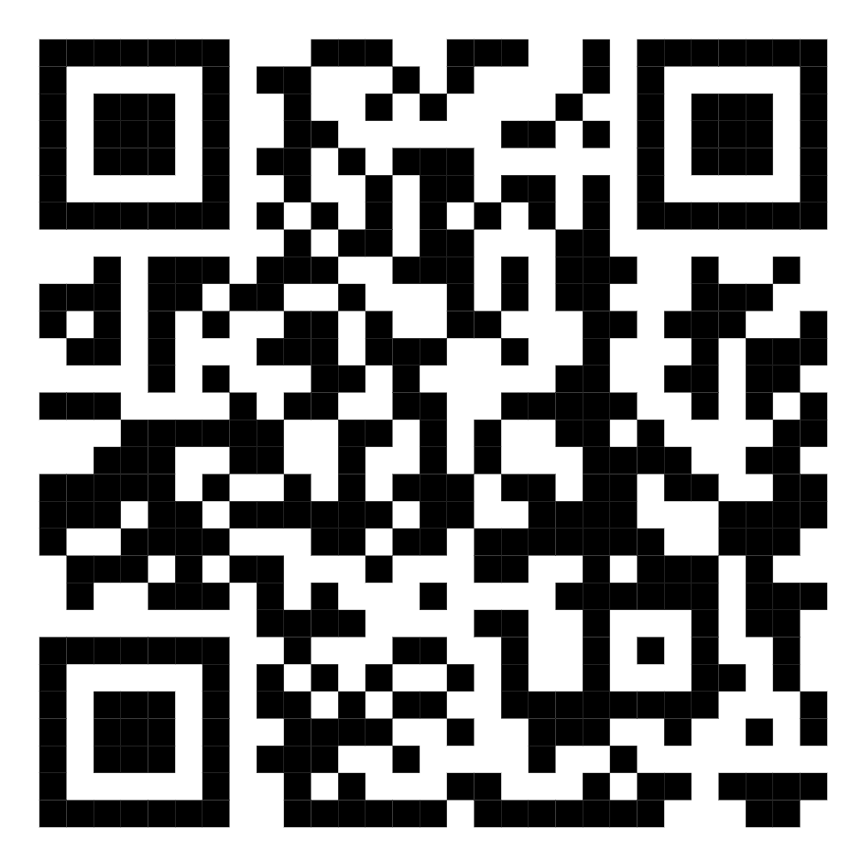
WHAT IS THE SGAC?
The Space Generation Advisory Council (SGAC), in support of the United Nations Programme on Space Applications, is a non-governmental organisation that represents university students and young space professionals to the United Nations, States, space agencies, industry and academia. The SGAC network of members, volunteers and alumni has grown to more than 27,000 members representing more than 170 countries.
SGAC has permanent observer status in the UN Committee on the Peaceful Uses of Outer Space (COPUOS). SGAC provides pragmatic space policy advice to policy makers based on the interests of students and young professionals, broadly in the age range 18-35, interested in space from around the world. SGAC also provides input to national and international space agencies on a regular basis. SGAC is registered in the United States as a 501(c)(3) non-profit organisation.
Learn more: https://spacegeneration.org/
MORE INFORMATION:

Slide 3
WHAT IS A SPACE STARTUP COMPETITION?
A Space Startup Competition (SSC) is a 2-day business accelerator for pre-bootstrap startups or teams with space business ideas.
The event is open to a global applicant pool of students and young professionals between the ages of 18 - 35.
Selected individuals will have the opportunity to develop their business ideas under the guidance of expert mentors from the space sector.
The event finale is a pitch competition where delegates will present their business plans to a prestigious panel of judges who will provide feedback and select winners.
This forward-thinking event is designed to capitalize on the vigor and creativity of the next generation of entrepreneurs. We aim to enable knowledge-sharing amongst peers and professionals to provide participants with the necessary backdrop to network, learn, and advance the future.

Slide 4
1ST BENELUX SPACE STARTUP COMPETITION
 | Thu 1st May 2025 | Fri 2nd May 2025
08:30 | Doors open, Registration | Doors open, Registration
09:00 | 1st day Welcome | 2nd day Welcome + keynote session 3
09:30 | Keynote session 1 | Keynote session 4
10:00 | Coffee break | Coffee break
10:30 | Keynote session 2 | Working session 4
11:00 | Mentors presentation | -
12:00 | Free lunch time | Free lunch time
13:00 | Working session 1 | Working session + pitch submission
14:00 | - | Pitch competition
16:00 | Coffee break | Jury decision + break
16:30 | Working session 2 | Winners announcement and closing session
18:00 | Day 1 closing session | -
20:30 | Aperitivo/Dinner (TBD) | -
Participants lists will be frozen 6 weeks before the event
WHEN?
May 1-2, 2025
(international workers day)
This will allow the coupling of individuals with already established teams and the delivery of 2+ webinars to introduce participants to the event and startup-building best-practices
WHERE?
Rotterdam Science Tower (NL)

Slide 5
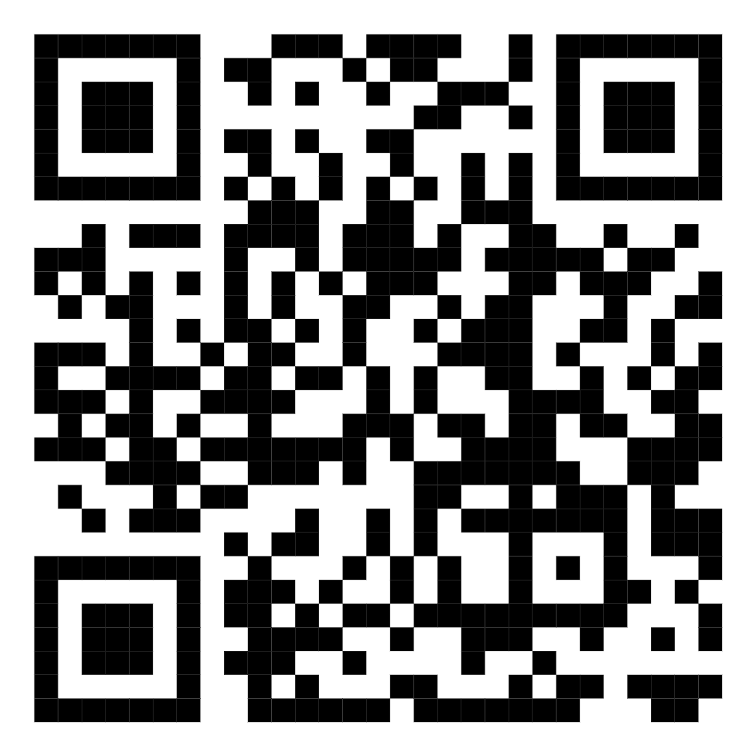
HOW TO REGISTER?
USE THIS QR CODE!
EARLY BIRD RATES STILL OPEN FOR ANOTHER WEEK!

Slide 6
SPONSORSHIPS ARE STILL OPEN!
REPRESENT
YOUR ORGANIZATION
IMPROVE
YOUR VISIBILITY
OFFER
YOUR SPECIAL PRIZES
SOURCE
NEW TALENTS
Pitch your organization to young space enthusiasts
SGAC is an international organization that organizes events in more than 100 countries
.. and have a member from your organization as a mentor and in the jury. Take inspiration from the examples below to define your prize.
Leverage the SGAC network of young professionals & create relationships with talented leaders from across the globe
NOTABLE EXAMPLES FROM THE PAST EDITIONS (in other European regions)
6 hours coaching with CEO
2 internships
3-months internship
6-months internship
Presentation at AIDAA general assembly
Access to the “Switch2Product” program
Pre-incubation programmes
Visit to a facility

Slide 7
DO YOU HAVE ANY QUESTION?
WHERE?
Rotterdam Science Tower
(The Netherlands)
WHEN?
May 1-2, 2025
(international workers day)
Point of Contact: alice.pellegrino@spacegeneration.org

