Slide 1





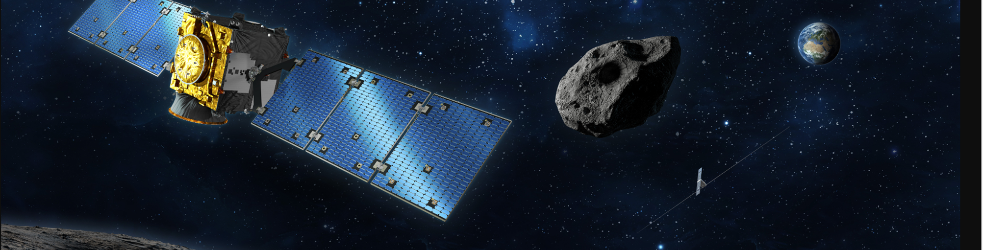
The Draft EU Space Act
Webinar // 15 September 2025, 12:30

Slide 2
Agenda
Motivation & Objectives
Overview
Scope: Who is Affected?
Scope: Affected Services & Activities
Authorisation Procedure
Obligations in Detail – Safety
Obligation in Detail – Resilience
Objectives in Detail - Sustainability
SMEs & Start-ups – Impact and Relief Measures / Nereus Regions
Timeline – Implementation of the EU Space Act

Slide 3

1 Motivations & Objectives
Reasoning for EU Space Act?
need to provide for sustainable use of Space
Autonomy and independent European capacities
De-fragmentation of EU legal framework (one single market – free movement)
Key Objectives
enhance safety (debris mitigation, collision avoidance)
strengthen resilience (cybersecurity, risk management)
promote environmental sustainability (lifecycle assessment, green standards)
foster a level playing field and legal certainty
At the same time: Strengthen the EU competitivness

Slide 4
2 Overview
What is the EU Space Act?
A comprehensive Regulation (not a Directive) directly applicable in all Member States
Covers authorization, registration, supervision, and enforcement of requirements of space activities
Harmonizes and introduces technical, operational, and environmental requirements
Applies to both EU and non-EU operators providing services in the Union
Strategic Context
Autonomy, own independent capabillities
Aims to position the EU as a global standard-setter in space governance

Slide 5
3 Who is Affected (1/2)
Entities Covered
Space operators (satellite owners, launch providers, ground segment operators)
Collision avoidance service providers
Primary providers of space-based data
International organizations (e.g., ESA, EUMETSAT)
Third-country operators providing services/data in the EU
Exclusions
Space objects used exclusively for defense/national security
Assets launched before January 1, 2030

Slide 6
3 Scope: Who is Affected (2/2)
Indirectly Affected?
Companies not directly regulated by the EU Space Act but supplying products, components, or services to space operators, are indirectly affected in 2 ways
The Act itself requires directly regulated companies to demand their suppliers to comply with specific safety, resilience, and environmental standards (e.g., design, cybersecurity, environmental data)
Directly regulated companies will factually be required to impose back-to-back requirements on suppliers to streamline compliance and reduce risk
Key Areas of Impact
Product Standards: Suppliers must meet technical and operational requirements for safety and debris mitigation.
Cybersecurity: Suppliers may need to implement information security and risk management measures.
Environmental Data: Suppliers must provide data for environmental footprint calculations and life cycle assessments.

Slide 7
4 Scope: Affected Services and Activities
Space-Based Data & Services
Satellite communications, navigation, Earth observation, remote sensing
Launch services and operations
Collision avoidance and in-space servicing (ISOS)
Data provision and downstream applications
Cross-Border Activities
Operations involving multiple Member States (manufacturing, launch, operation)
Services provided by non-EU entities within the EU market

Slide 8
5 Authorisation and Registration Procedure
(1/2)
Application Process
Application to Member state authority (except: operation of Union owned Space Asset: EU Comission / EUSPA)
submission of a technical file demonstrating compliance with safety, resilience, and sustainability requirements
Assessment by qualified technical bodies (QTBs), national authorities
12-month decision period (suspension possible for additional information)
Third-Country (Non-EU established) Operators
Application to EUSPA authority, two alternatives:
- either: Equivalence Decision; or
- Detailed EUSPA assessment of requirements
Registration in so called URSO and appointment of a legal representative in the EU

Slide 9
5 Authorisation and Registration Procedure (2/2)
Simplified Procedure for constellations (single authorisation for the entire constellation)
Light Regimes for research or education institutions, small-sized enterprises, and In-Orbit Demonstration/Validation (IOD/IOV) missions
Principle of Free Movement – mutual recognition of authorisations issued by other EU Member States
! Applies only within the scope of the EU Space Act (e.g., does not cover supplementary matters such as national security or liability and liability coverage)
! Possibility for stricter requirements where objectively justified
-> No full harmonisation
Third Country Providers: Registration and demonstration of equivalence (Equivalence Decision) or individual assessment, possibly in addition to recognition procedures in the provider’s home country. In addition: multi-national agreements.

Slide 10
6 Obligations in Detail: Safety
Launch, flight and Spacecraft Safety: Operators must submit launch safety plans, coordinate with air and maritime authorities, perform risk and collision avoidance assessments, and equip vehicles with tracking, telemetry and neutralization systems.
Debris Mitigation: Mandatory plans to limit debris creation / fragmentation, failure response plans and ensure end-of-life disposal.
Mitigation of collision risks with aircraft, ships, spacecraft, debris.
Trackability and Collision Avoidance (CA) : Spacecraft must be trackable; operators must subscribe to collision avoidance services and follow orbital traffic rules.
Spacecraft must allow precise orbital position tracking.
Maneuverability required above 400 km apogee / Re-entry: provide safety data to air traffic & authorities.
Contact list database for event alerts.
Exemptions for research/education spacecraft in specific conditions.
Constellations and Pollution: Special rules for large constellations and requirements to limit light and radio pollution.
Notes:
Constellations
Daily collision risk screenings.
Intra-constellation avoidance measures.
Orbits chosen to minimise congestion & conjunctions.
Dead-on-arrival mitigation and stricter disposal rules.

Slide 11
7 Obligations in Detail: Resilience (1/2)
Risk Management: Operators must implement comprehensive risk management for digital and physical threats across all mission phases.
Cybersecurity: Establish information security systems, access controls, cryptography, backup, and redundancy measures.
Interaction with NIS2, Critical Entities Resilience Directive (CER)
Continuity & Supply Chain Security: Operators must manage supply chain risks and ensure supplier compliance with security requirements.
Notes:
Security measures:
Identify & categorise critical assets & information.
Strict access management protocols (need-to-know).
Physical resilience: protected, segregated sensitive areas.
Incident detection & monitoring, with event reporting.
Preventive & protective cybersecurity measures for ground & space.
Use of cryptography & encryption (end-to-end authentication, key management).
Continuity & supply chain:
Backup & redundancy policies for systems, power, and geography.
Business continuity plans & recovery strategies.
Regular testing & penetration testing (TLPT) every 3 years.
Staff training & lessons learned integration.
Crisis communication strategies for staff, clients, third-party payloads.
Incident handling & root cause analysis.
Supply chain risk management: inventories, security clauses in contracts.
Risk management:
Aligned with NIS 2 & Critical Entities Directives.
Risk management across lifecycle (design, operation, disposal).
Maintain information security management systems.
Regular risk assessments & treatment plans.
Simplified risk management for certain entities.

Slide 12
7 Obligations in Detail: Resilience (2/2)
Information sharing
Incident Reporting & Networks & Space cyber governance
Incident Reporting: Significant incidents must be reported to authorities and the EU Agency.
Operators must report significant incidents:
Early warning: 12–24h.
Detailed report: 72h.
Final report: 1 month.
Significant = severe disruption or cross-border impacts.
Union Space Resilience Network (EUSRN):
Coordinates responses, exchanges with ENISA, CSIRTs, EU-CyCLONe.
Regular meetings chaired by Commission/Agency.
Operators may share cyber threat information (attacks, vulnerabilities, indicators).
Sharing within trusted communities, respecting confidentiality & data protection.
Commission & Agency facilitate EU-level information sharing arrangements .

Slide 13
8 Obligations in Detail: Sustainability
Environmental Footprint: Operators must calculate and report the environmental footprint (EF) of their activities, submit EF declarations (EFD) with certificate, and provide supporting data.
Data sent to EU EF database (aggregated public, disaggregated confidential).
Life Cycle Assessment: Use a space-specific LCA methodology for environmental impact.
Circular Economy: Encourage eco-design, reuse, and recycling in space activities.
Proportionality: Lighter or delayed requirements for SMEs and research/education missions.
Exemptions until 2031 for SMEs & research institutions.

Slide 14
9 SMEs & Start Ups, Industry - Impact and Easements
Proportionality & Light Regimes
Simplified risk management for small-sized enterprises, research, and education institutions
Exemptions for certain missions (e.g., In-Orbit Demonstration/Validation)
Extended compliance deadlines for SMEs and research institutions (until end of 2031 for environmental requirements)
Support Measures
Capacity-building, technical assistance, and guidance materials
Vouchers and co-funding for compliance costs (e.g., environmental reporting, cybersecurity testing)
One-stop information portal for regulatory support

Slide 15
10 Timeline – Implementation / Transition Period
Key Dates
Regulation enters into force: 20 days after publication
General application: January 1, 2030 (for assets launched after this date)
! Transitional period: Additional 24 months for assets in critical design phase
Exemptions for Smal size companies /research:
-- Environmental requirements apply from January 1, 2032;
-- ISOS requirements from January 1, 2034
Reporting & Review
Annual monitoring and reporting by Member States and the Agency
First evaluation by December 2035

Slide 16

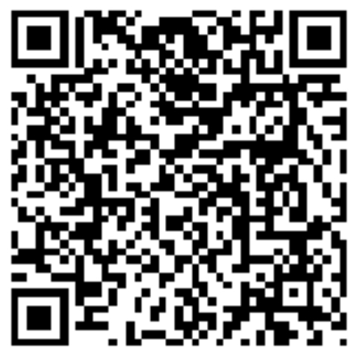
Your Speakers 1/6
Secretary General at NEREUS aisbl
Secretary General at NEREUS aisbl
Roya Ayazi
Secretary General at NEREUS aisbl
rayazi.nereus@euregions4space.com
Being trained as a German lawyer, Roya Ayazi held for more than 20 years positions in European/Governmental Affairs and has work experience in public administration and associations of civil society represented in Brussels. Since 2009 Secretary General of the European network NEREUS (Network of European Regions Using Space Technologies), Roya heads its Brussels/Belgium-based secretariat and is the main interface of the association at the European level. She has been following the major space legislative procedures with an impact on the downstream sector in the past 15 years and established the network as a reference for regional user communities. Monitoring European space policy developments, advocating for concerns of the regional and local level and coordinating interregional cooperation/partnerships and joint initiatives with the European Commission and the European Space Agency such as Copernicus4regions, Roya gained an in-depth expertise on the regional and territorial dimension of European space policy.

Slide 17

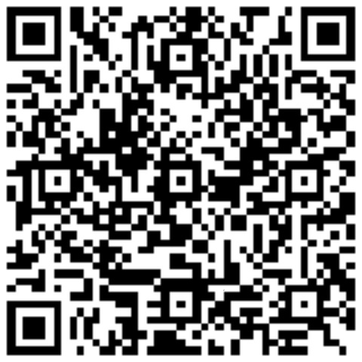
Your Speakers 2/6
Secretary General at NEREUS aisbl
Secretary General at NEREUS aisbl
Dr. Andreas Lenz
Lawyer | Partner at Heuking
a.lenz@heuking.de
Andreas Lenz is a partner based in HEUKING’s Cologne office and a member of the firm’s Corporate/M&A practice group. Andreas has 25 years of experience as a M&A and transaction lawyer, mostly in the area of private equity and investment. He advises German and international clients in transaction and investment-related matters, with a strong focus on providing strategic guidance. Andreas co-chairs the focus group “NewSpace & SpaceTech”, has been involved in legislative and policy-related developments in the space sector for many years and is co-author of a series of publication regarding the draft EU Space Act published inter alia via Linkedin. Andreas is a frequent speaker and author on space-related topics.

Slide 18
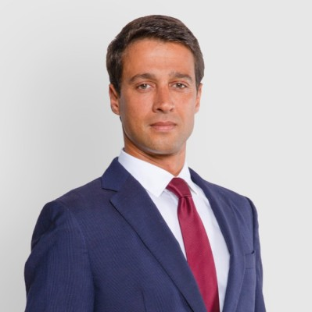
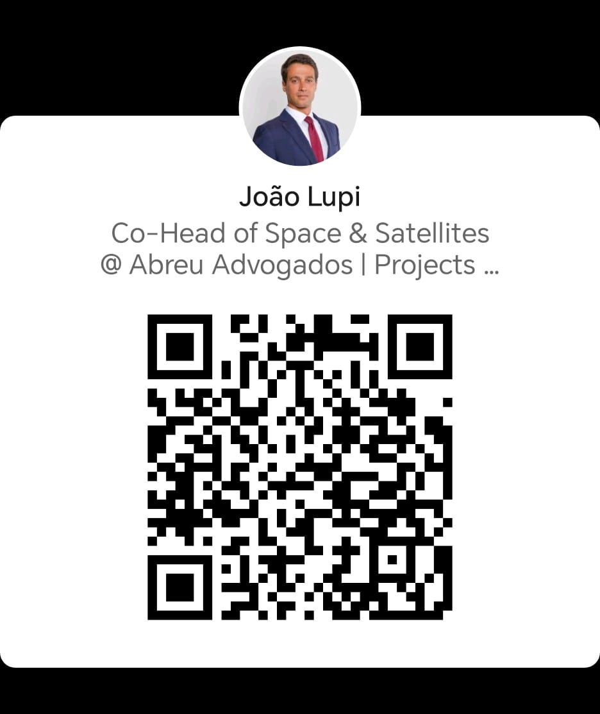
Your Speakers 3/6
Secretary General at NEREUS aisbl
Secretary General at NEREUS aisbl
João Lupi
João Lupi is a lawyer registered in Portugal and Brazil bar associations and currently Co-Head of a team dedicated to the Space and Satellites sector at Abreu Advogados.
Certified in space law by ECSL and in ESG by the European Institute for Management and Finance, he was awarded in 2025 under the “4 under 40 Future Leaders” category by Iberian Lawyer and has stood out for his work in providing strategic legal advice and support in Projects, with a special emphasis on the space and satellite and energy and natural resources sectors.
He advises leading companies in their sectors of activity and on various types of transactions, markets, and products, interacting with the respective regulatory authorities.

Slide 19
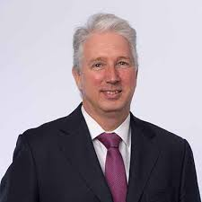
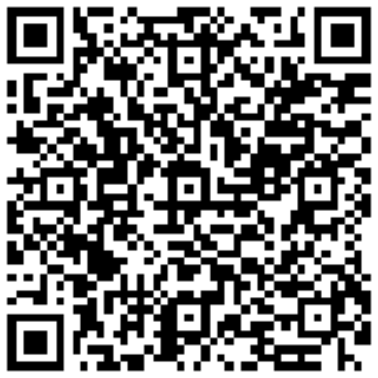
Your Speakers 4/6
Secretary General at NEREUS aisbl
Secretary General at NEREUS aisbl
Sergi Giménez
Lawyer | Partner at AUGUSTA
s.gimenez@augustaabogados.com
Sergi Giménez has extensive experience in the field of international commercial law and in advising on mergers and acquisitions. He has been advising national and international companies linked to all types of industrial activities, particularly in the aeronautical and tourism sector, for more than 30 years.
His clients include airlines, aircraft and engine owners, lessors and finance companies. He also has extensive experience in the tourism industry, advising tour operators, online travel agencies, hotel companies, cruise operators and leisure centres of all kinds.
His professional career has always been closely linked to international law, working on a recurring basis with multinational companies doing business in Spain and vice versa.

Slide 20
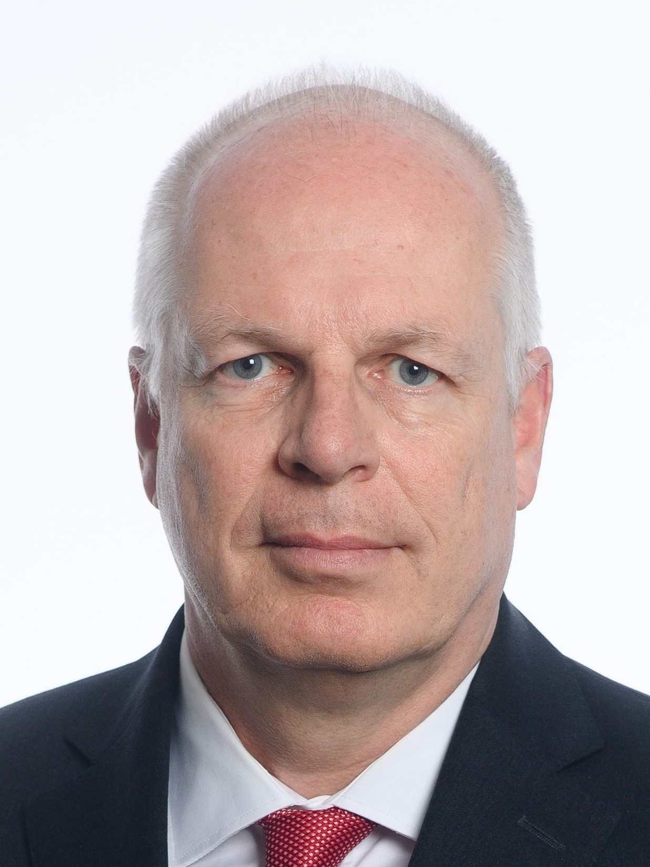
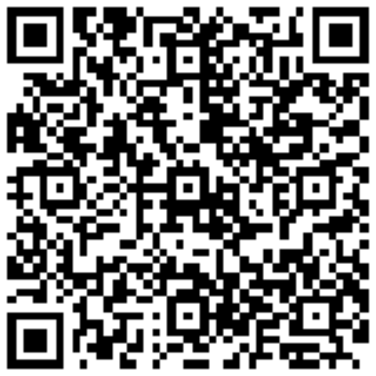
Your Speakers 5/6
Secretary General at NEREUS aisbl
Secretary General at NEREUS aisbl
Dr. Thomas Jansen
Lawyer | Partner at Heuking
t.Jansen@heuking.de
Thomas Jansen is a partner based in HEUKING’s Munich office and a member of the firm’s IP, Media and Technology practice group. Thomas has over 25 years of experience as a technology transactions lawyer. He advises German and international corporate clients across diverse industries on all kinds of technology-related matters, with a focus on providing strategic guidance in the creation, acquisition, use and commercial exploitation of technology. He also counsels clients on the intellectual property aspects of mergers, acquisitions and financings. Thomas co-chairs the focus group “NewSpace & SpaceTech” and has been advising clients on space-related issues for many years. Thomas is co-author of a series of publication regarding the draft EU Space Act published inter alia via Linkedin and is a frequent speaker and author on technology-related topics

Slide 21
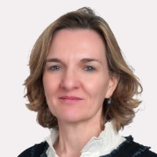
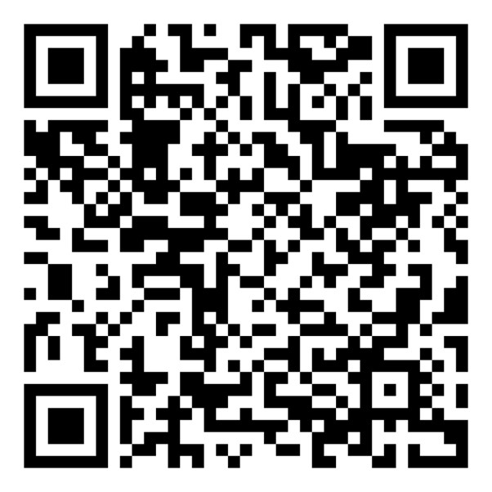
Your Speakers 6/6
Secretary General at NEREUS aisbl
Secretary General at NEREUS aisbl
Cécile Théard-Jallu
Lawyer | Partner at De Gaulle Fleurance
ctheardjallu@dgfla.com
Cécile Théard-Jallu is a partner at De Gaulle Fleurance, and a specialist in innovation and space law with a robust background in healthcare and life sciences regulations, innovative technologies, data protection, cybersecurity and IT. Cécile helps clients develop and implement innovation strategies, including telemedicine, AI, digital twins, connected devices, blockchain, metaverse, and smart cities.
A GDPR-certified adviser, Cécile represents De Gaulle Fleurance in the Cyber & Security Hub of the Systematic Paris-Region global competitiveness cluster and has been part of the EU Health Data Space as an expert appointed by the European Commission. She is part of the European Space Agency’s new working programme on the European Space Data Space.

Slide 22


