Slide 1
EU Space Act and Vision for a European Space Economy
NEREUS Webinar
10 October 2025

Slide 2
EU Space Act

Slide 3
Why an EU Space Act: Space is congested and contested
Number of rocket launches since the start of the space age in 1957: about 6 910 (excluding failures)
Number of satellites these rocket launches have placed into Earth orbit: about 21 620
Number of these still in space: about 14240, out of these about 11 700 are functioning today
Risk of collision and number of debris increased
Today: 140 Millions of space debris smaller than 1cm
Satellites are dual use by nature
Hostile activities
Hundreds of cyberattacks affecting space systems over the past decades.
Number of satellites will increase dramatically
50 000 New satellites in the next 10 years
Orbital slots in interesting orbits – Low Earth Orbit are overcrowded
1,3 Million fillings ITU
Reusable launchers and micro launchers lead to lower launch costs
Smaller satellites reduce price tag
Venture Capital funds & IT billionaires see in space higher return on investment
Vulnerability of satellite cyber attacks increases

Slide 4
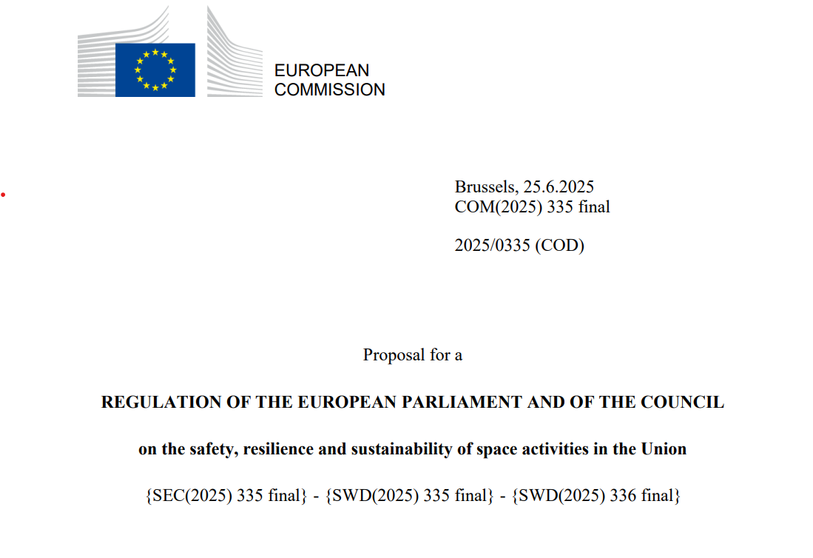
Proposal of the European Commission
Background: call for actions
The European Commission has identified the EU Space Act as a key priority, as outlined in the Draghi and Letta reports, and more recently in the Competitiveness Compass and the Commission work programme for 2025.
The need for such a legislative initiative was also reflected in two recent Joint Communications:
  the EU Approach for Space Traffic Management (2022)
  the EU Space Strategy for Security and Defence, echoing Member States’ calls for establishing, through a coherent and stable regulatory framework, an internal market for space activities (2023).

Slide 5
EU Space Act: a functioning Single Market for space
Increase competitiveness
Protect space assets
Defragmentation
Simplification/Proportionality: unified, stable and predictable legal framework
Levelling the playing field for all operators, EU and non-EU
  Safety
  Resilience / Security
  Environmental sustainability
“Space Act will safeguard and improve the functioning of the internal market (..)”
Competitiveness compass
”It is necessary to establish a greater coherence and coordination of the rules applied to space activities by all European institutional space actors, through the upcoming EU Space Law.
Letta Report

Slide 6
Feedback from industry and MS
Broad support for development of a common legal framework for safe, resilient and sustainable space activities.
3
Workshops with Member States
+40
Bilateral meetings with Member States
+300
Replies to
Targeted Stakeholder Consultation
+10
Position Papers
from Industry
4
Industry Workshops
Space industry associations (SME4SPACE, YEESS, Eurospace) recognise EUSL as a crucial tool to prevent market fragmentation.
Most respondents to the targeted consultation (79%) believe that current national space laws are not fit.
6

Slide 7
EU Space Act: Two types of topics
1
2
Horizontal elements
Title I. General provision Subject matter, Scope, Free movement, national security and definitions
Title II. Authorisation and registration: Chapter I: Authorisation of Union Space Operators Chapter II: Authorisation of union Space Operators operating Union- owned assets Chapter III: Space services providers from third countries and international organisations Chapter IV: Provision of space-based data and space services in the Union and E-traceability
Title III. Governance Chapter I: Governance in the Member States Chapter II: Governance at Union level
Title V. Equivalence decisions, international agreements and regime for international organisations
Title VI. Supportive measures
Title VII. Implementing rules
Technical requirements
Title IV. Technical rules + Annexes Chapter I: Safety and Sustainability in Space, Annexes I to VI Chapter II: Resilience of space infrastructure, Annex VII Chapter III: Environmental sustainability of space activities Chapter IV: ISOS and Annex VIII Chapter V: Orbital traffic rules
7

Slide 8









Scope: space operations in the Single Market
Scope
Space system manufacturing
Space launch
Ground segment
Space data, services and user terminals
Satcom
Earth observation
Navigation
Other sectors, SSA&STM, space resource mining, etc.
Impacted assets:
    EU
      MS assets (Commercial, civil governmental)
International organisations and third country assets providing services in the Union
Military assets excluded
Slow growth
Fast growth

Slide 9
Out of Scope
Defence and national security purposes
Temporally placed under military control
1
space objects exclusively used for defence or national security purposes, irrespective of which space services provider carries out the space activities
space objects temporarily placed for defence purposes under a military operation and control, for the duration of the respective space mission
2
Radio spectrum
Assets already launched
3
4
Authorisation / Management of radio spectrum governed by Decision 676/2002/EU, Directive (EU) 2018/1972 and Decision no 243/2012/EU
Assets launched before 1 January 2030

Slide 10
Governance: Streamlined and non-discriminatory process
MS
Status Quo: National Competent Authority, Technical Bodies (National, ESA or EUSPA levels)
EU
Europeanisation: EU Space Agency + Technical Bodies
Assets
3rd countries
EU Space Agency, or alternatively equivalence - and future mutual recognition agreements
International organisation
Need to have an international agreement and specificity of ESA

Slide 11
A set of « rules of the road »
1
2
3
Safety
Resilience
Sustainability
Space is congested
Space is contested
Earth and space are polluted
Collision avoidance services
Trackability
Debris mitigation plans
Coordination: air traffic/maritime authorities
Risk Assessment
Key Risk Management Measures:
  Detection
  Protection
  Business Continuity
  Supply Chain Measures
Building on NIS 2 Directive
Environmental Footprint Declaration
Calculation rules of environmental impacts
Common database to use for calculation data

Slide 12











Supportive measures for industry (SMEs and Mid-Cap) + MS
Supporting operators in their dossier preparation
Funding R&I: Develop new technological solutions
Access to testing facilities
Digital portal to facilitate applications
Standards
Mentoring and coaching
Capacity building via guidelines
Technical support instrument (for MS)
Exchange of best practices
Labels

Slide 13
Vision for a European Space Economy

Slide 14
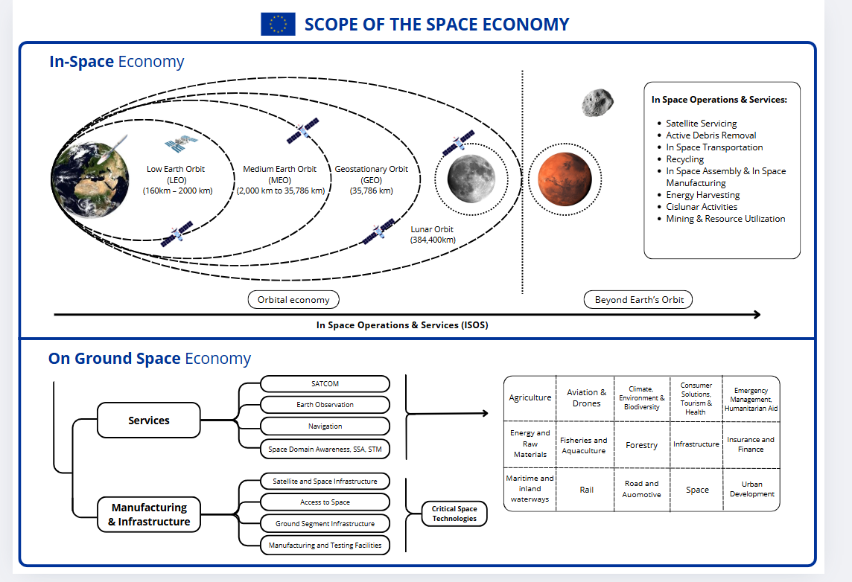
What is the Space Economy?
The Space Economy encompasses all economic activities, both on Earth and in space, enabled by space-related technologies, services, and infrastructure.
Notes:
First time the commission looks at the entire space economy, focusing on the development of space infrastructure and space services, aiming to integrate space-based services across all sectors of the economy
First time for the Commission to include emerging orbital and beyond Earth’s orbit economy

Slide 15
Why a vision for the European Space Economy
Supporting facts
The space sector’s contribution to the global economy is expanding rapidly and significantly.
Space-based data, products and services have become indispensable across nearly all sectors of the economy, including defence, agriculture, transport and logistics, energy, insurance and finance, urban development, information technology, climate and the environment).
The space sector is expected to grow ninefold by 2030 [Competitiveness Compass], with the global space economy expected to reach EUR 1.6 trillion by 2035, up from EUR 560 billion in 2023
Despite this growth, the full economic potential of the EU space sector remains largely untapped.
“A space revolution is coming. The 21st century will be the century of space. Europe needs to be at the forefront.”
Andrius Kubilius, Commissioner for Defence and Space

Slide 16
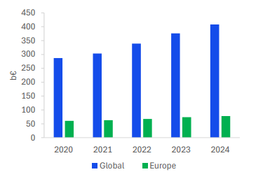
Objectives of the European Space Economy Communication
To position the EU as a leader in the global space economy by 2050, leveraging space technologies and services on Earth and in space to strengthen the EU’s competitiveness, resilience, security and autonomy.
Opportunities: EU market growth in Upstream & Downstream sectors
Challenges: significant market share loss, low public and private investment
Europe’s share of global Upstream Market value (€3.78B)
Downstream space market value, 2020 - 2024
Global Value: € 63B
Infrastructure & Manufacturing
6%
Launch
Europe’s share of global Downstream Market value (€ 78B)
Global Value: € 408B
Satcom
19%
Navigation
Earth Observation
Source: ESA Report on the Space Economy 2025

Slide 17








Paving the way for EU competitiveness – 6 Building blocks
Simplification
EU Space Act
Critical space technologies & raw materials
Reinforce support to ‘space’ R&I
Single Market for Space
Accelerating Research & Innovation
Industrial readiness and technological non-dependence
Funding, Scaling, Market access
Develop skills & talent
Public procurement
Supporting space commercialization
Skilled workforce
Promoting international cooperation and economic diplomacy
Bilateral summits, space dialogues & non-EU procurement opportunities

Slide 18

3 priorities for European leadership in Space Economy
2
Strengthen EU space upstream (manufacturing) and downstream (space services)
Support the development of satellite constellations, launchers, robotics and ground hardware;
Strengthen space derived products and services, improving uptake of space-based solutions across various sectors
3
Capture the In-space Economy
Encourage the development of emerging ‘in-space’ activities, including: ‘In space Operations and Services’ (ISOS); active debris removal, satellite life extension and repair, recycling, in- space assembly and manufacturing, energy harvesting. Eventually extending activities to beyond Earth’s orbit: supporting EU space industry in lunar exploration, mining and resource utilization
1
Tackle key challenges that hinder EU space sector growth through six building blocks
These include limited funding, restrictive procurement, slow time to market, and fragmentation.
“Entire economic sectors and essential services depend on the resilience of our digital, transport and space infrastructure.” [Competitiveness Compass]
“Space is a New Frontier. Materially and politically, we need to be in space. (…). This means European leadership and presence in orbital, cislunar or lunar economy. This means working together. Resisting fragmentation.”
Andrius Kubilius, Commissioner for Defence and Space

Slide 19
Make it happen
The Commission will develop a dedicated methodology to monitor the EU’s competitiveness in space and the EU’s share of the global space economy
The Commission will establish a ‘Space Team Europe’, a high-level forum bringing together all European Space Stakeholders to prepare an EU Space Master Plan
The EU Competitiveness Coordination Tool, which ensures coordination of EU and national policies, will include space in the selected key areas that are deemed of strategic importance

Slide 20
Space in the European Competitiveness Fund

Slide 21
Why ECF
NOW
NOW
NOW
Limited coordinated strategic focus
Untapped potential to mobilise private capital
Lack of funding continuity on investment journey
FUTURE
FUTURE
FUTURE
  Focus on a set of commonly agreed strategic funding priorities
  Predictability, while ensuring flexibility to adapt to new emerging priorities
  Mobilise the full financial toolbox (grants, loans, equity and procurement)
  Improve access to funding for scaling up companies and projects
Accompany projects along the entire investment journey (from research up until manufacturing and deployment), support entire value chains (from critical raw material until final products)

Slide 22
ECF structure and budget
Resilience and Security, Defence Industry, and Space
Clean Transition and Industrial Decarbonisation
Health, Biotech, Agriculture, and Bioeconomy
Digital Leadership
€125,2 Bn
€26,2 Bn
€20,4 Bn
€51,5 Bn
ECF InvestEU Instrument
Project Advisory, SME Collaboration, and Skills
€11 Bn
Support for Defence Industry Policy
Space Systems and Space Policy Implementation
  Proposed Budget Allocation Over Period 2028-2034 ECF + Horizon Europe
  131€ billion
Support for Security Industry Policy
Support for Resilience Policy
2

Slide 23
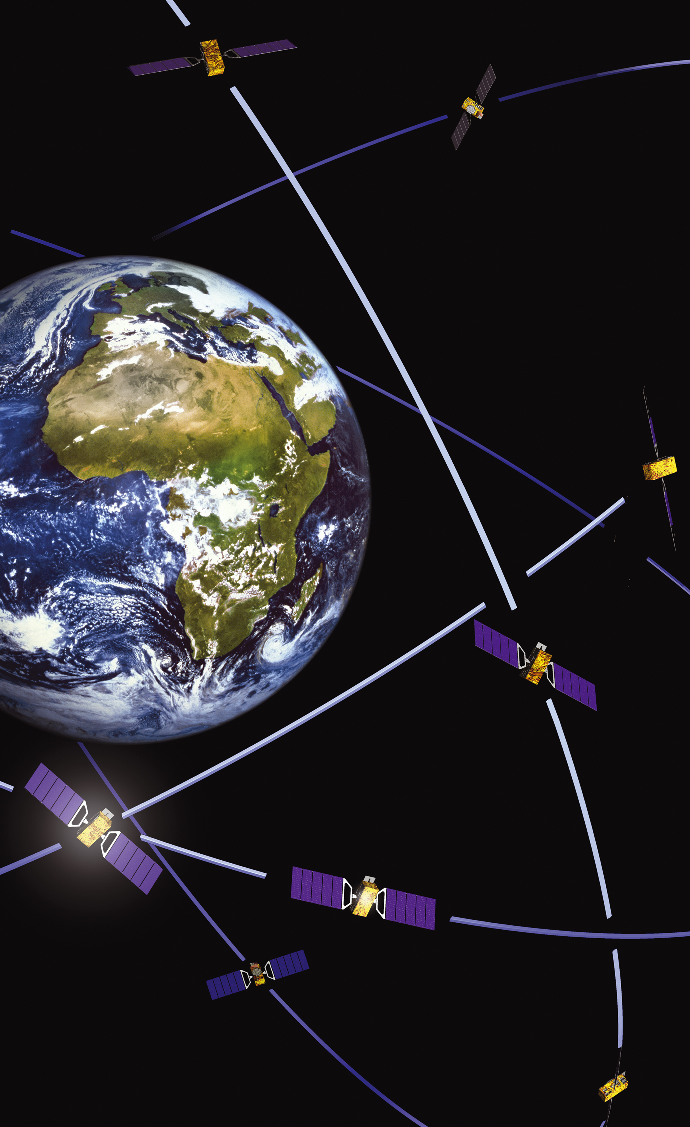



Evolutionary Approach
Continuity and enhancing existing space components
PNT
Galileo &
EGNOS &
LEOPNT
EO
Copernicus & EOGS
Secure Connectivity
IRIS2 & GOVSATCOM
SSA
SST, SWT
& NEO
New Components
Space Commercialization and Space Economy
Technological Sovereignty, Research, and Innovation
  Building on the CASSINI initiative
  Developing critical space technologies for EU non-dependence
Access to Space
  Aggregating demand, upgrading ground systems and infrastructures

Slide 24


Governance & Rules
Continuation of successful governance structure (EUSPA and ESA)
Complementary rules to preserve the security, integrity, and resilience
Eligibility and Participation
Grants
Procurement

Slide 25
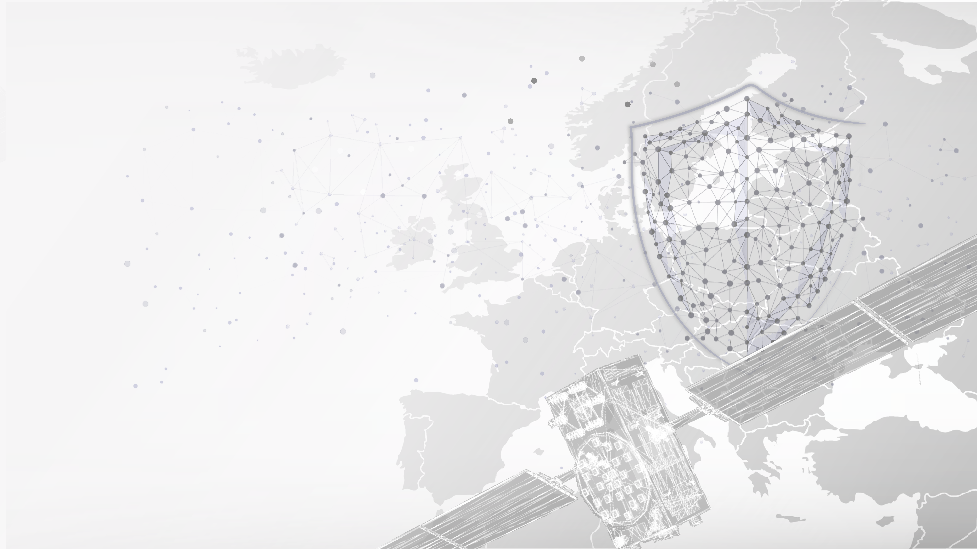
THANK YOU

