Slide 1
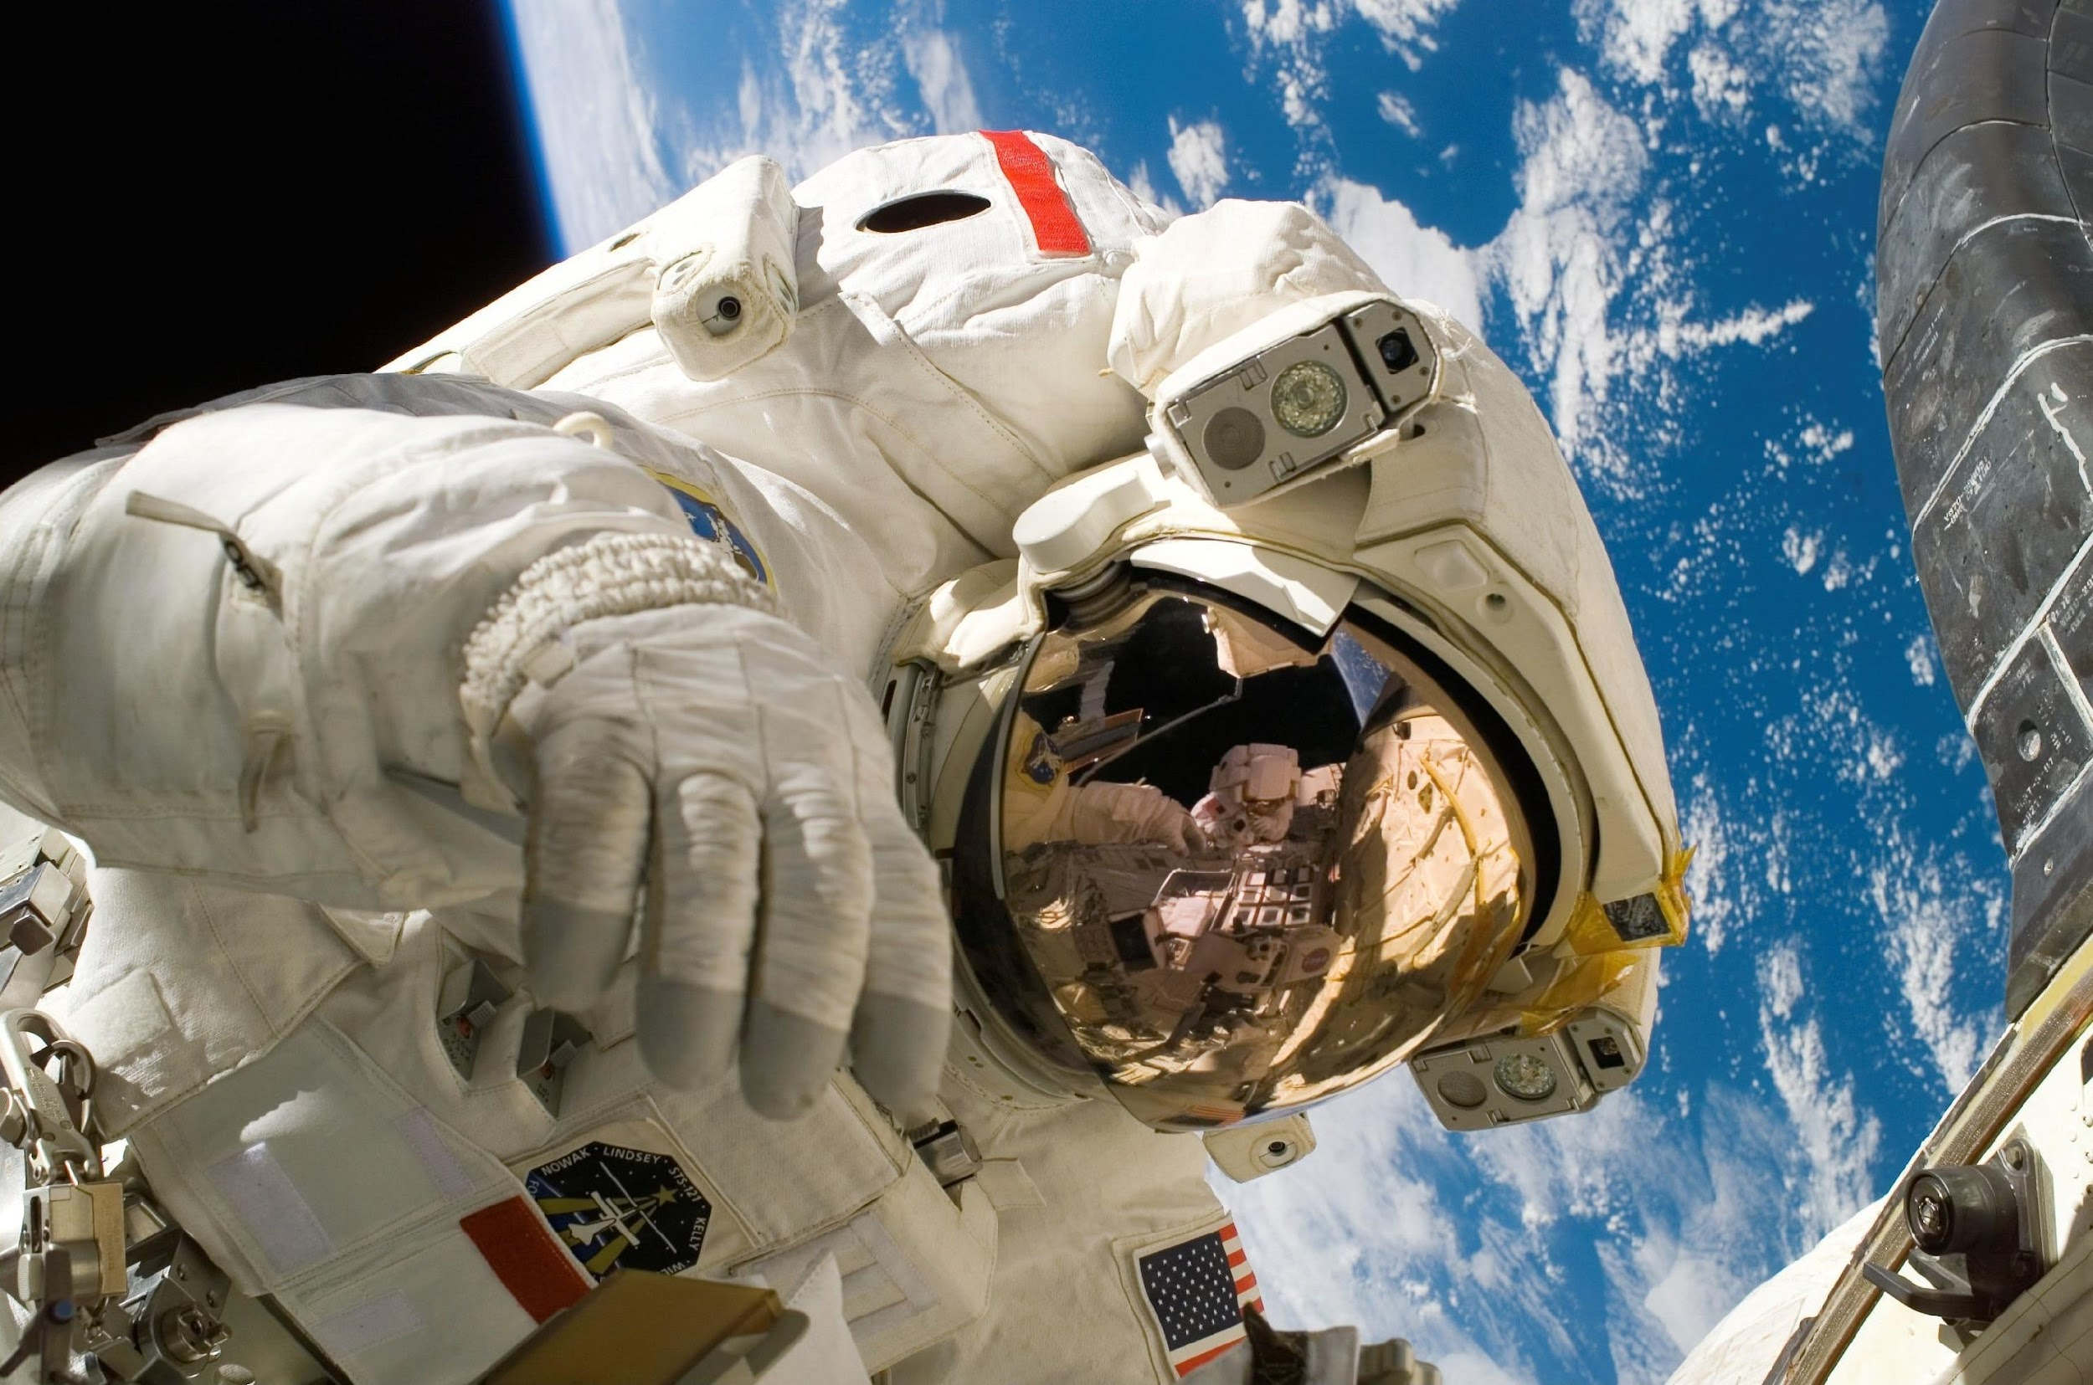



BUILDING BRIDGES: BADEN-WÜRTTEMBERG’S SCIENCE COMMUNITY MEETS NEREUS
24/11/2025
Adriano Gilli – Regione Emilia-Romagna
Head of the Attractiveness, Internationalisation, Research Sector
May 22nd, 2023

Slide 2
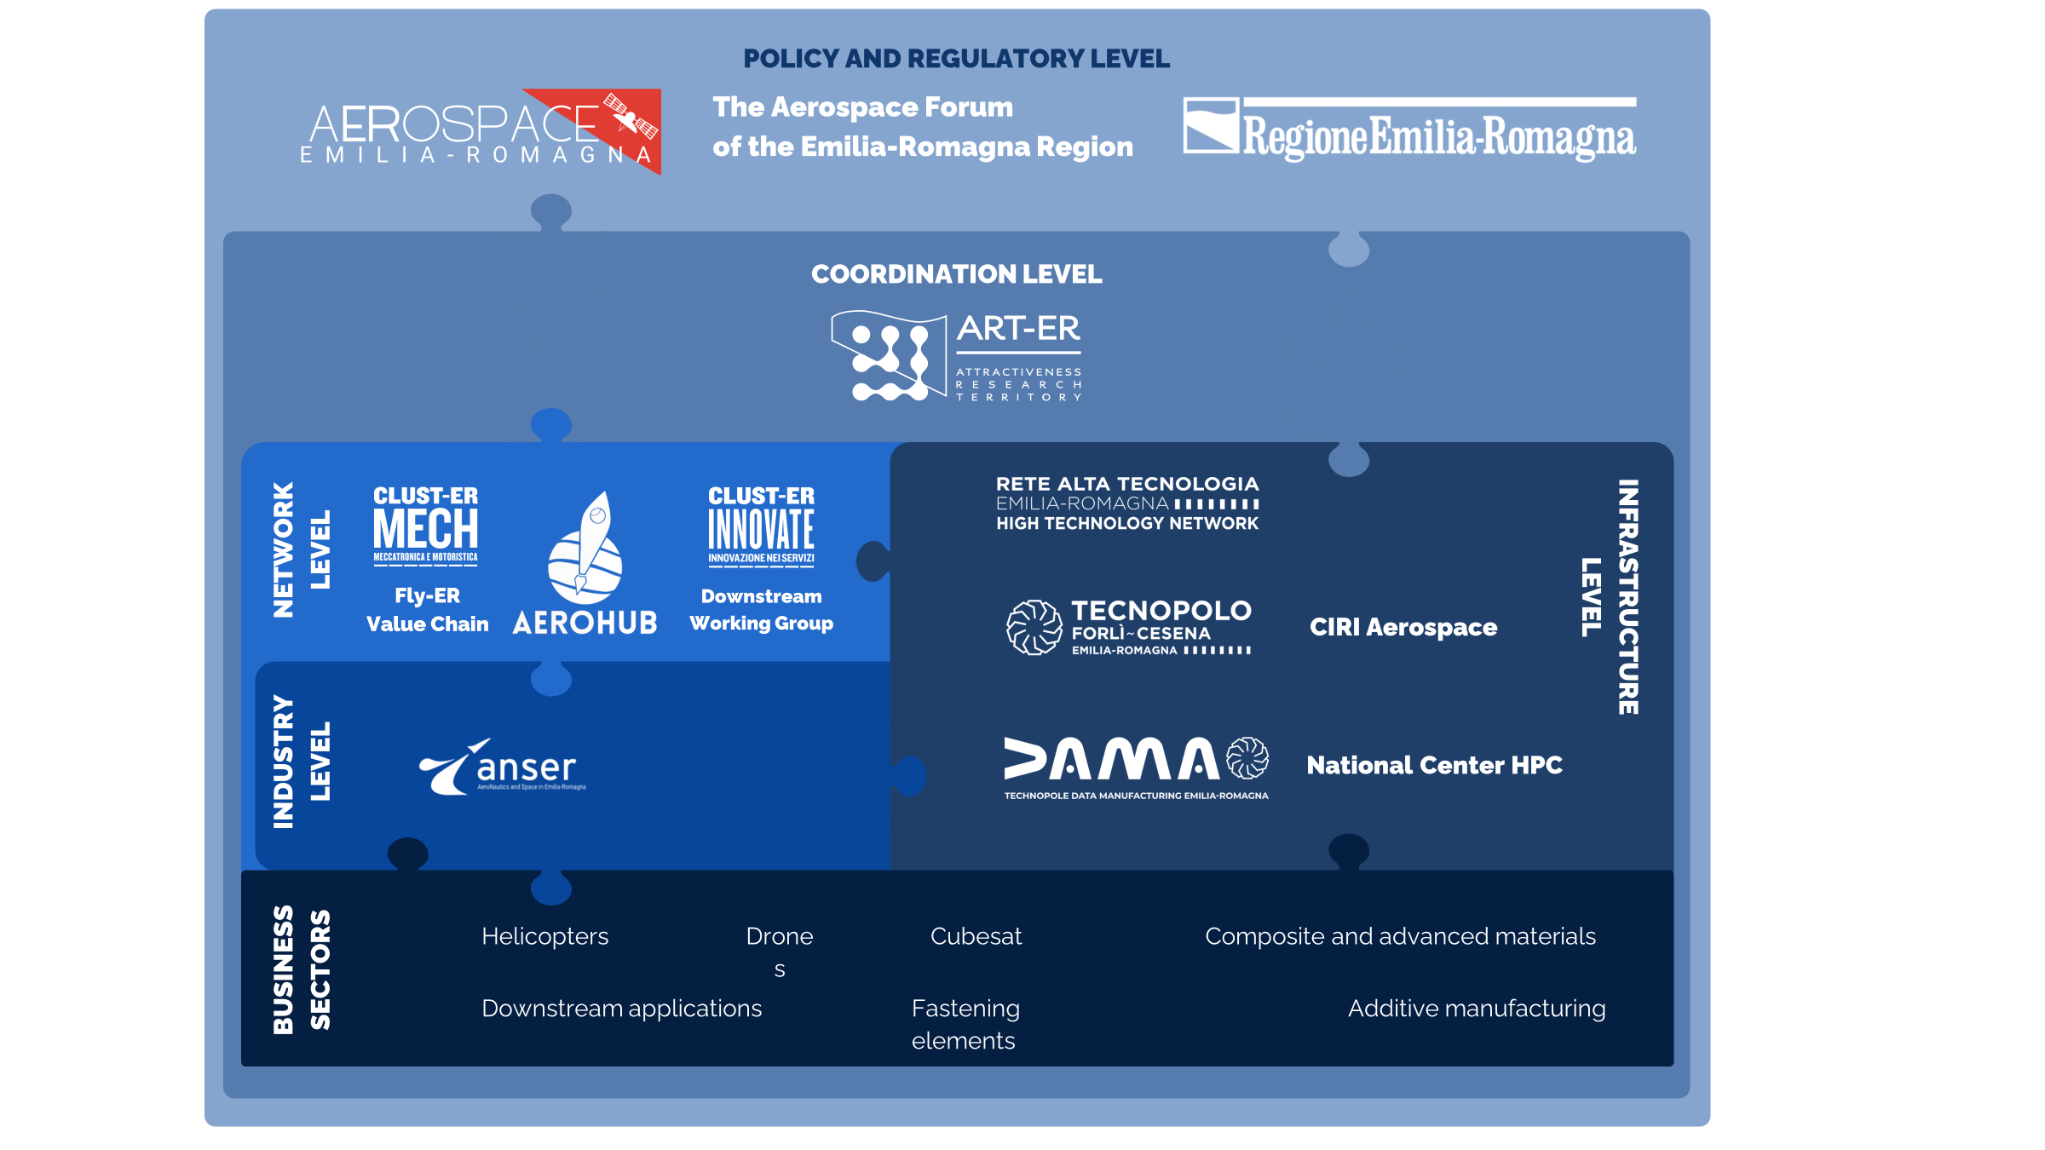
The Innovation & Aerospace Ecosystem structure

Slide 3


Slide 4
DAMA Technopole, Bologna – Location of Leonardo HPC, the AI Factory, ECMWF and soon the University of the United Nations

Slide 5
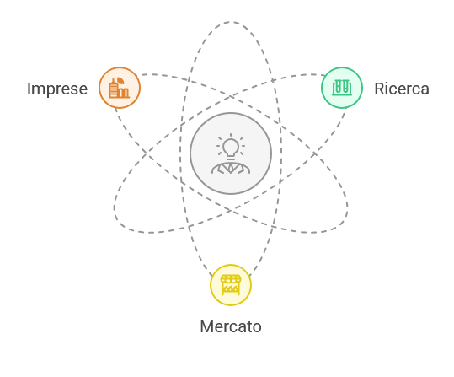

The challenge of the Regional ecosystem construction
Market/Business/Research
* R.ER facilitates dialogue to increase the meeting of demand (market) and offer (companies)
* R.ER supports research, to enhance the development of products and services, capable of responding to demand - on the business side - and scientific validation of the same (on the market side).
Notes:
Commentare l'immagine a voce parlando delle 7 factory finanziate a livello europeo.

Slide 6
Important meeting and networking opportunities
In consideration of the strong overlap with BW’s key sectors, we invite BW to join us at:
Research to Business Italy, June 2026 – a national project of collaboration between E-R and the Conference of Italian Regions, where the worlds of research and companies meet.
23-25 September 2026 : Beyond Exploration, Rimini Exhibition Centre:
the first event in Emilia-Romagna focusing on the space economy, with an international focus
22-23 October 2026: Nereus Annual Symposium, Bologna – DAMA Technopole
Main theme: “Space in Emilia-Romagna: Data Valleys and AI Factories for the
progress of Earth Sciences and Services".
Focus on Artificial Intelligence (AI), High Performance Computing (HPC) and Data Management to guide the process of Earth Observation
Notes:
Commentare l'immagine a voce parlando delle 7 factory finanziate a livello europeo.

Slide 7
info.aerospace@art-er.it

