Slide 1


Presentation of the NEREUS network
By Roya Ayazi, Secretary General &
Margarita Chrysaki, Comm/Project/Policy officer

Slide 2
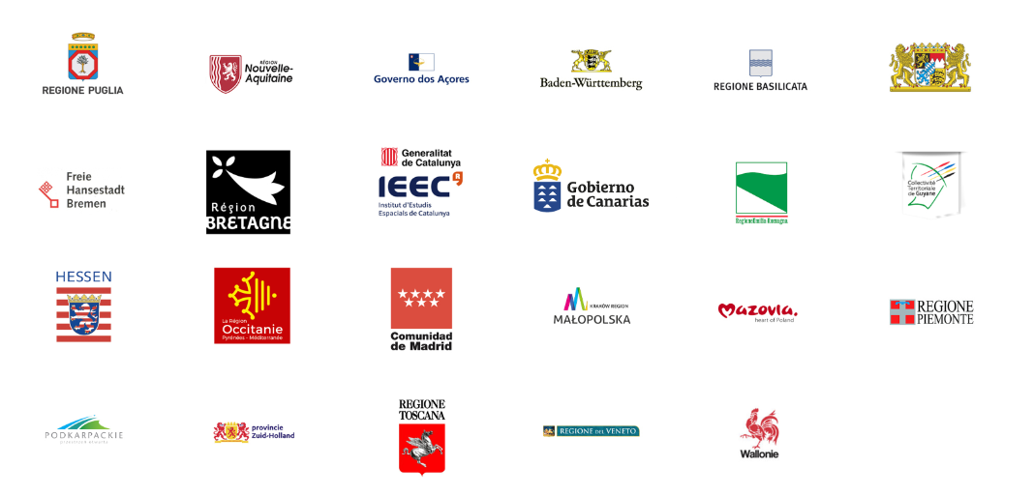

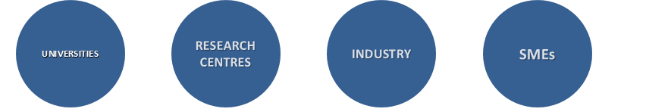
23 European Regions and
38 Associated Partners
ADVOCACY / POLITICAL
DIALOGUE
INTERREGIONAL
CO-OPERATIONS, PARTNERSHIPS and NETWORKING
NEW TRENDS /
PUBLIC
OUTREACH
Notes:
NEREUS addresses all actors present in a regional ecosystem: Research, Business, Industry, SME, Administration, Politics
Three main columns of NEREUS activities are:
Advocacy/Political Dialogue
Interregional Collaboration and Partnership
New Trends/Public Outreach

Slide 3
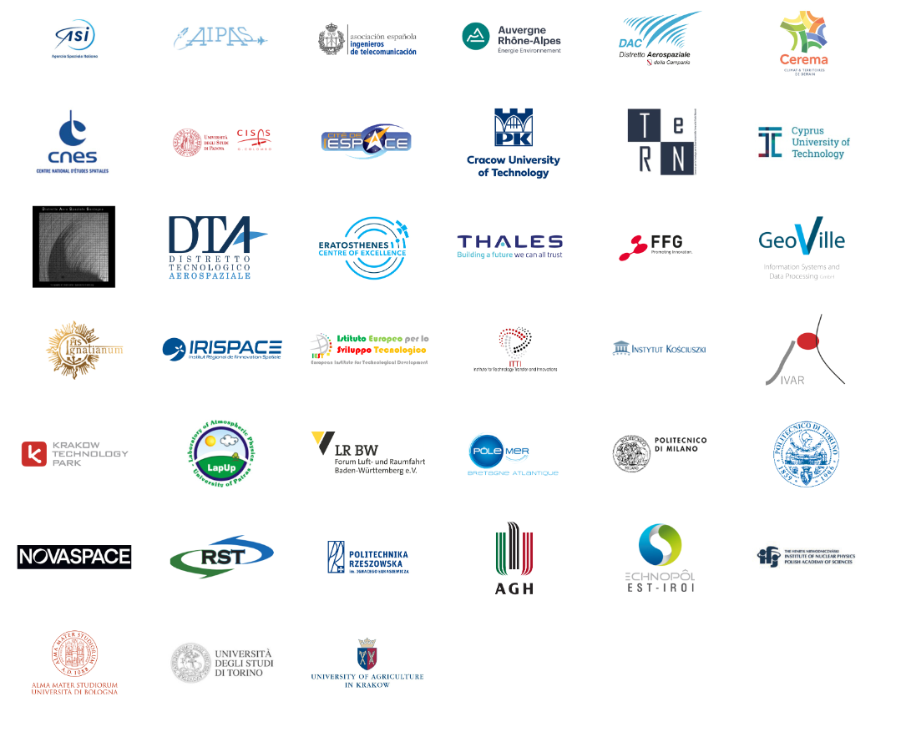
Associate Members
20 out 38 members are universities/ research centres!

Slide 4
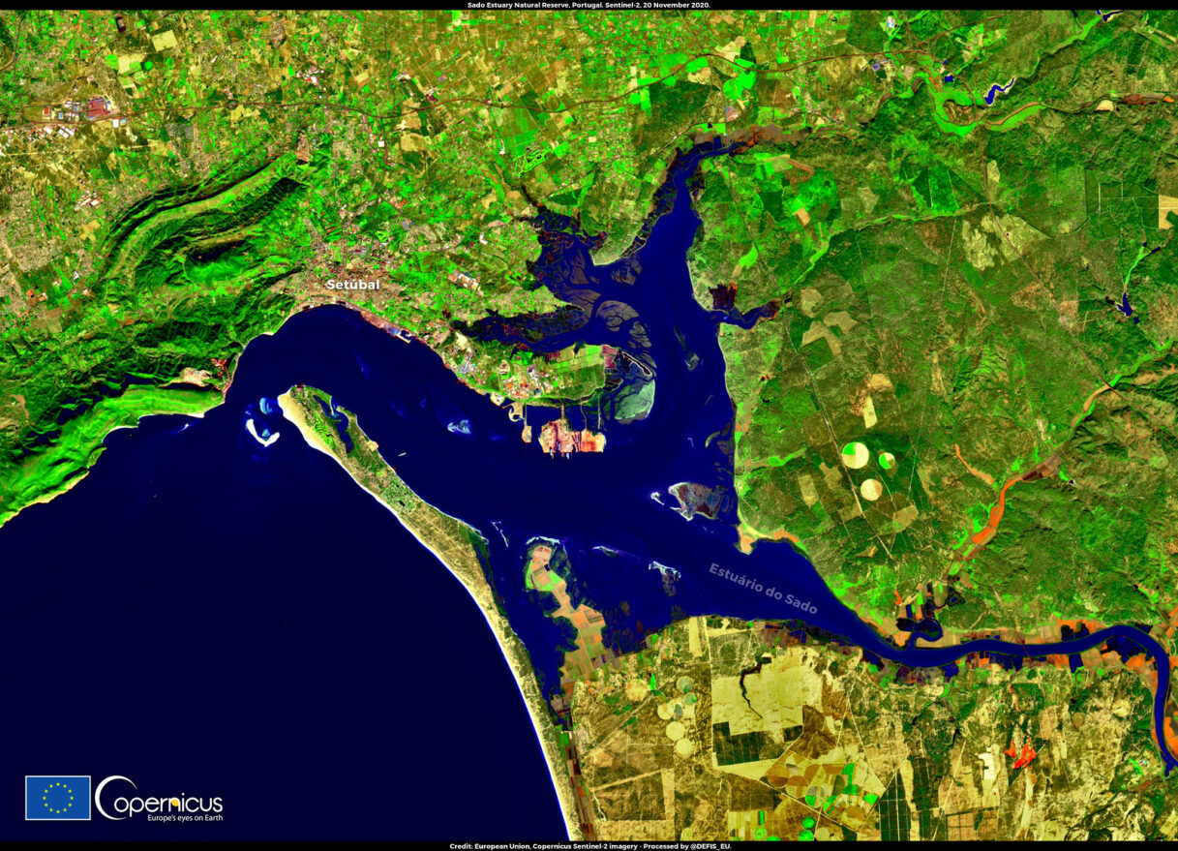

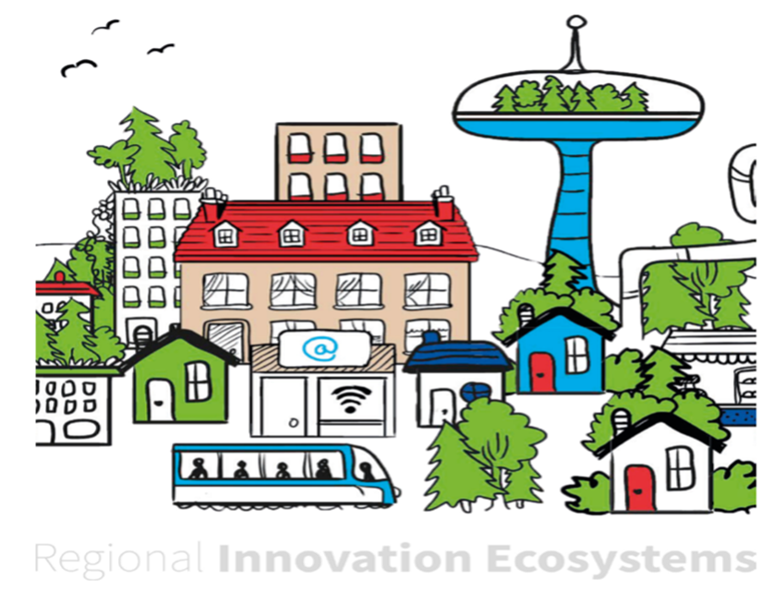
NEREUS is about
using Space
Credit: Copernicus
Useful Information for public authorities, people, companies and organisations
Copernicus = 16 terabytes of high-quality data / day
Better informed
and sustainable
policy-making
Bringing Copernicus to regional Ecosystems
Credit: Committee of the Regions
Notes:
Image : The wetland of Estuário do Sado, in Portugal, where scientists tested a numerical model based on Copernicus data to assess the impact of climate change on aquaculture site selection.
Grasping satellite data and turning it into useful information for better and more informed decision-making and innovating delivery of public policies
Although “data is the new gold”, the reality is, however, that translating data into useful information to be used by citizens, companies and administrations, is still a great challenge. Much needs to be done to facilitate data access, management and processing to overcome policy barriers, governance difficulties, technical issues as well as a lack of skills and awareness.
By providing a dynamic platform, the Network raises awareness of the benefits offered by space and helps all regions and their citizens to avail of these. Therefore, it is expected to (i) serve as a forum to facilitate this translation process and to promote a broad uptake across Europe, and (ii) to ensure that upstream systems evolve to better serve the needs of the downstream users.

Slide 5
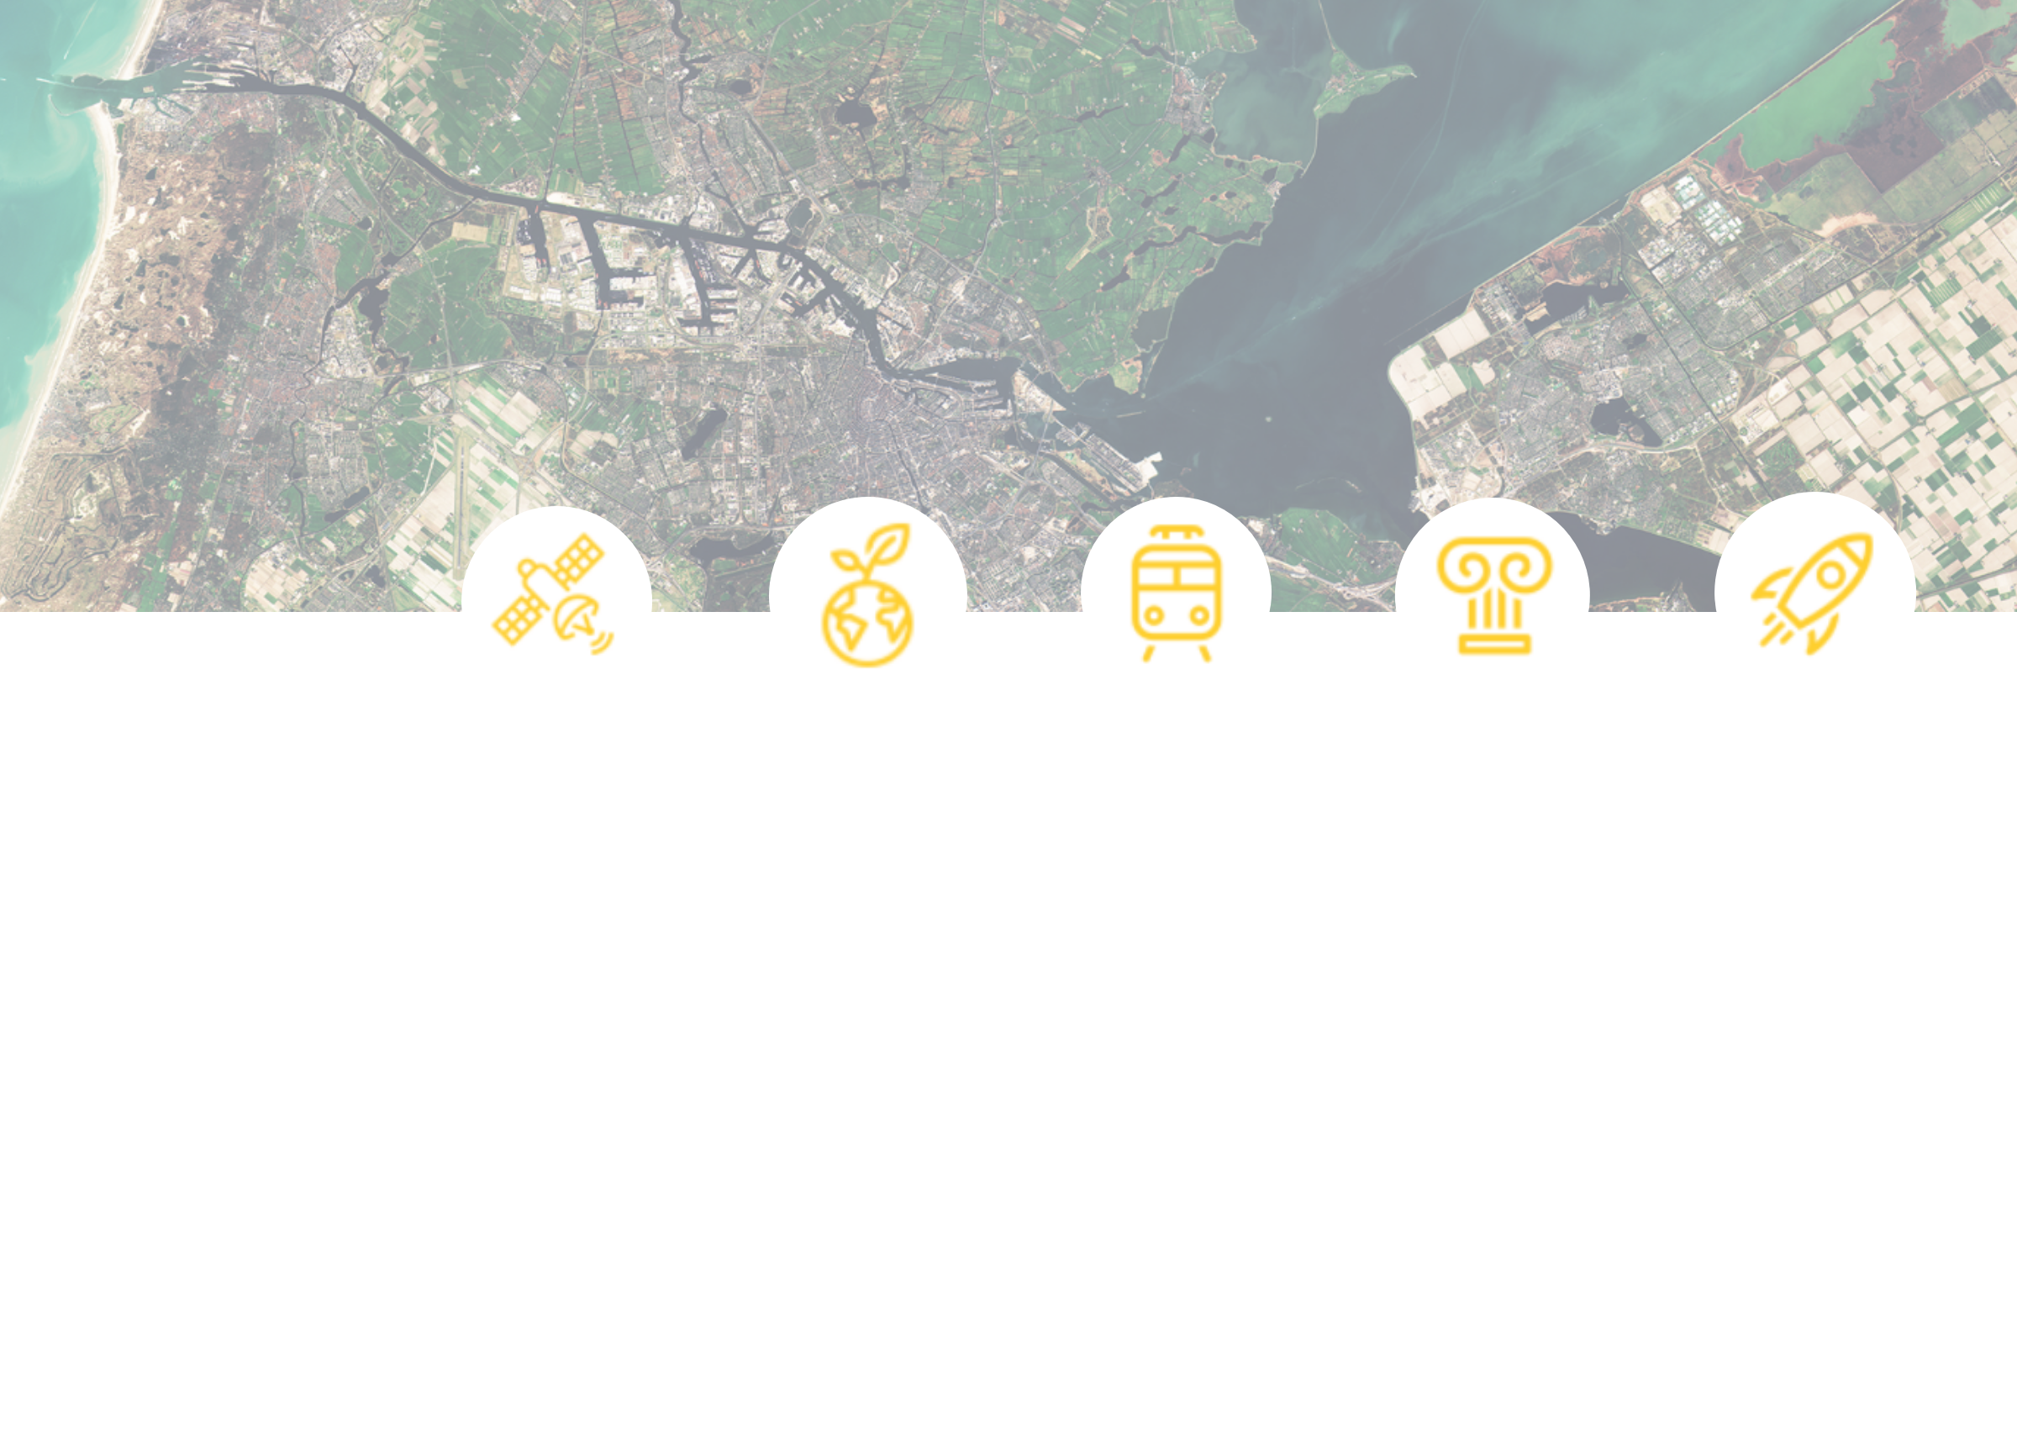

A JOINT PLATFORM TO:
Highlight the regional dimension of European space policy
and programmes
Build partnerships and networks at a European scale
Facilitate the involvement in EU/ESA-funded activities
Enhance cross-sectorial exchanges among operators
Access crucial information in advance
Develop joint positions as European users of space technologies, voice them, and provide enhanced visibility of regions at the European level
What does NEREUS offer its members ?

Slide 6
Monitoring relevant EU policy developments and advocating towards the European institutions
Providing regions a joint platform to define common positions and advocate them
Advocating regional dimension of space
Giving regions more visibility as active player of the space community towards strategic partners (European Commission, European Parliament, Committee of the Regions, European Space Agency (ESA))
Political Dialogue/ Strategic
Partnerships

Slide 7

European Commission
European Space Agency
European Commission
Strategic Partners
European Parliament
NEREUS
NEREUS
NEREUS
Committee of the Regions
National Space Agencies
Notes:
Key interlocutors and Strategic Partners to advocate matters of regional space uses

Slide 8
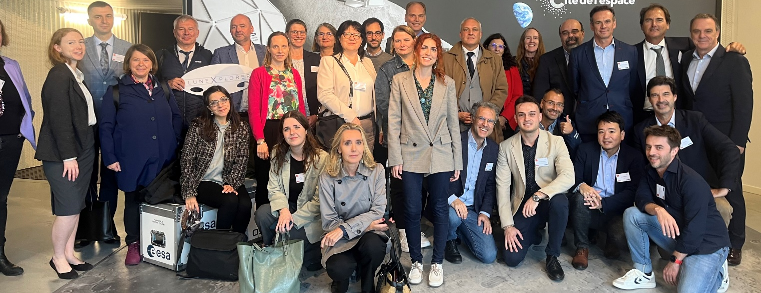
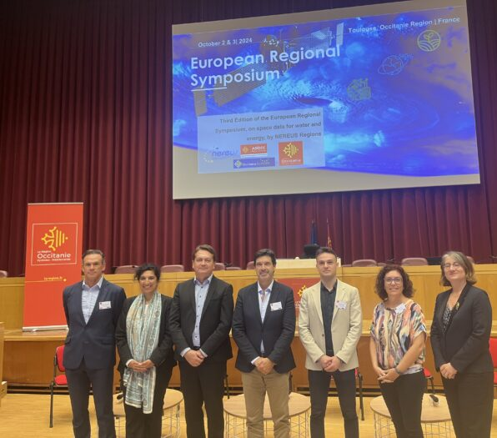
Positioning the network
Response to the EC consultation with a view to a
European Water Resilience Strategy
3rd edition European Symposium by NEREUS Regions on Space Data for Water & Energy, 2-3 October 2024, Toulouse/Occitanie
Water is a priority for many regions – more than 12 Best Practices

Slide 9
Positioning the network
(4)
Response to the EC consultation with a view to a
European Water Resilience Strategy
NEREUS Position submitted /Position paper available on website
Objective of European Water Resilience Strategy:
  make Europe water-resilient, ensuring that water sources are properly managed and scarcity is addressed
  strengthen the competitiveness and innovative edge of our water industry and take a circular economy approach.
Consultation covered Water Resilience and Water Efficiency
More information here: https://ec.europa.eu/info/law/better-regulation/have-your-say/initiatives/14491-European-Water-Resilience-Strategy_en

Slide 10
INTERREGIONAL
CO-OPERRATIONS, PARTNERSHIPS and NETWORKING
Mobilising EU/ESA-funded projects
Notes:
Second pillar Interregional collaborations and networking comprises a broad range of activities, key is the mobilization of EU/ESA-funded model projects (e.g. Horizon2020, COSME, Framework Contracts etc.)
With the European Space Agency (ESA) NEREUS has a long term partnership to promote the European Earth Observation Program at regional level;
NEREUS strives to realizes a strong presence in the regions and to contribute to building regional space communities. To this end NEREUS organizes in Member regions with network partner European Workshops

Slide 11

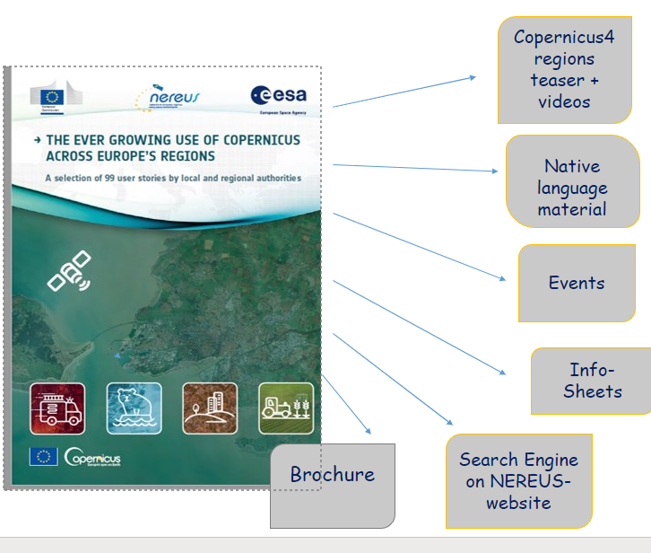
Making situation and needs at regional level more transparent
Enhancing regional cooperations/
partnerships
EO4GEO
  Flagship initiative Copernicus4Regions
Bridging service provider and public users
Community building
Developing strong advocacy tools for promoting the regional dimension
Notes:
With our flagship initiative we have concrete examples of how space can be useful
TCopernicus4Regions objective is to make more transparent
ln order to bring regions and its stakeholders together with the objective to adapt Space-based solutions to common problems and foster their use in new domains, NEREUS commits to intensify networking, building partnerships, fostering dialogue and knowledge exchange as well as stimulating cooperation within and between regions and bring new members to the Network. Linking the Space community with other user communities and associations is vital in this process. Over the past year, the Network has increased its presence in European projects with the aim of promoting regional space uses and reinforcing the regional dimension in European space policies and programmes.

Slide 12

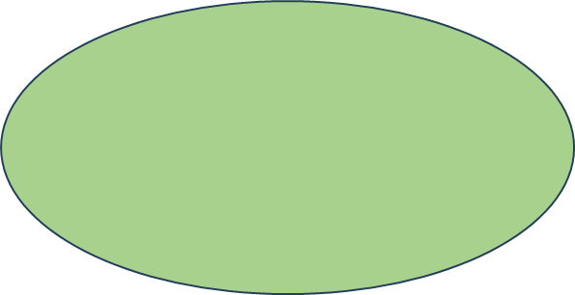
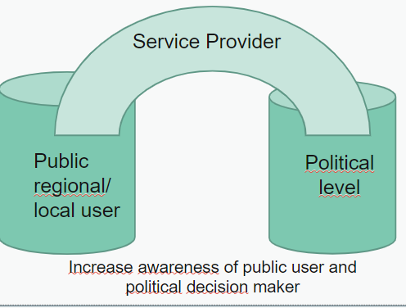
Copernicus4regions –
An initaitive how interregional best practice and knowledge sharing contributes to space capacity building​
36 New User Stories
Copernicus4regions
2023 – 2027 moves forward
Azores, Veneto, Apulia, Bavaria, Mazovia, Catalonia, Podkarpackie, Tuscany, Wallonia,
We need more peer reviewers
Volunteers welcome!
All info
https://www.nereus-regions.eu/copernicus4regions/
Copernicus4regions Parliament Debate
04th December 2025

Slide 13

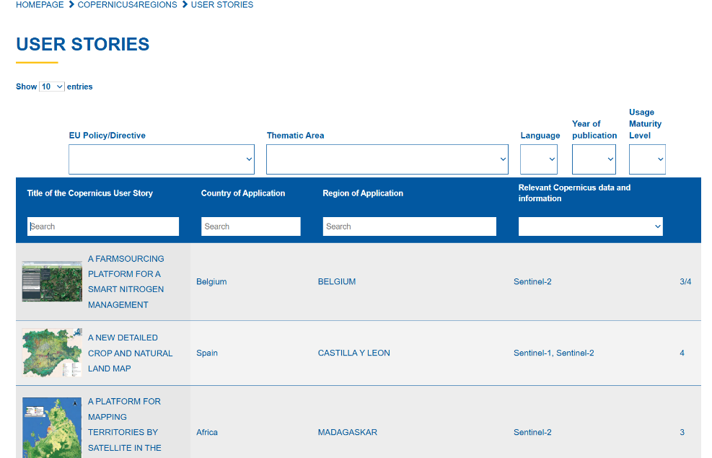
Part of a peer-reviewed collection of outstanding EO stories inventory managed by NEREUS
Copernicus4regions
https://www.nereus-regions.eu/copernicus4regions/2024-user-stories-2/
Notes:
https://www.nereus-regions.eu/copernicus4regions/

Slide 14
What is the added value of Copernicus4regions for regional and local players?
Information and knowledge sharing for the practical value of Copernicus on the local and regional levels;
Copernicus4regions authors and public authorities that contributed user stories are part of a comprehensive collection including universities and research centres!
User stories are presented during a festive event in the European Parliament and authors and users take the floor to share and discuss their experiences with the political and institutional levels;
Copernicus4
regions

Slide 15


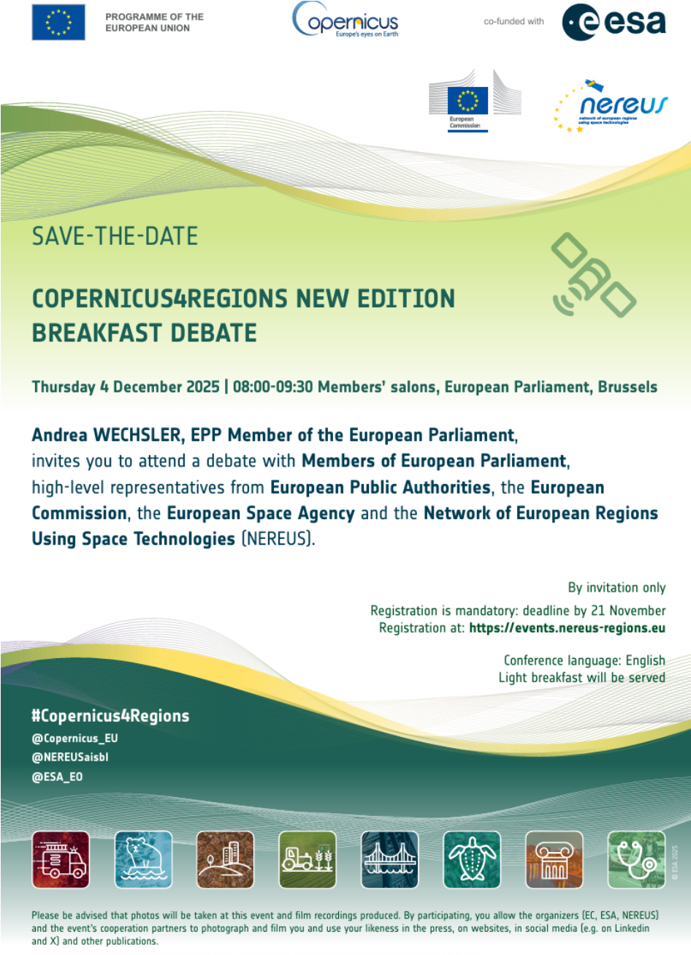
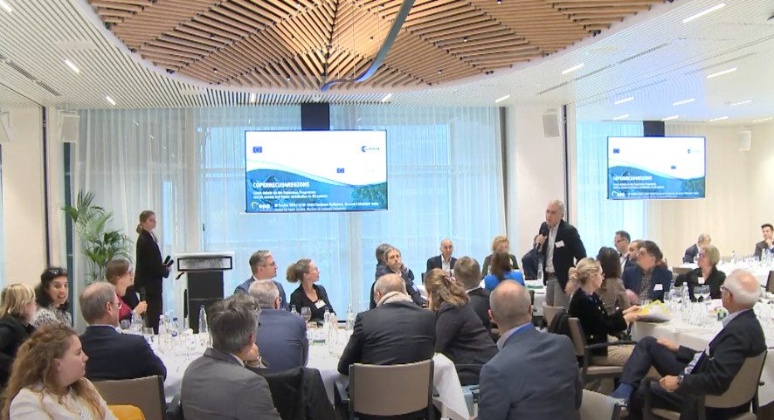
Thomas Wolf
Copernicus4regions Breakfast Debate 4 December 2025
Thomas Wolf
Thomas Wolf on behalf of BADEN-WÜRTTEMBERG
is one of the invited speakers.
Copernicus4
regions
2023 Breakfast Debate

Slide 16
What is the added value of Copernicus4regions for regional and local players?​
Videos on selected user experiences (soon for BADEN-WÜRTTEMBERG)
Application domains and topics with high relevance for the regional and local levels are selected for webinars
Illustrative information and promotion material
Local and regional users get more European visibility
Initaitive contributed to stimulating interregional cooperation (e.g. INTERREG)
Copernicus4
Regions (optional)

Slide 17
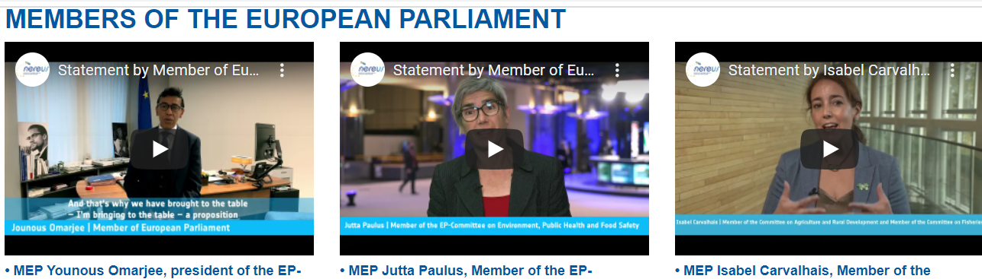
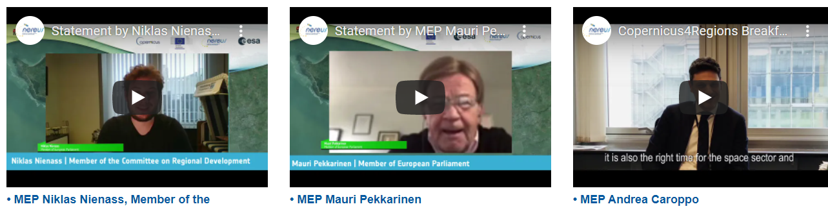
Copernicus4regions
Webinar series
3

Slide 18
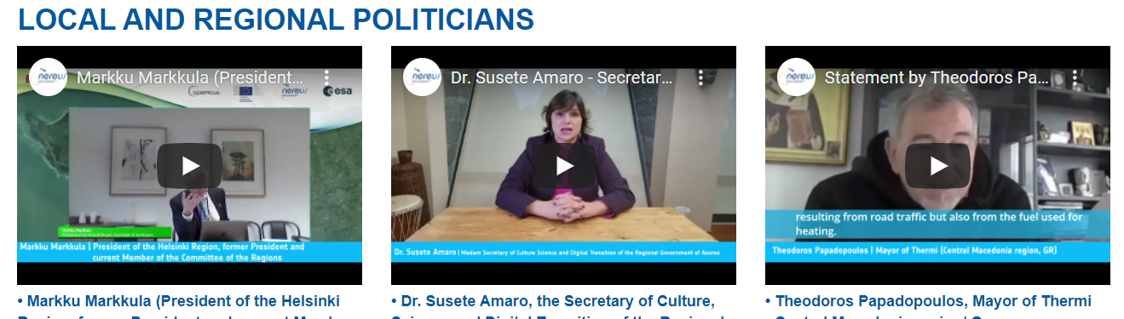
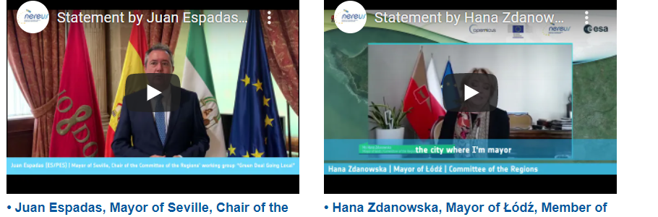
Copernicus4regions
Webinar series
4

Slide 19

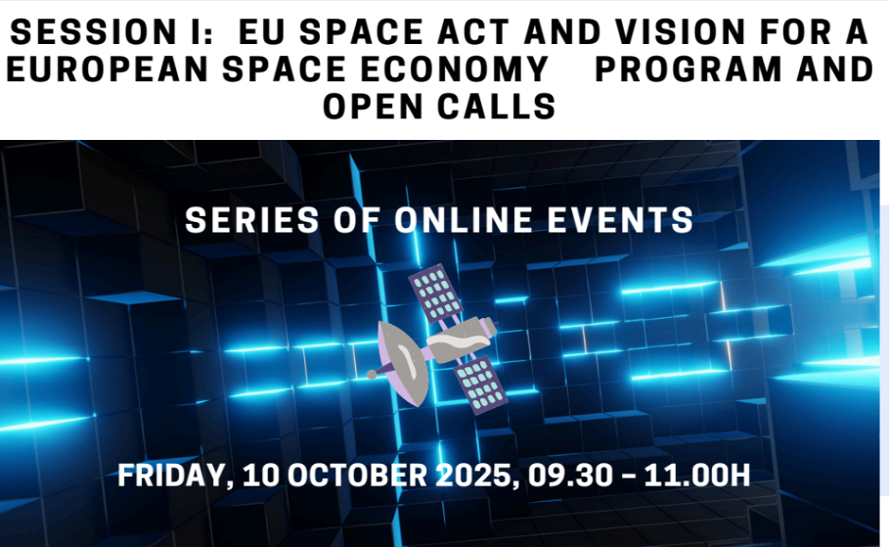
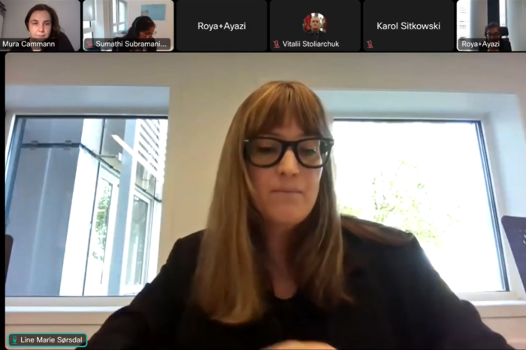
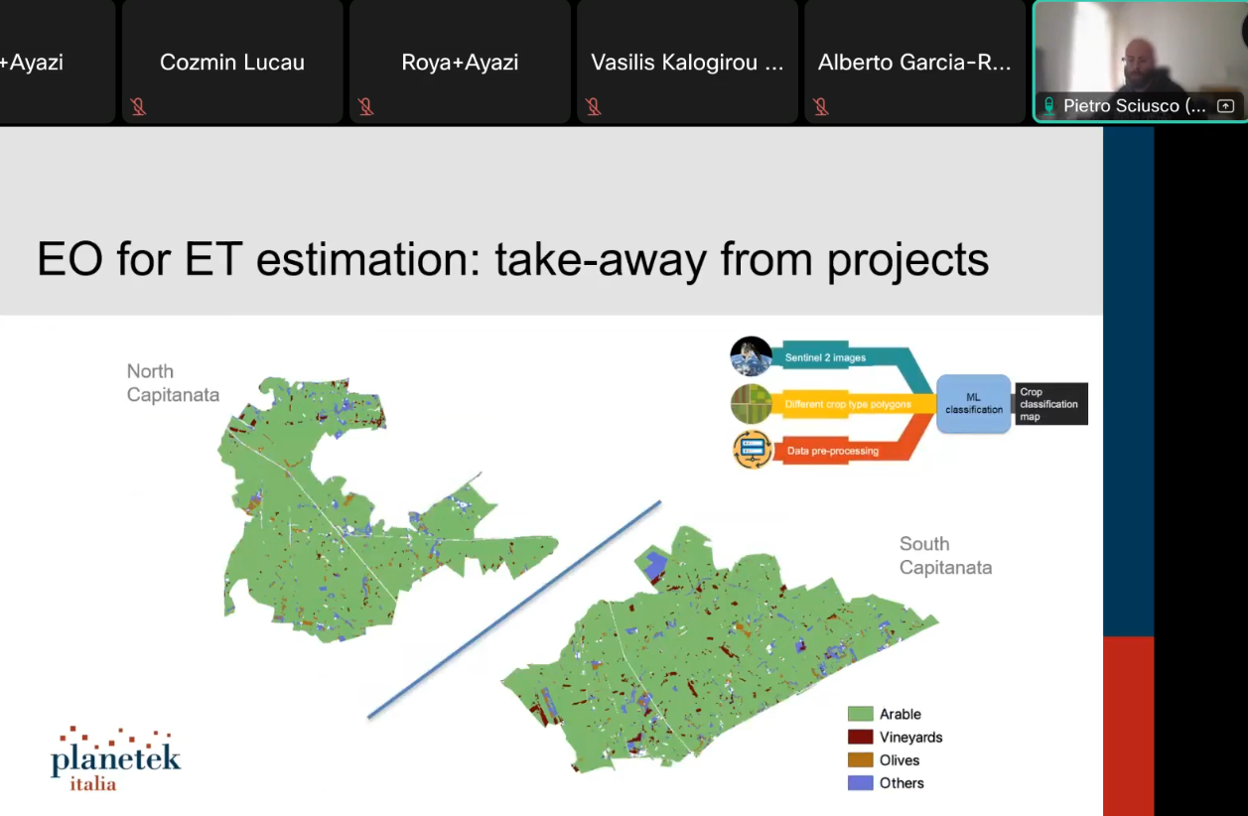

NEREUS has hosted a dynamic series of webinars showcasing how space technologies support sustainable tourism, energy, health, agriculture and civil security, and underscore the growing importance of cross-border collaboration in leveraging space innovation for societal impact. Research/scientific contribution is highlighted during these webinars.
Application domains

Slide 20
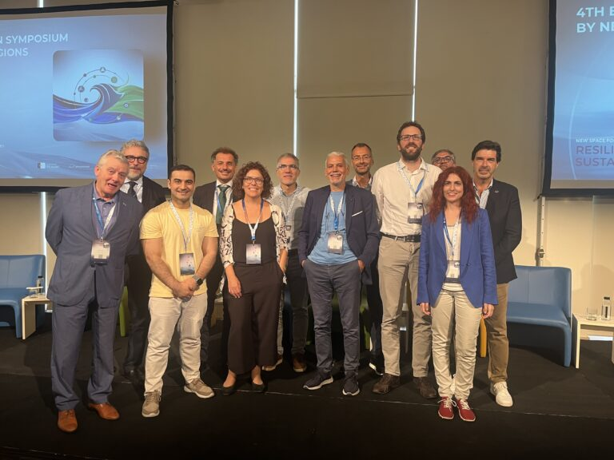
The NEREUS Earth Observation Working Group, is a group of scientific regional experts focused on the promotion of the EO/Copernicus technologies. It advises the Management Board, monitors emerging EO trends, and hosts expert meetings to foster collaboration and innovation. The group supports regions by sharing tools, conducting policy analysis, and offering practical recommendations aligned with stakeholders’ needs. In 2025, it is preparing a peer-reviewed publication on satellite data, highlighting regional contributions to the SDGs and the critical role of regions in the space sector.
Earth Observation Working Group

Slide 21
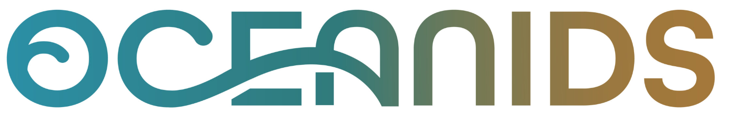
User-driven applications and tools for Climate-Informed Maritime Spatial Planning and integrated seascape management, towards a resilient & inclusive Blue Economy
https://www.oceanids-project.eu/
Scientific & Technological Objectives
Define scientific requirements for new EO data services and advance climate, meteorological and environmental impact models.
Develop multi-hazard climate-risk assessment methodologies and integrated EO–spatial data platforms.
Build a scientific Decision support systems to support climate-informed maritime spatial planning in coastal regions.
Deploy modular EO tools on operational infrastructures and ensure cross-regional validation and replication.
Conduct gap analysis, stakeholder mapping and participatory co-creation to strengthen scientific uptake and impact.

Slide 22

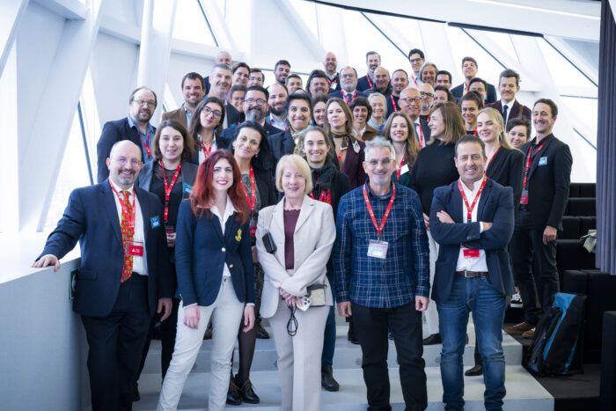
Final event June 2026 organised by NEREUS!
  OCEANIDS, EU H2020
2025 workshop in the port of Antwerp organised by NEREUS

Slide 23
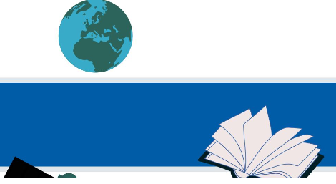
Webinar Series: EDUCATION AND TRAINING IN THE SPACE SECTOR
  Education/training series
Since 2021, the webinars on education and training in the space sector aim to promote the work of our member universities/research centres and invite young generations to incorporate space into their education/ work and to showcase education opportunities in the space sector. Additionally, we facilitate their engagement with key EU and international stakeholders to enable partnerships and collaborative opportunities.
https://www.nereus-regions.eu/category/events/education-training/

Slide 24
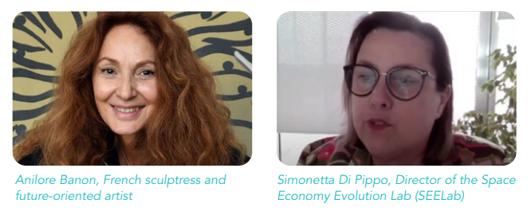
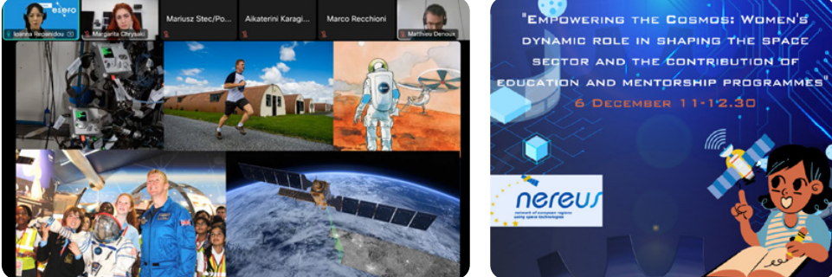
  Education/training series

Slide 25
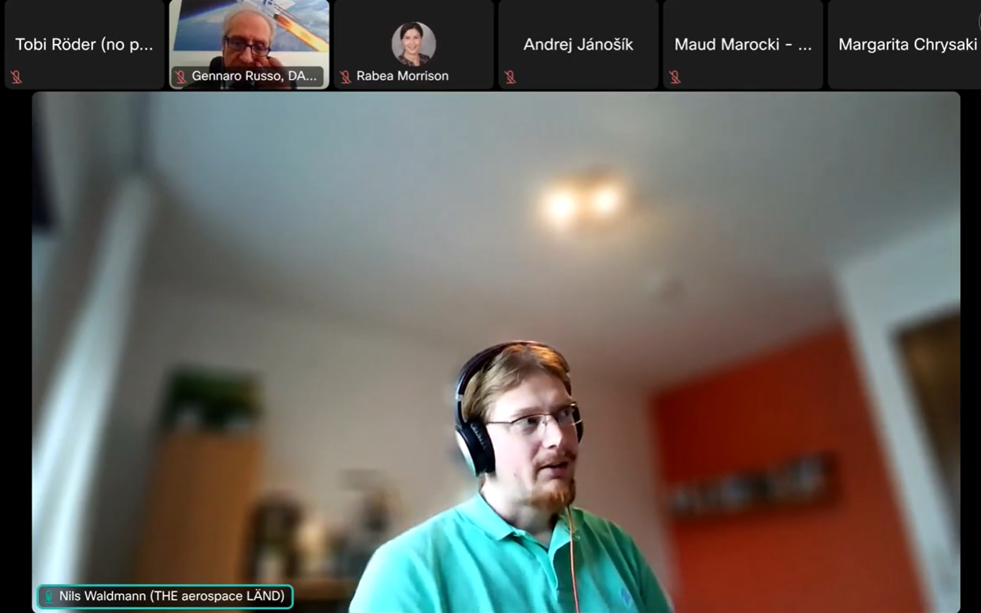
Education/training in the Space sector XIX: Young Space: When Children, Teenagers, and Young Adults Reach for the Stars ON 13 NOVEMBER WITH BADEN-WÜRTTEMBERG!
  Education/training series

Slide 26


EO4GEO- INNOVATIVE SOLUTIONS FOR EARTH OBSERVATION/ GEOINFORMATION TRAINING
The initiative aimed at supporting the upskilling and reskilling of the workforce in the EO*GI sector and fostering the uptake and integration of EO*GI data and services in a broad range of application domains. EO4GEO focused on building education and capacity skills in the Earth Observation/Geoinformation sector.
  ERASMUS+ EO4GEO
Project partners developed a wide range of training tools and webinars to support public authorities, academia, companies, SMEs and EO experts. NEREUS connected its regional stakeholders with the EO4GEO consortium to strengthen skills development and capacity building in EO and identify relevant EO*GI occupational profiles and training needs for regional businesses and administrations.

Slide 27

UNIVERSEH, EUROPEAN SPACE UNIVERSITY FOR EARTH AND HUMANITY
  ERASMUS+ UNIVERSEH
NEREUS President Thierry Cotelle is a member of the Advisory Board of UNIVERSEH, a European Universities alliance that brings together five leading institutions under the European Commission’s flagship initiative to innovate space-related education.
https://universeh.eu/

Slide 28



THANK YOU!
www.nereus-regions.eu
@NEREUSaisbl
NEREUSaisbl
Network of European Regions Using Space

